Slide 1
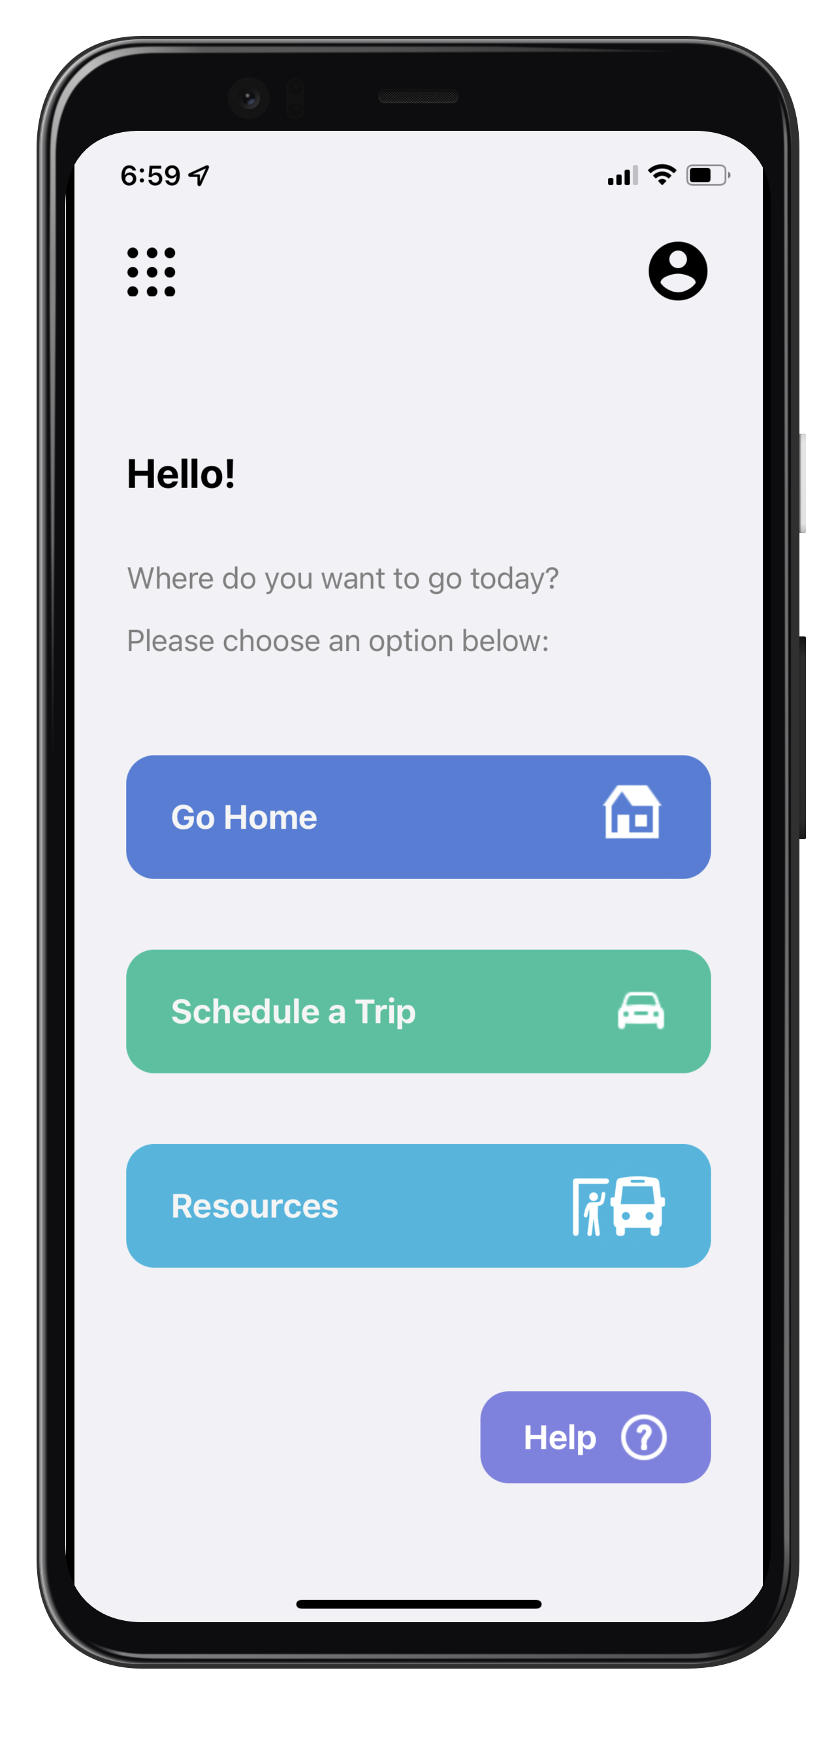
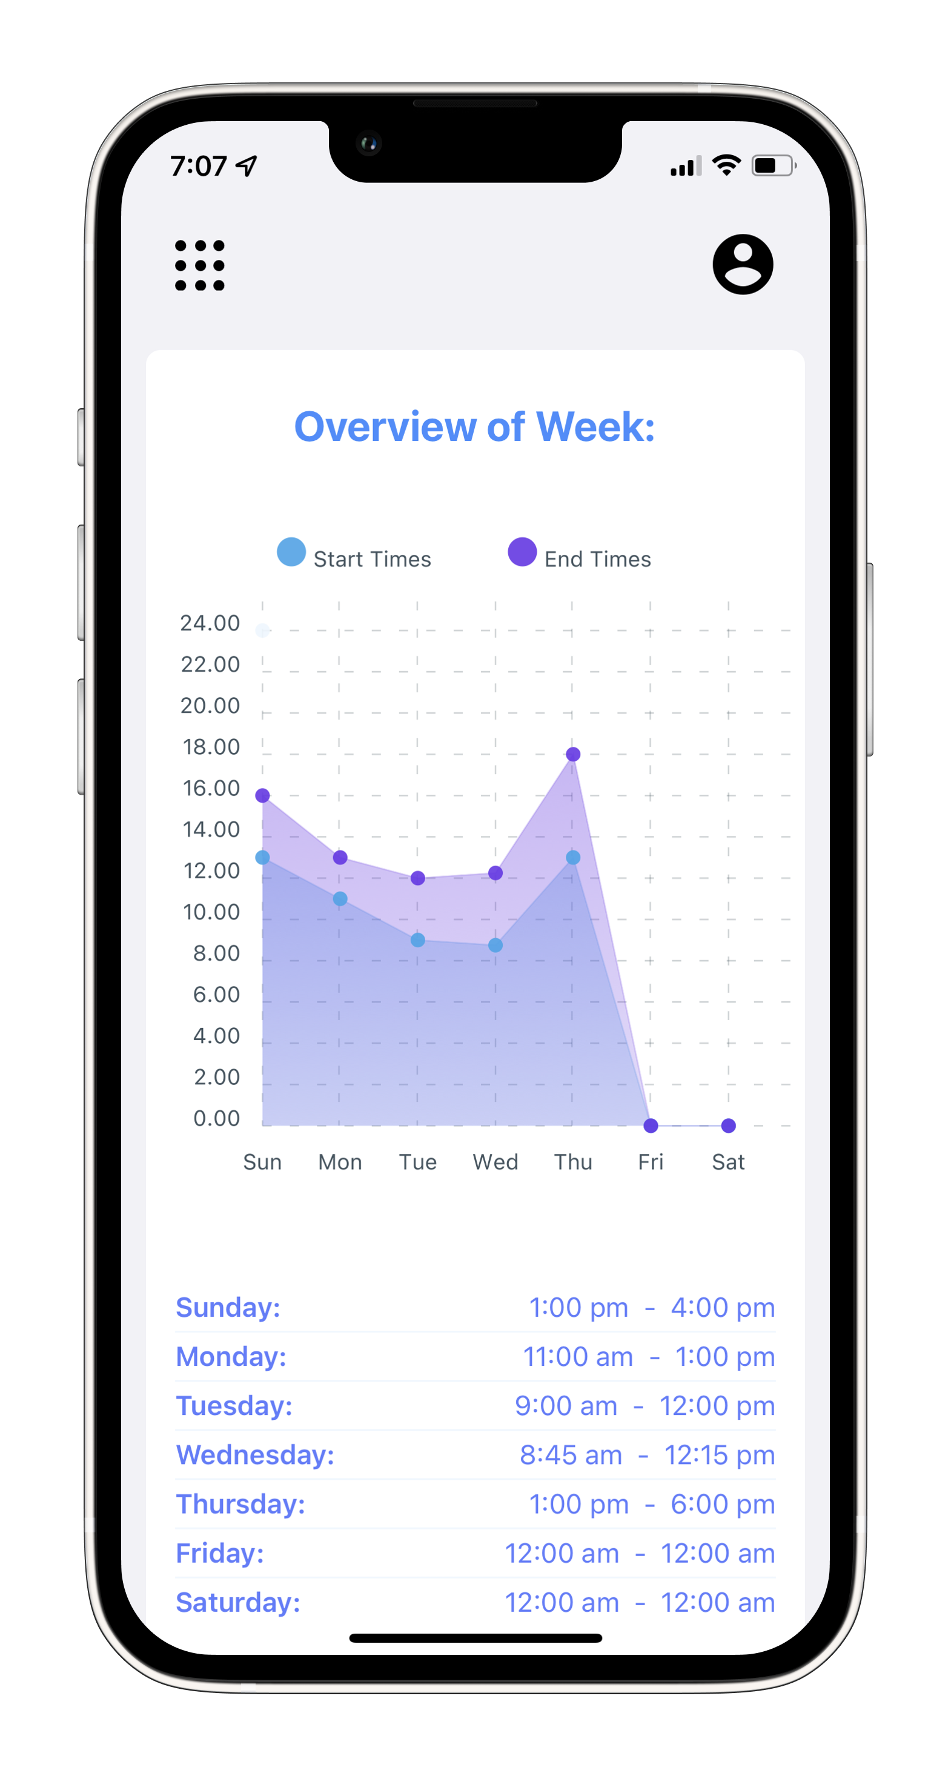
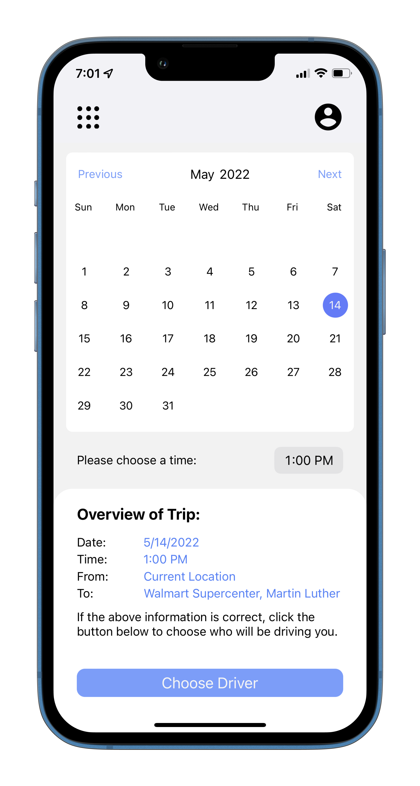
MAGIC
A Transportation Toolkit and Application for Older Adults​
Team: Emily Lea, Patrick Karangwa, Patrick Page, Alan Torres, Sailesh Sirigineedi​
Project Sponsor: Dr Suman Mitra​
Champion Advisor: Dr Matthew Patitz​

Slide 2
Abstract
Problem
Adults ages 65+ lack reliable transportation services.
There is a lack of easy-to-access information about local transportation resources.
Most adults find ridesharing apps hard to use and unsafe.
Objectives
To implement a user-friendly application for iOS and Android mobile devices.
Enable older adults to be transported by family, friends, and volunteers at no cost.

Slide 3
Application Overview
MAGIC is a mobile application for iOS and Android devices.
It allows older adults to make transportation requests and access their local public transportation resources.
MAGIC also gives older adults the ability to schedule a ride ahead, on any given day.

Slide 4
Technologies Used
Fronted: React Native application with Expo framework
Backend: Python application with Django framework
Database: PostgreSQL
Heroku: hosts the Django app and database

Slide 5
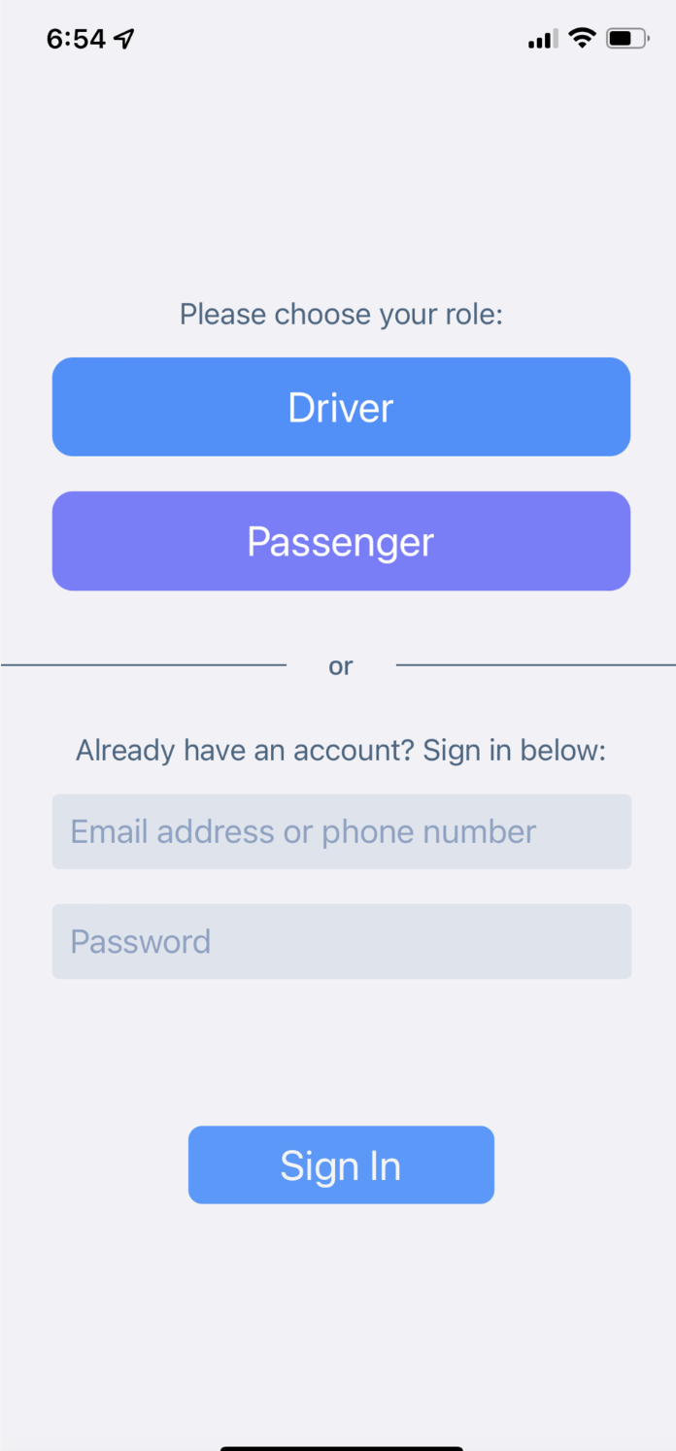
Login Page
New users choose to sign up as a driver or passenger
Users with an account can login with their credentials.
The user will be redirected to the appropriate side of the application.

Slide 6
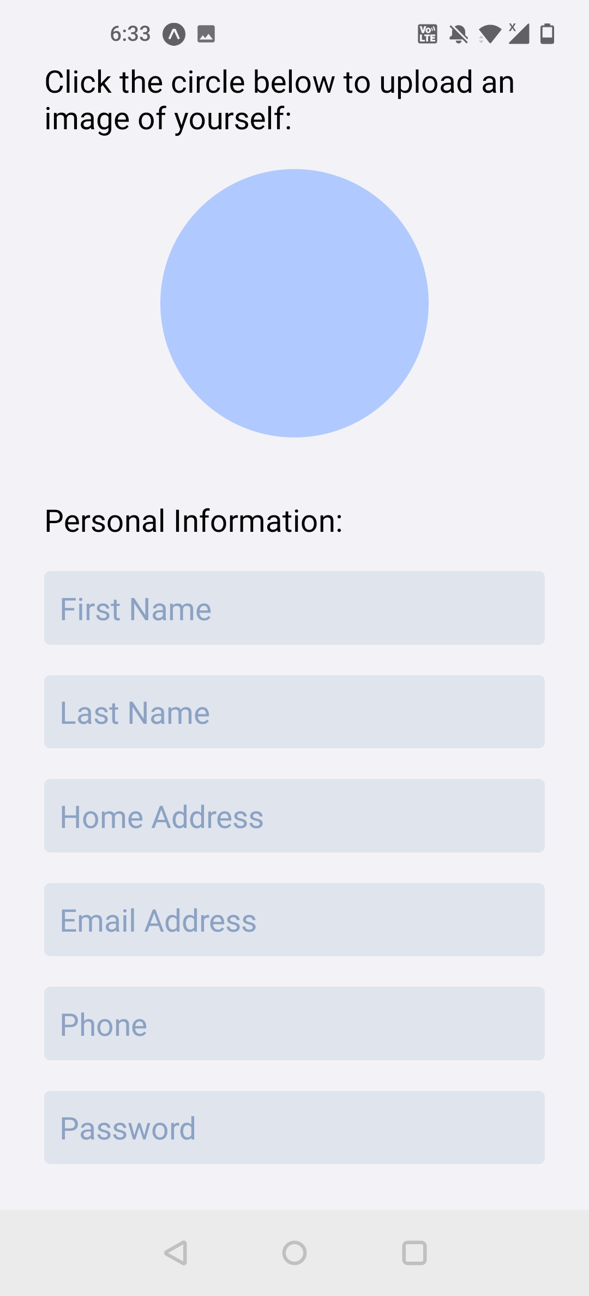
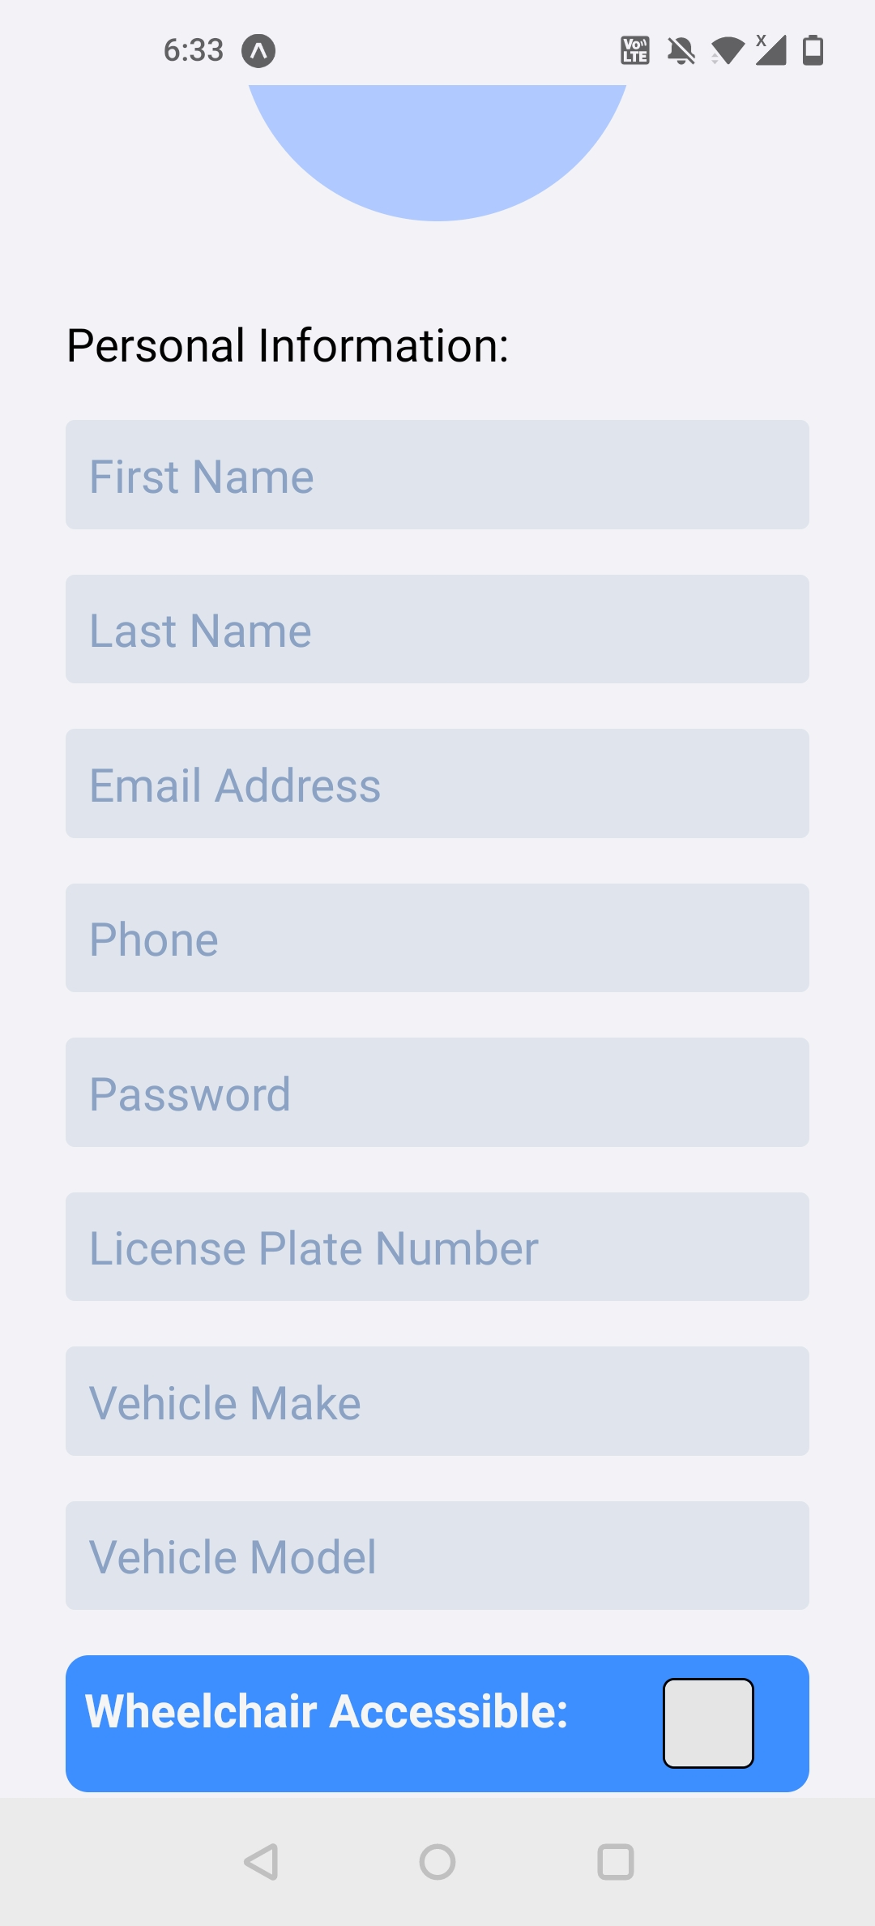
Account Creation Pages
Both passengers and drivers have to create accounts.
Drivers have to provide more information, specifically about their vehicle.
Both drivers and passengers can upload profile pictures, but drivers will be required to
Passenger
Driver
Notes:
React - Cross platform, javascript framework
Django – python based
Postgresql – open source dbmg, usernames, passwords, driver information, client information, home addresses, and any other important information needed to help our application successfully run.

Slide 7
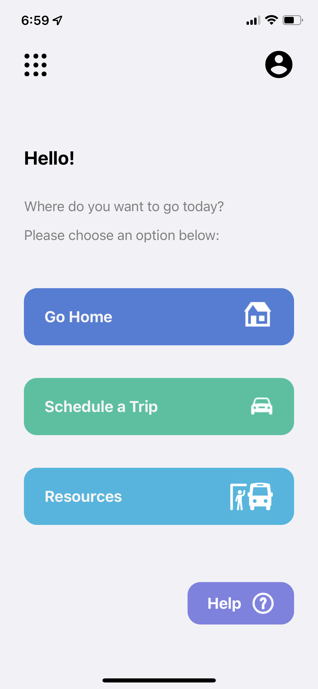
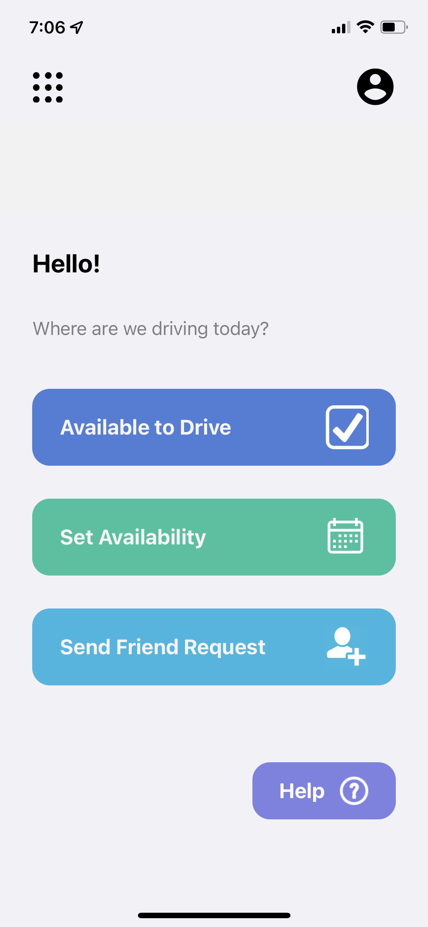
Home Screens
Passenger
Driver
Go Home: from current location to home address.
Schedule a Trip: from current location to another destination.
Resources: information and contact to other transportation resources.
Available To Drive: makes driver instantly available to drive.
Set Availability: driver sets times they are able to provide rides.
Send Friend Request: driver sends a request to become a trusted driver.

Slide 8
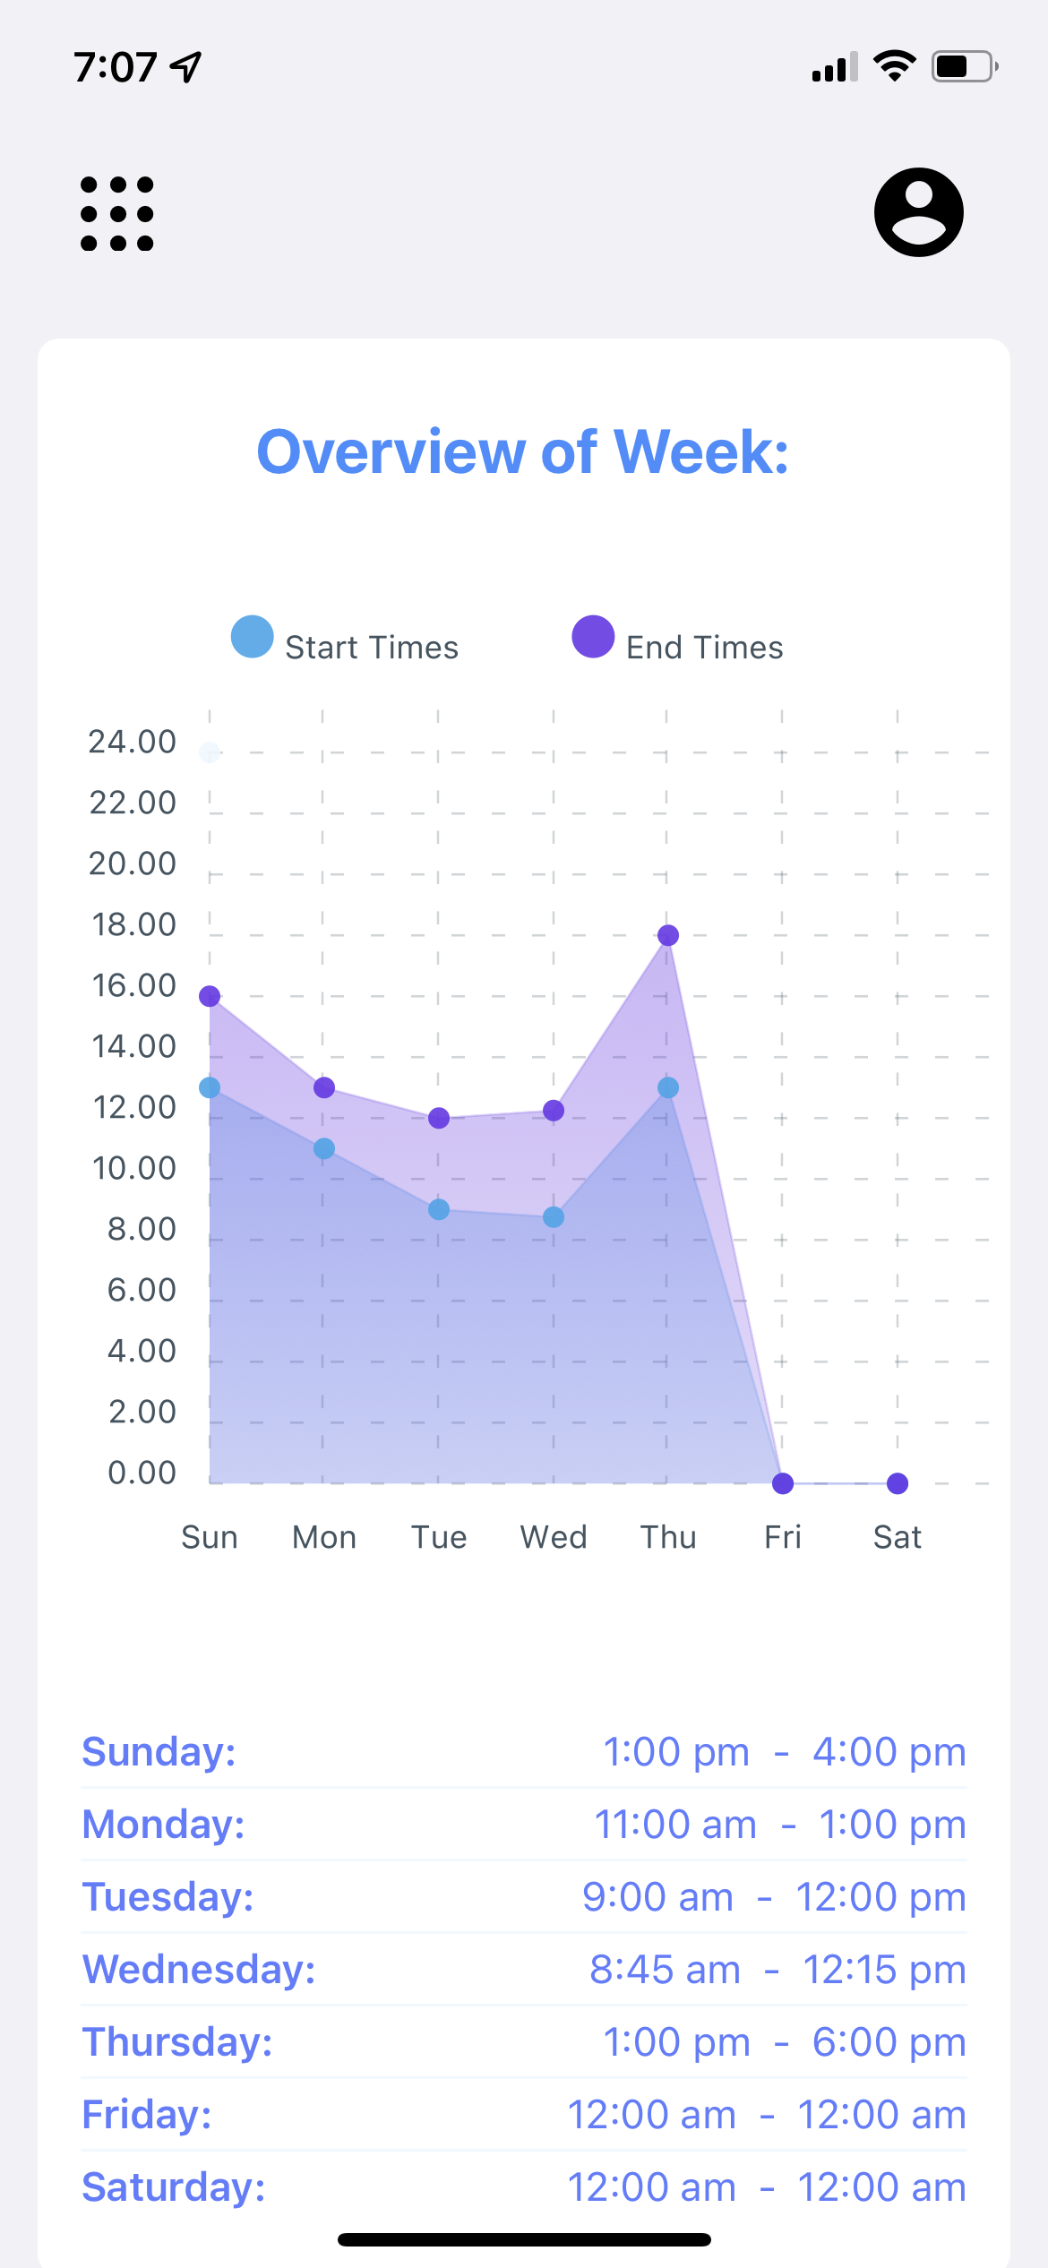
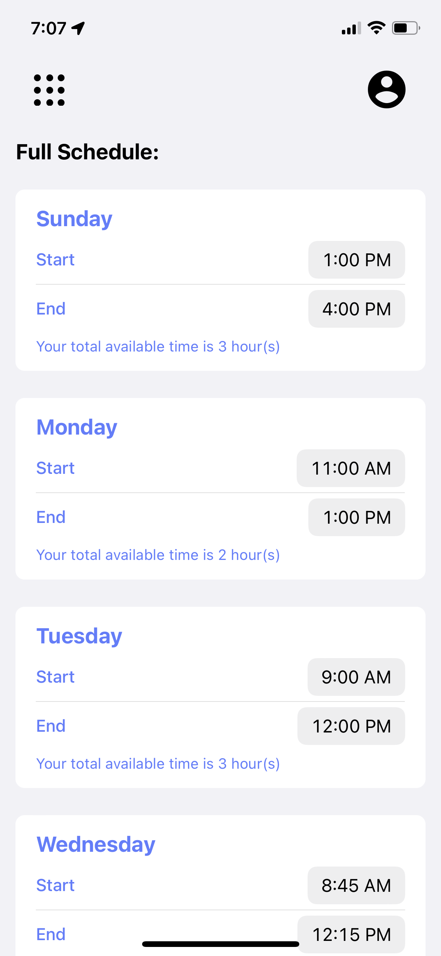
Setting Driver's Availability
Weekly schedule of driver's availability
Can be updated as needed
Overview of the week
Seven boxes with start/end times
Display letting them know how many hours they are available for that day.

Slide 9
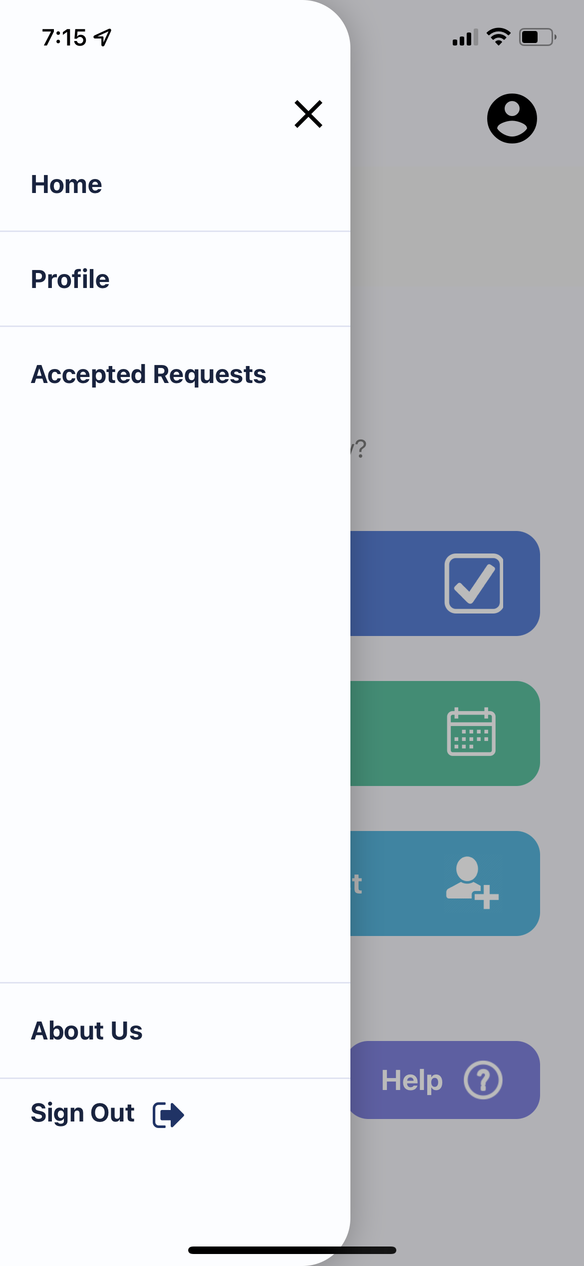
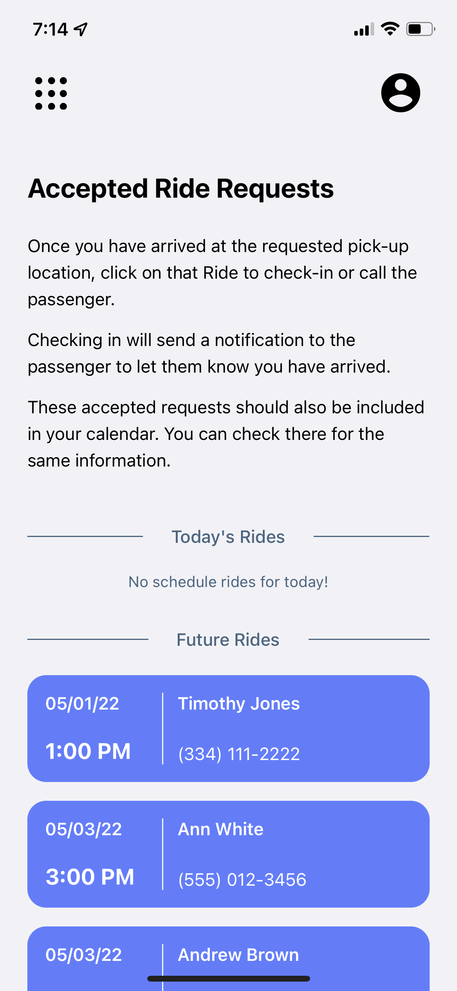
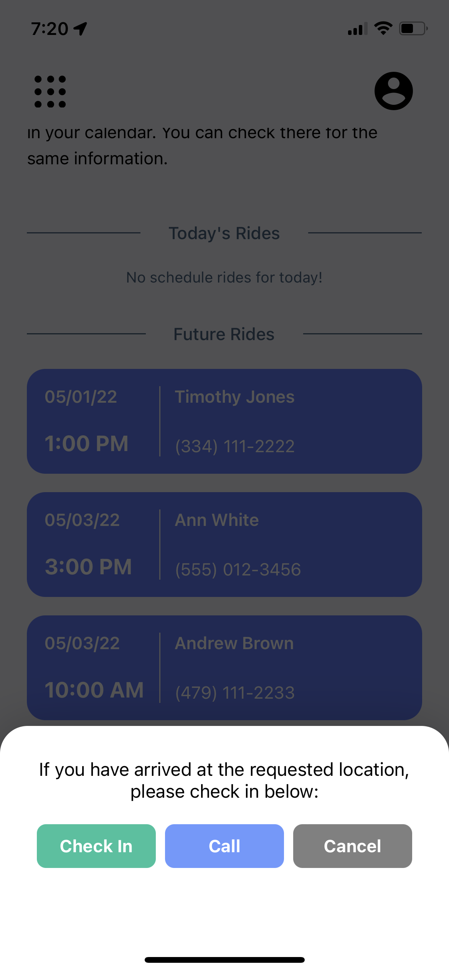
Accepted Transportation Requests

Slide 10
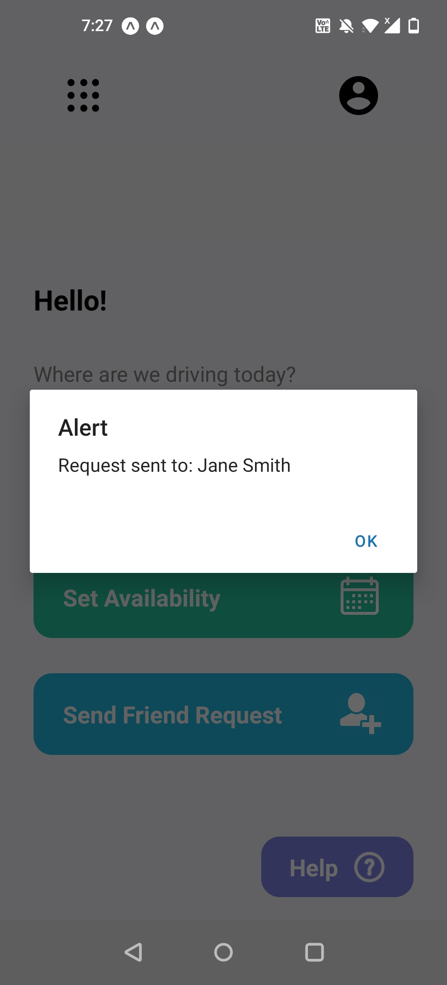
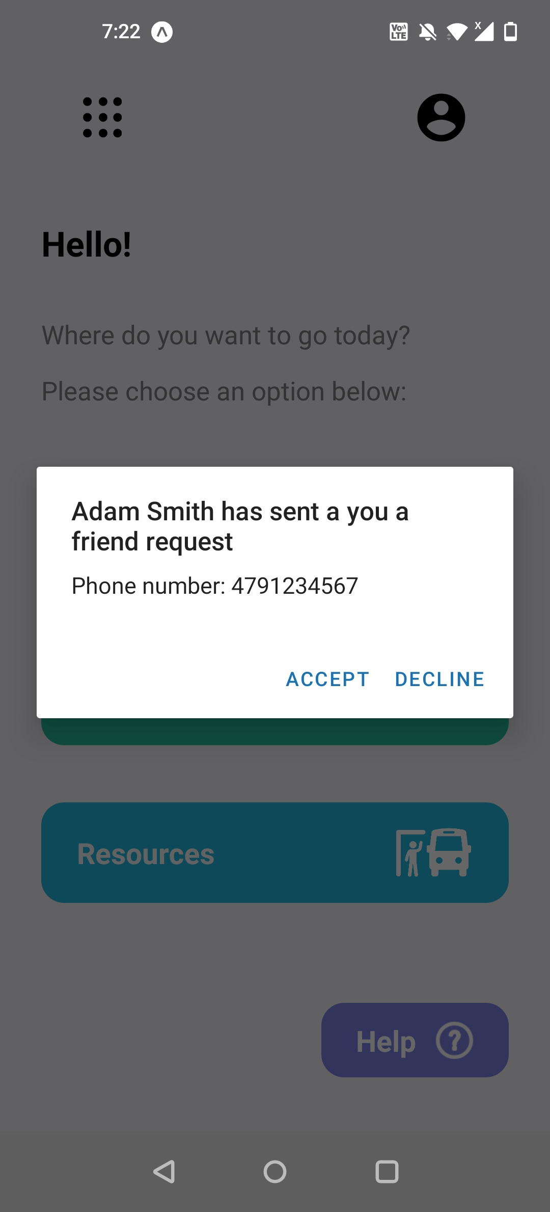
Sending and Receiving Friend Requests
Driver searches by name or phone number for a passenger.
Driver can send a request to be added to the passenger's friends and family list.
Passengers can either confirm or deny the request.

Slide 11
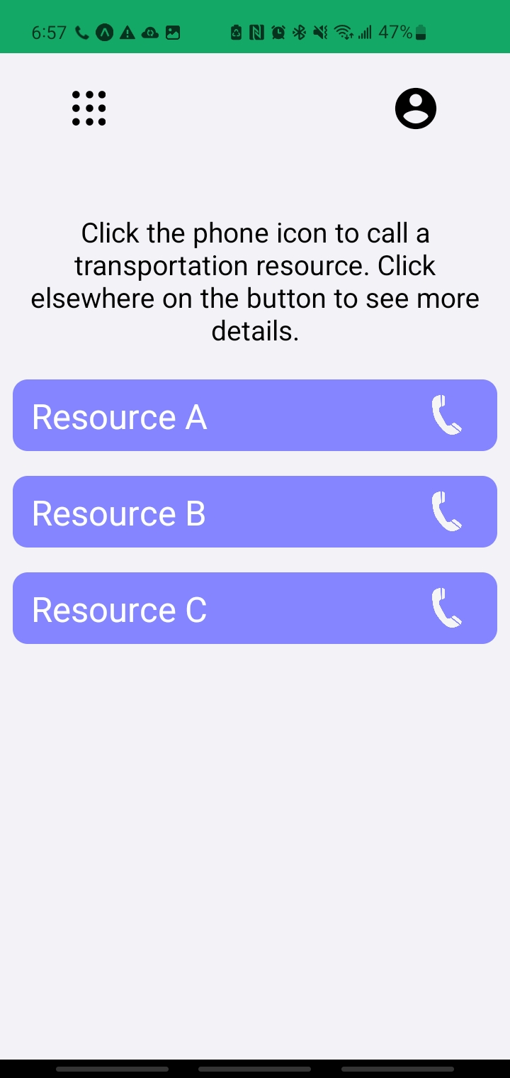
Local Transportation Resources
Clicking the button shows details about the resource.
Clicking the phone icon calls the phone number associated with the resource.

Slide 12
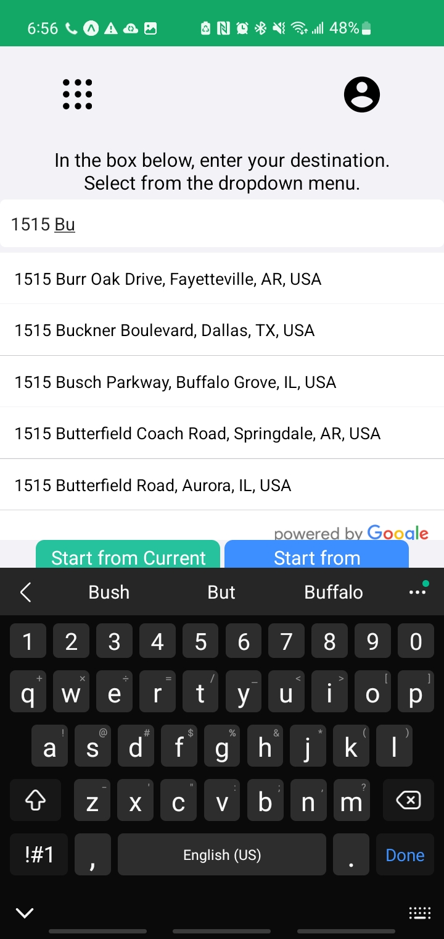
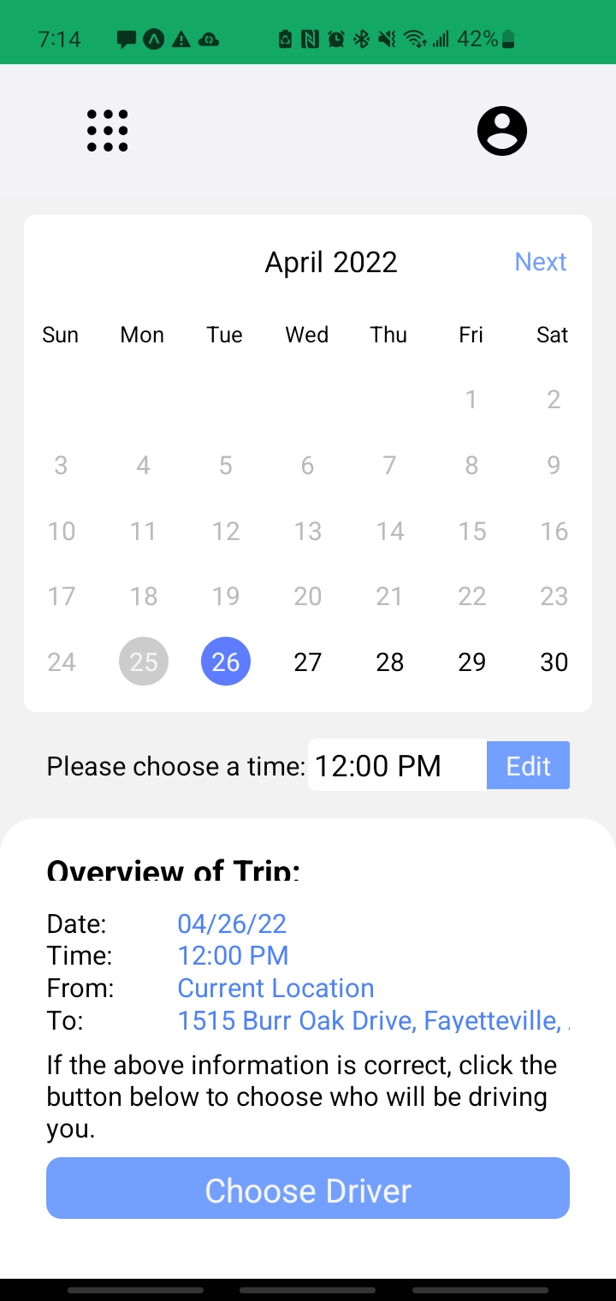
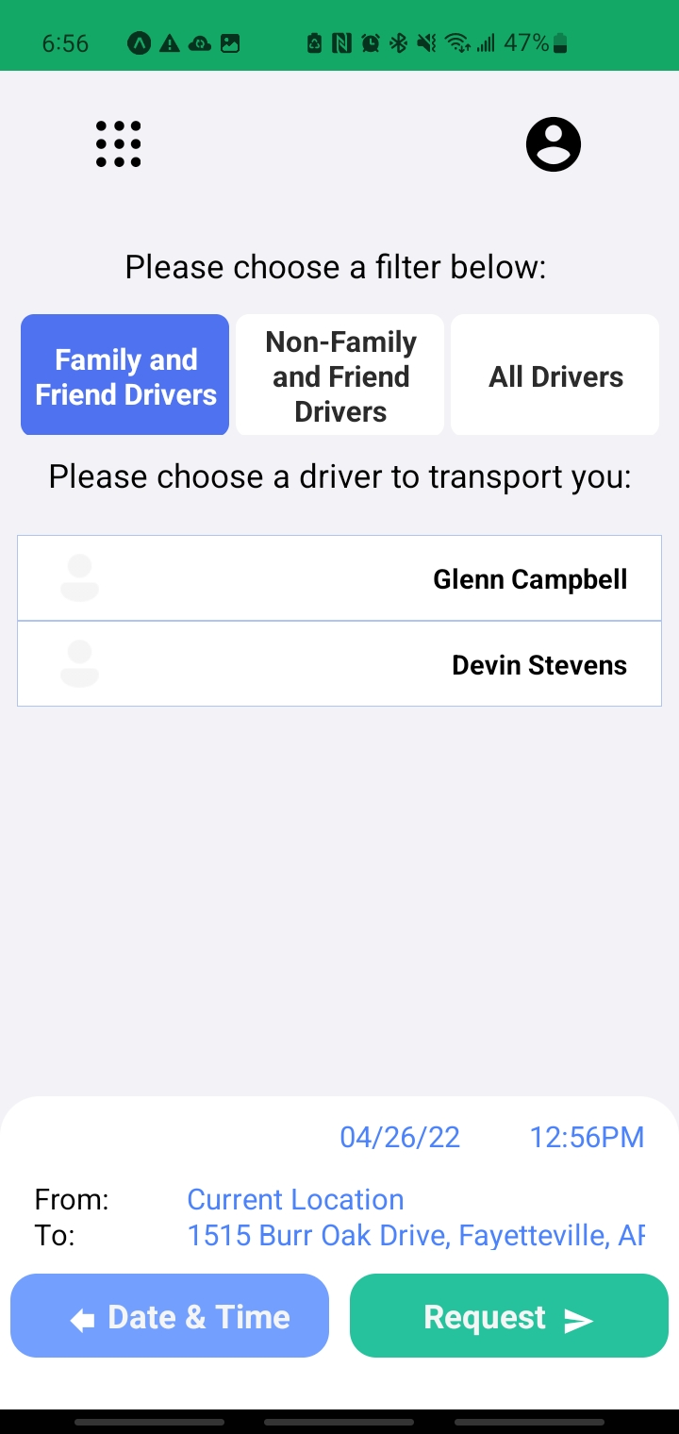
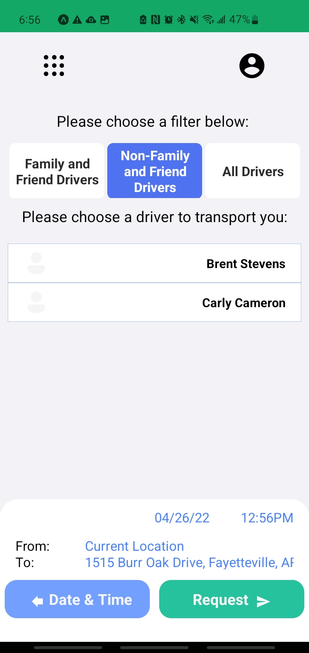
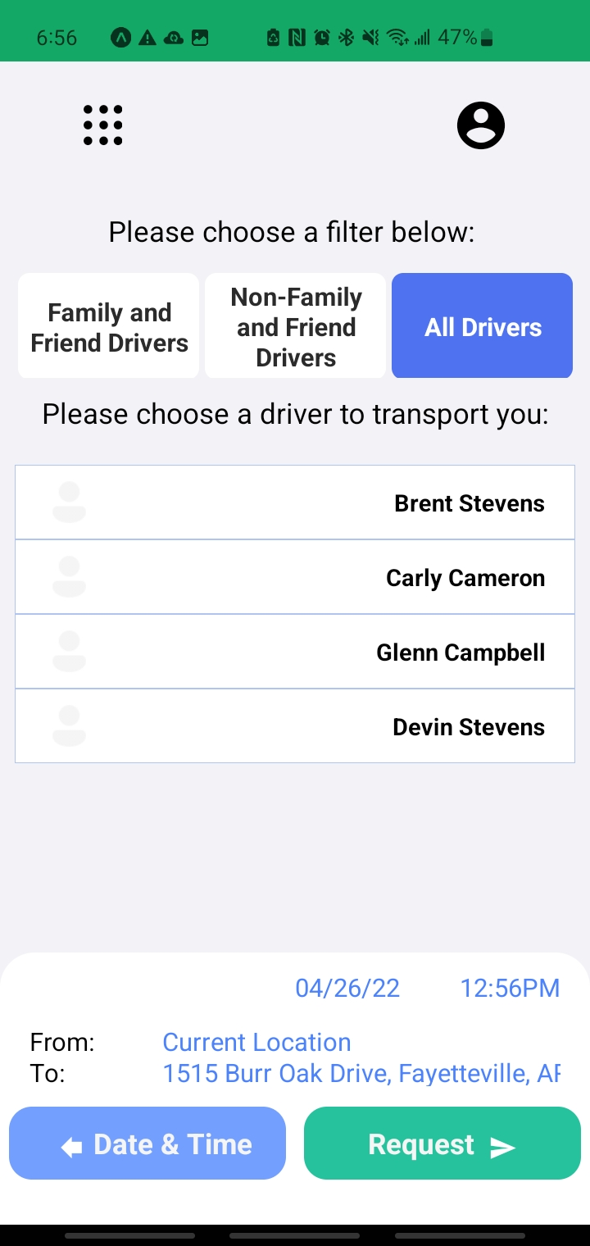
Trip Planning
Suggestive addresses are auto-filtered based on what passenger types in address field.
Passenger can filter out drivers with three options.
A request is then sent to a driver.
Driver can then accept/decline a request

Slide 13
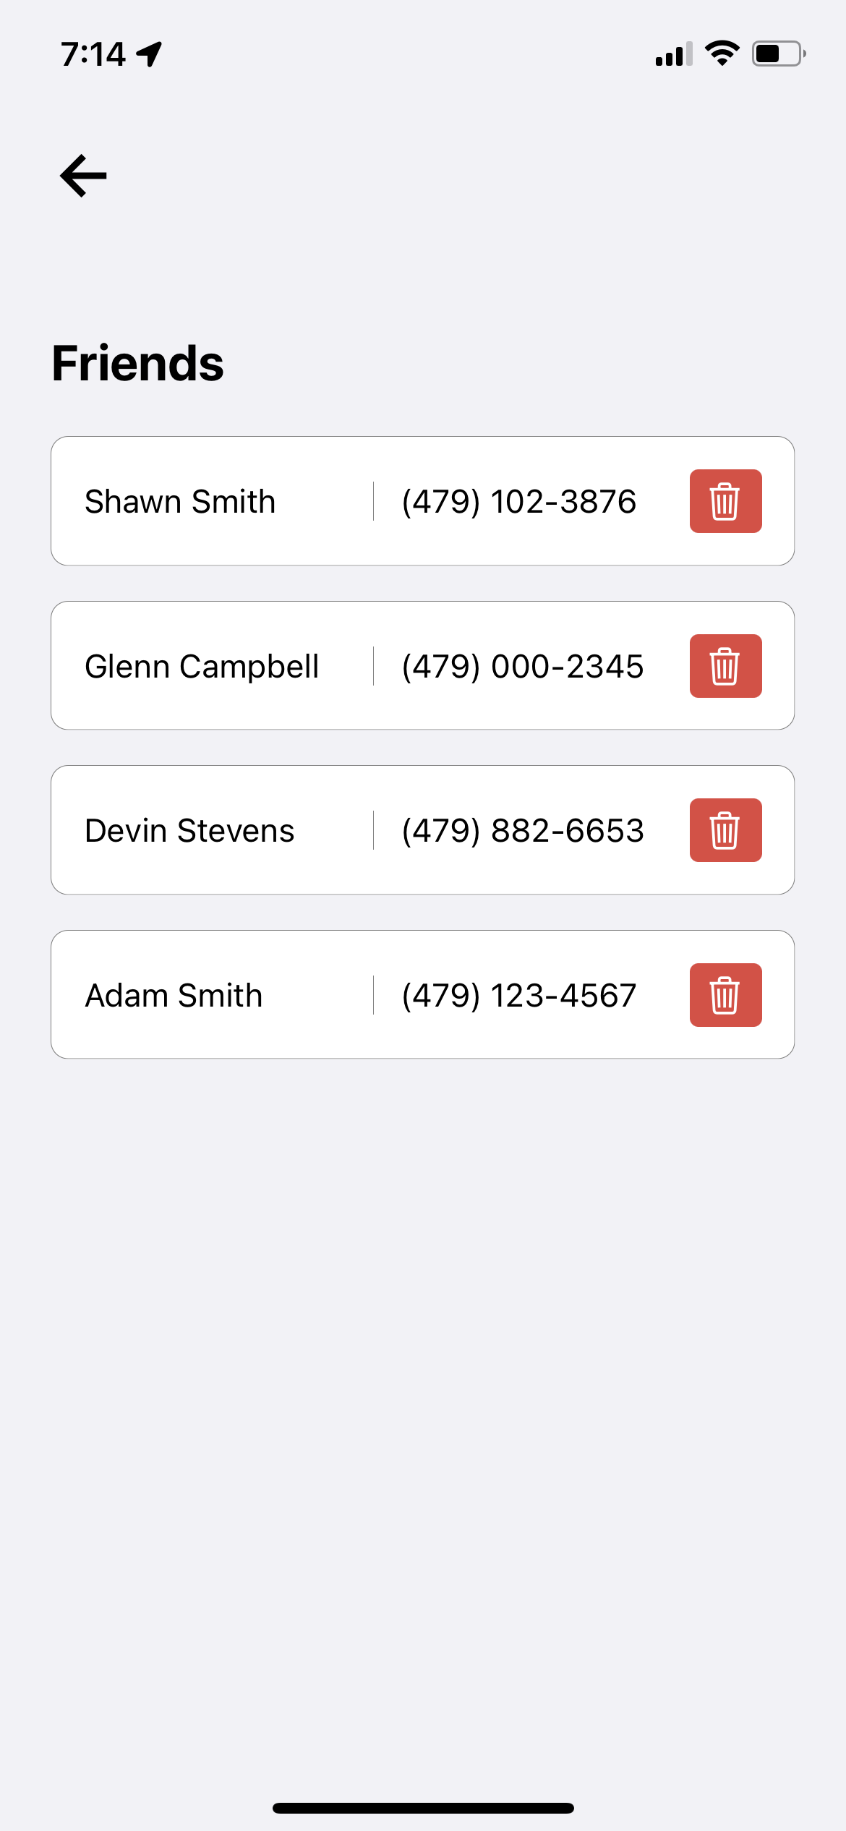
Passenger Friends List Page
Accessed through the navbar in passenger accounts.
A list of drivers whose friend requests a passenger has accepted

