Slide 1
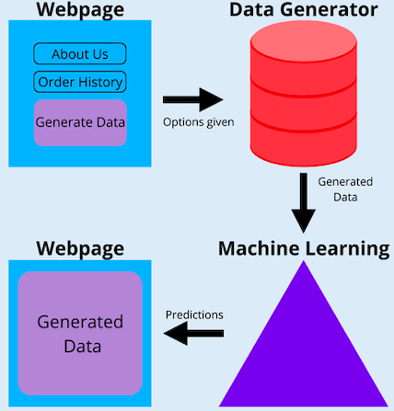
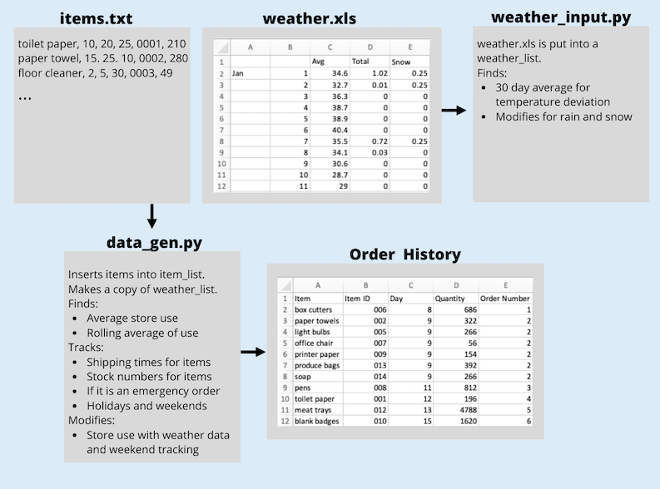
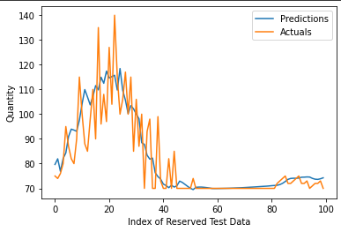
Kyle Orman, George Romano, Abigail Tee, Joshua Thornburgh, Margaret Turner
Architecture
​
Introduction
Machine Learning
The objective of Predictive Planning, Ordering and Monitoring is to design and implement a program that assists Walmart associates when ordering store supplies. To achieve this goal, we used machine learning (ML) to forecast what items are needed and in what quantity. Overall, this will increase efficiency, minimize human error, and avoid additional costs.
The data generated with our generation tool is used as the basis for our predictive ordering implementation. Using Python along with the TensorFlow 2 library and Keras framework, we built and trained three predictive learning models, all with benefits and drawbacks, to predict the quantity needed given isolated item data.
Figure 2
Data Generation
Results
The data generation tool was designed to account for many variables that may affect the quantity of any item that needs replenishment. The tool accounts for weekend/weekday traffic, holidays, and the weather. For training, five years of weather data was collected.
Front-End
While the 2nd model had the least complexity, and therefore ran the fastest of the three, the 3rd model was the most efficient with a compromise between the complexities of models 1 and 2. The 3rd model was a Gated Recurrent Unit model with 26,593 trainable parameters (medium complexity). At a learning rate of 0.0001 and over 1000 iterations, the model produced predictions with a 1.797 value mean squared error when compared to the actual values that were reserved for testing. The best prediction was also saved early enough in the process to suggest that the number of iterations could be reduced to save time and achieve the same result.
The front-end user-interface will be used to prompt for the input and display the output of the data generation tool. Using Django Software to develop our clean design, the user-interface will also be utilized to display the output for the ML process.
Back-End
The back-end development focuses on how our website functions. It lays the foundational code that will enable the website to process the actions of the user on the front-end and deliver the correct information in return.
Figure 3
Challenges
The Walmart provided us with data from their test system, but it was necessary to create our own dummy data to supplement. Due to this, the focus of our project shifted to data generation followed by machine learning assisted predictive ordering.
Figure 1: Data Generation Visualization

