Slide 1
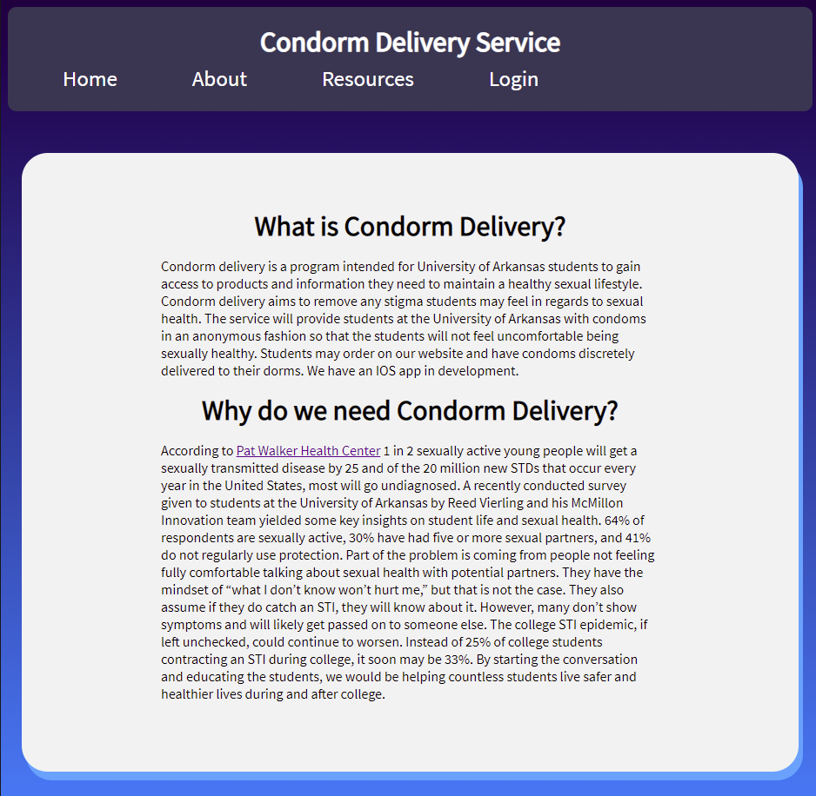
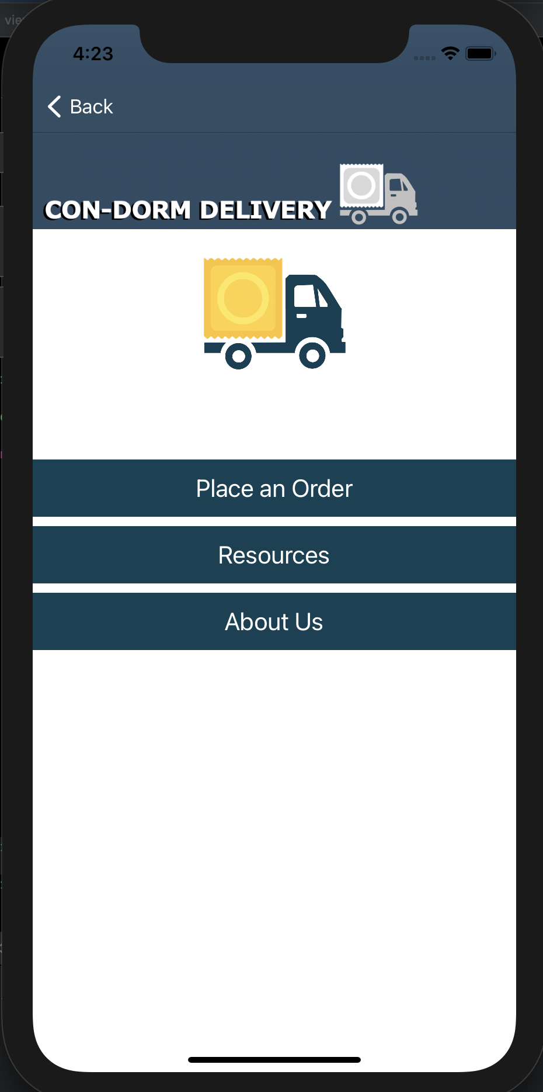
Condorm Delivery
Jackson LaCrue, Braden Dressendorfer, Reed Vierling, Joshua Francis, Christian Aguilar
Introduction
Condorm Delivery is a way to enable students anonymous access to contraceptives. Students are able to order contraceptives and other sexual health items. Once ordered, the items will be discreetly delivered to the student’s dorm.
Condorm Delivery is comprised of a web and mobile application.
Methods
Website:
Users can sign up and order sexual health products.
Access information from sexual health experts through a resources page.
Mobile App:
Mirror the web application.
Users can order sexual health products and access information from sexual health experts.
Results
Website: The website is fully functional and has been deployed. Users can sign up and order condoms.
Mobile App: The mobile app has been created and has function at a local level but has not been deployed to any app store.
Purpose
A recently conducted survey given to students at the University of Arkansas by Reed Vierling and his McMillon Innovation team yielded some key insights on student life and sexual
health. 64% of respondents are sexually active, 30% have had five or more sexual partners, and
41% do not regularly use protection.
By giving students these
supplies and information, the user will feel more comfortable and go on to lead a safer and healthier lifestyle.
Conclusion
The goal of Condorm Delivery was to give students anonymous access to sexual health products. While we have a fully deployed website in which students can sign up and order sexual health products, there is still room to improve the project. While the mobile app works locally it still needs to be deployed to an app store. Currently the project lacks a sponsor. Without a sponsor we cannot actually provide the resources to students. In the future if the project is to be continued it must find a sponsor.
Screenshots taken from the homepage of the website and the iOS application

