Slide 1
Capstone II Final Presentation
Team 1

Slide 2
Team
Toma Tomonari – CS Senior / Leader
Takeshi Yamada – CS Senior
Tomohiro Nishimura CS Senior

Slide 3
PROblem
Lack of sufficient info and images of foods or drinks on restaurant’s menu.
Current digital menu is pretty hard to see
Cost of making and managing physical restaurant’s menu for owners.

Slide 4
Solution
Providing a web platform where restaurants’ owners make online menus accessible from customers’ smartphone via QR codes.

Slide 5
Schedule and task
Pilot run
Final Report
Finish web design
Design front end visually and decide what features exactly we are going to implement.
Set up
Set up the AWS environment and build and test an hello world program.
Check
Check what we have created so far and decide what we exactly need to build the whole service including necessary web services, database structure, and APIs we are going to use on the client side.
Start building the service (both backend and frontend)
Lanch
Start building the service

Slide 6
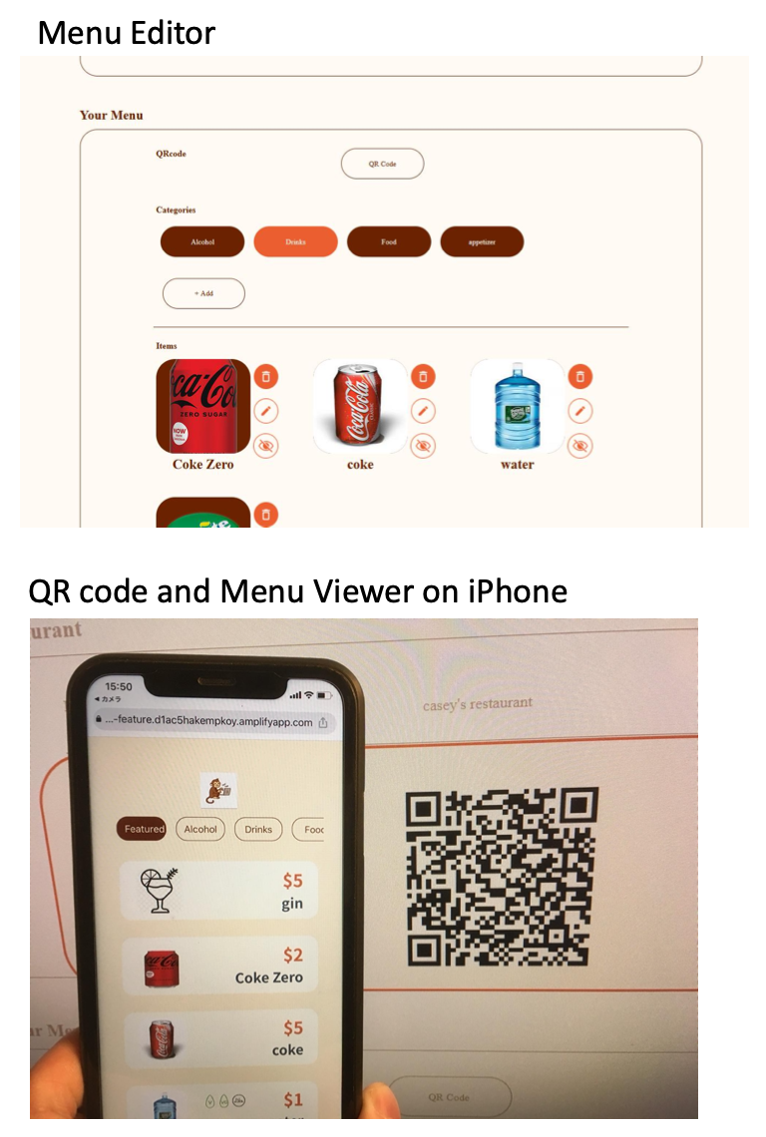
Design
Requirements
Web Application (Owner’s side)
Menu Viewer (Customer’s side)

Slide 7
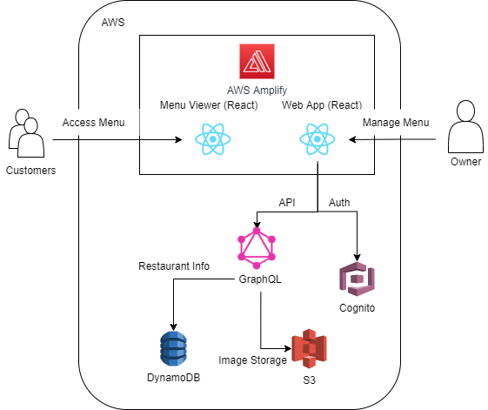
Architecture

Slide 8
How It Works
Input Menu
Generate QR Code
Scan
Restaurants register for the platform and input necessary information about their menu
Once they input the menu, QR code to their menu will be automatically generated
Customers scan the QR code at table and see menu easily

Slide 9
How Restaurants Can Manage Menu
Remove
Edit
Hide/Show
No need to re-create or edit the pdf files.
No need to print menu
Don’t have or ran out of ingredients? Just hit Hide button.
Want to put it back on the menu? Hit Show button.

Slide 10
Demo

Slide 11
Create Restaurant
Notes:
Create a restaurant

Slide 12
Create Categories
Notes:
Create Categories

Slide 13
Create Items
Notes:
Create Categories

Slide 14
Generate QR Code
Notes:
Create Categories

Slide 15
Use Case
Notes:
Create Categories

Slide 16
What’s Next
Business
Planning
Fund
Raising
Marketing/
Branding
Development

