Slide 1
ConDorm Delivery
Jackson LaCrue, Braden Dressendorfer, Reed Vierling, Joshua Francis, Christian Aguilar

Slide 2




Meet the Team
Jackson LaCrue
Braden Dressendorfer
Reed Vierling
Joshua Francis
Christian Aguilar

Slide 3

What is ConDorm Delivery?
Web and mobile application
Anonymous access to sexual health products
Provide access to sexual health resources

Slide 4

Why did we choose this project?
We want to establish a safe and healthy environment for student community
Benefits the college community
Improve quality of life for students on campus

Slide 5
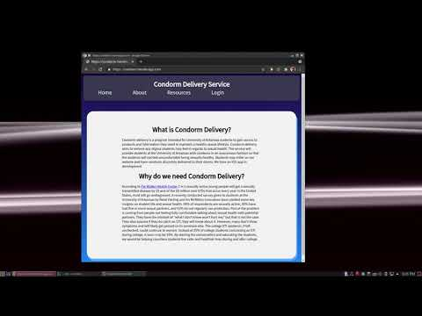
Website Design
Simple layout
Simple styling
Responsive Design

Slide 6
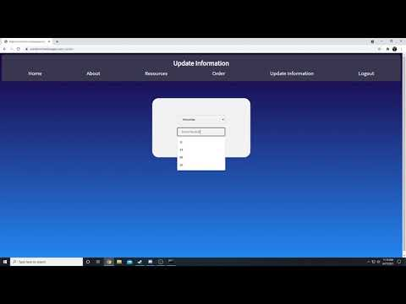
User Demo

Slide 7
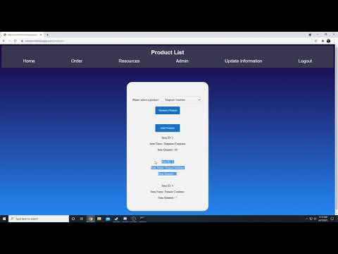
Admin Demo

Slide 8
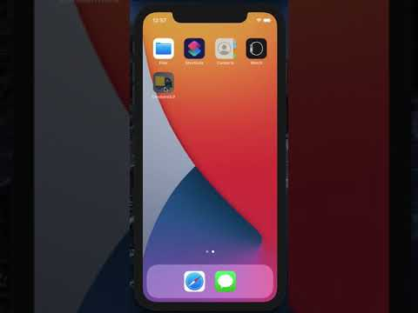
App Demo

Slide 9
Future plans?
Will need maintenance, partner with Pat Walker Health Center
Administrators can handle most database adjustments
Live-updated product pictures
Email to accounts for registration and confirmed order delivery
Maximum anonymity in database
  Currently tying orders to the user’s database ID

Slide 10

Thank You!

