Slide 1
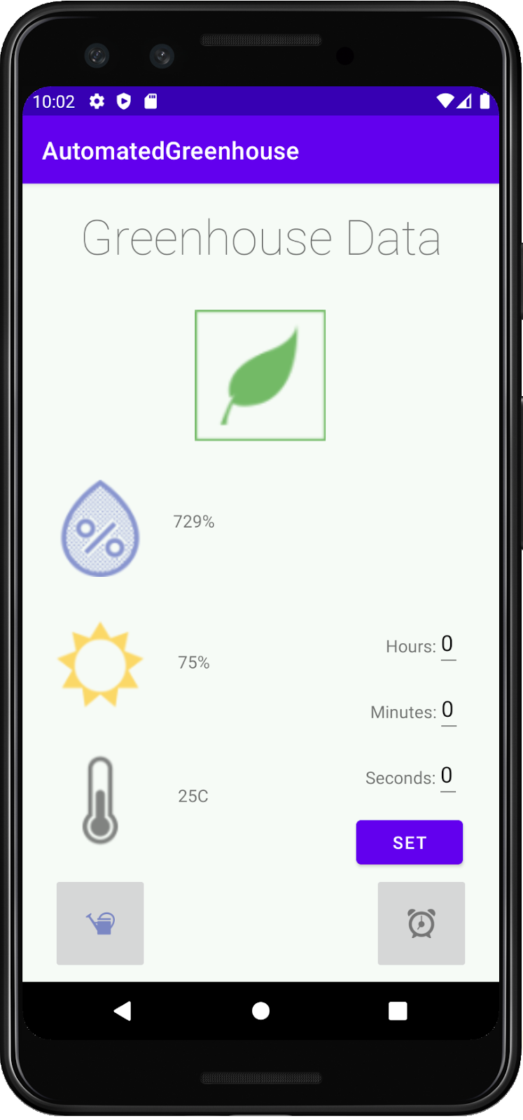
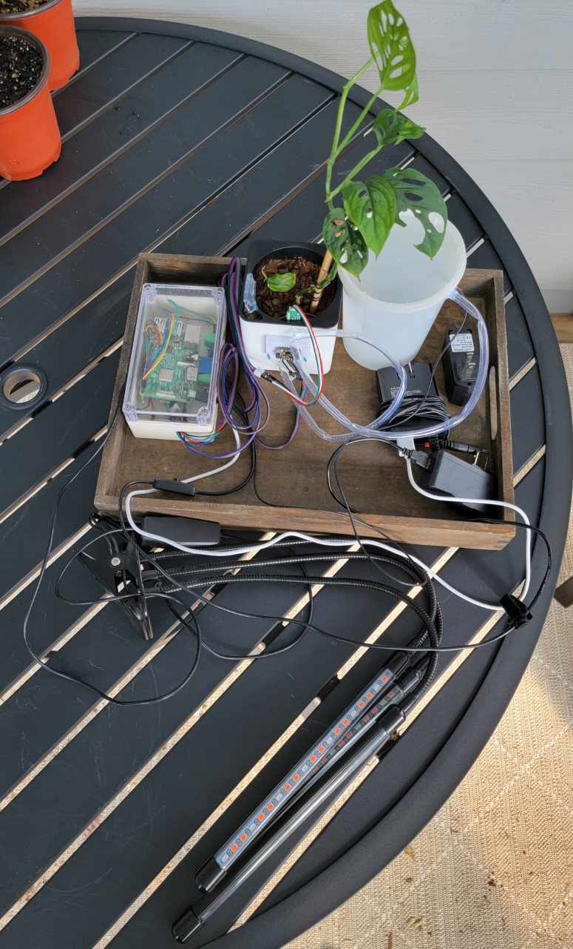
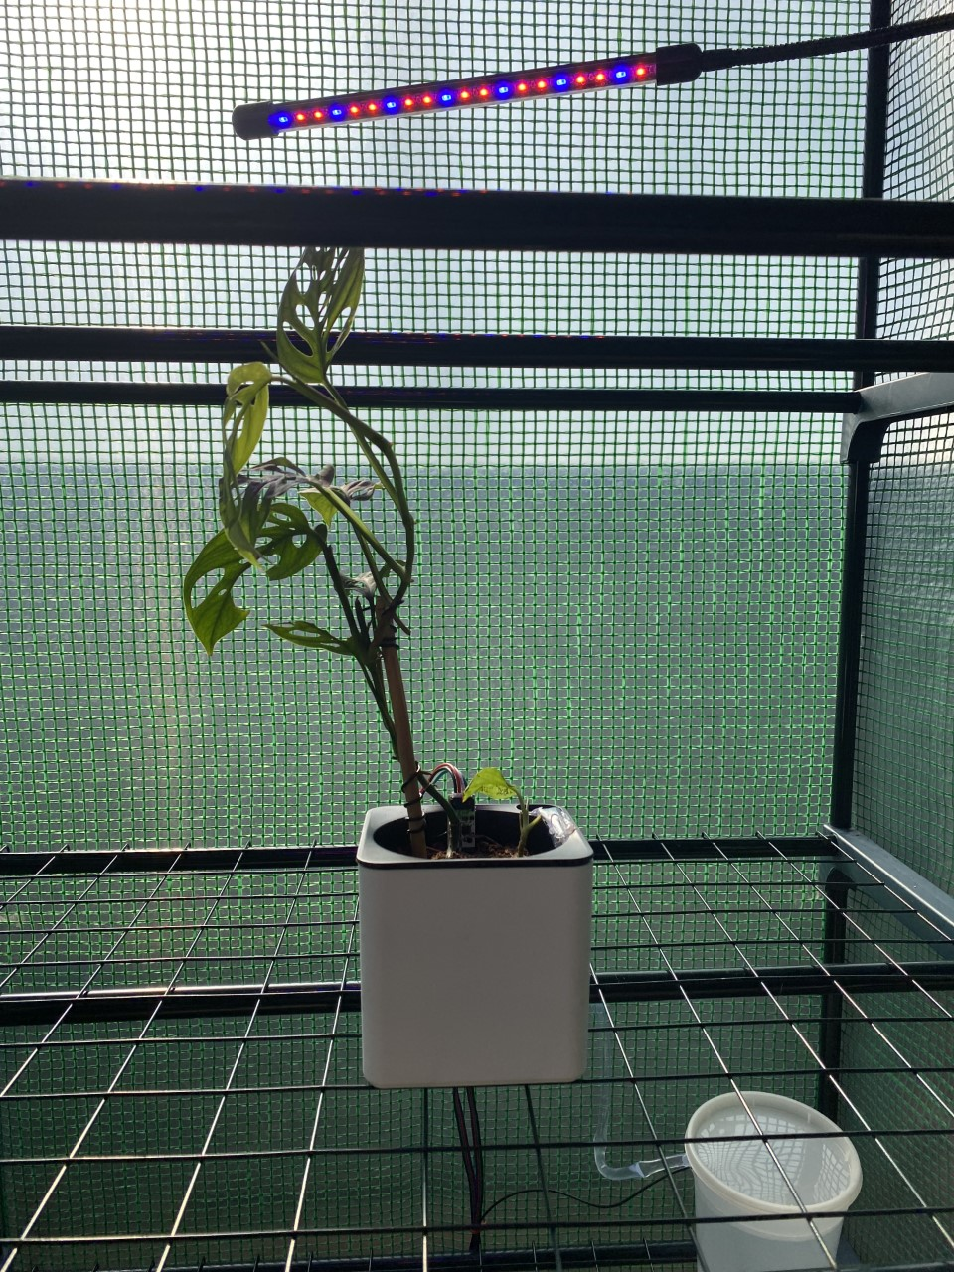
Automated Greenhouse
Scott Jackson, Nathan Barlass, Lauren Jackson, Zachary Tyler
University of Arkansas, College of Engineering, Computer Science
Introduction
The Automated Greenhouse is a product that allows the user to monitor their greenhouse remotely using a raspberry pi and a mobile application.
The layers of technology that were required for this project include: programming the raspberry pi to receive data from sensors like temperature, moisture, and light, a database that can be used with remote access, and a mobile application to view data and send controls to the raspberry pi.
Use Cases
Case 1:
User inputs command to actuate water pump
Mobile application sends command to database
Raspberry Pi pulls command data from database
Raspberry Pi sends command data to water pump
Water pump actuates
Case 2:
Sensor sends data to the Raspberry Pi
Raspberry Pi sends sensor data to the database
Mobile application pulls sensor data from database
Sensor data is displayed to the user
Results
Sensors: The temperature sensor, moisture sensor, and light sensor all transmit data to the database for remote access.
Mobile App Data: The application receives the data from the database and displays the correct data for viewing.
Mobile App Features: The application sends a command to the raspberry pi for immediate watering and sets a timer for future watering.
Case 3:
User inputs watering time frequency
Mobile device creates timer based on user input
Timer is activated and sends command to database
Raspberry Pi pulls command data from database
Raspberry Pi sends command data to water pump
Water pump actuates
Case 4:
User selects minimum moisture level of plant
Mobile application receives moisture sensor data
Minimum moisture level is met and sends command to database
Raspberry Pi pulls command data from database
Raspberry Pi sends command data to water pump
Water pump actuates
Purpose
The problem we are addressing is that it can be difficult to keep plants healthy and alive. With the threat of climate change, the capability for sustainable farming will be essential. This project is a small-scale example of what could be used in a larger scope.
It can be used for individuals who lack the time and/or energy to take care of their plants.
Not having an automated greenhouse could result in several plants dying and this could be a huge problem if it were being used to produce food.
Figure 1: The components of the project Figure 2: Our plant in the greenhouse
Conclusion
This project started with a goal in mind of creating a greenhouse that could be automated using a raspberry pi and mobile application. Throughout the semester we were able to accomplish that goal with everything working as intended.
In the future, we could develop an iOS application, and the ability to water multiple plants through the app.
Figure 3 Mobile application that connects to greenhouse
Citations:
“Smart Greenhouse: 2019 Guide to Best Sensors and Remote Automated Monitoring Software.” Postscapes, 6 Dec. 2019, https://www.postscapes.com/smart-greenhouses/.
T. Bhuvaneswari and J. T. H. Yao, "Automated greenhouse," IEEE International Symposium on Robotics and Manufacturing Automation (ROMA), IEEE, 2014

