Slide 1
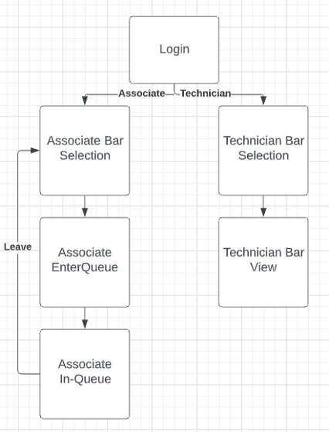
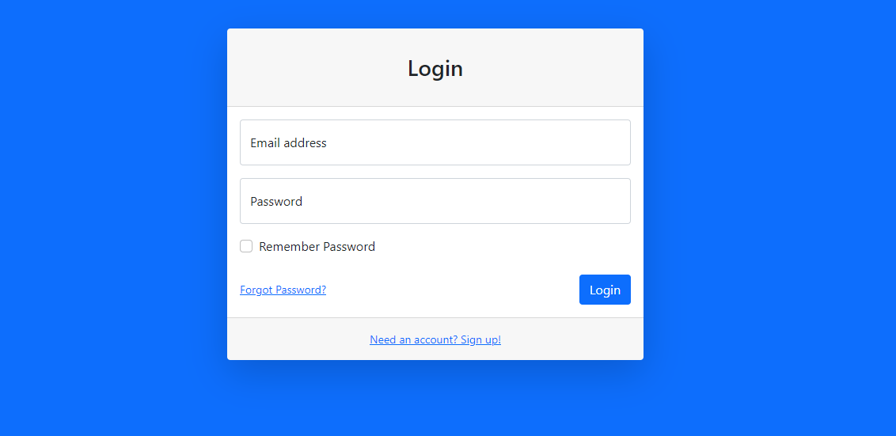
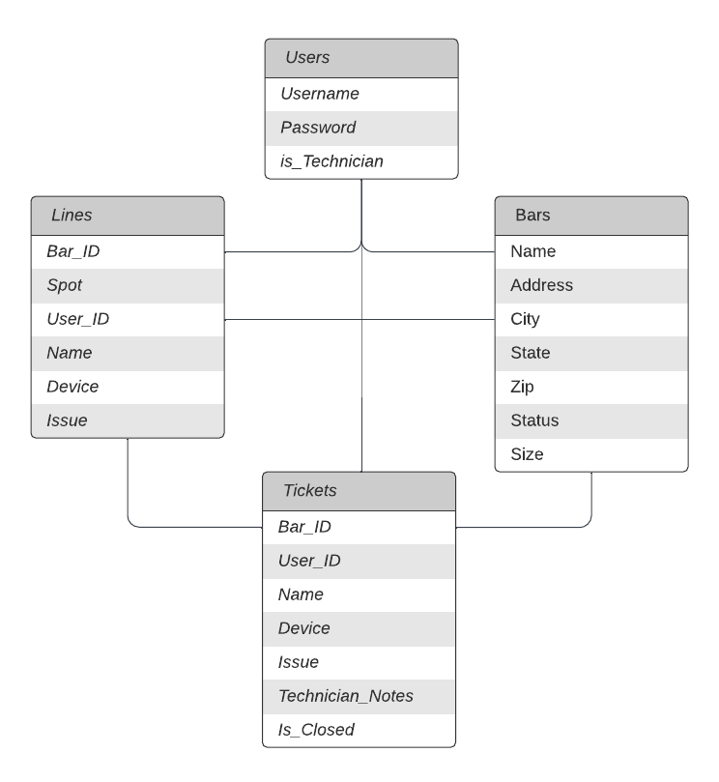
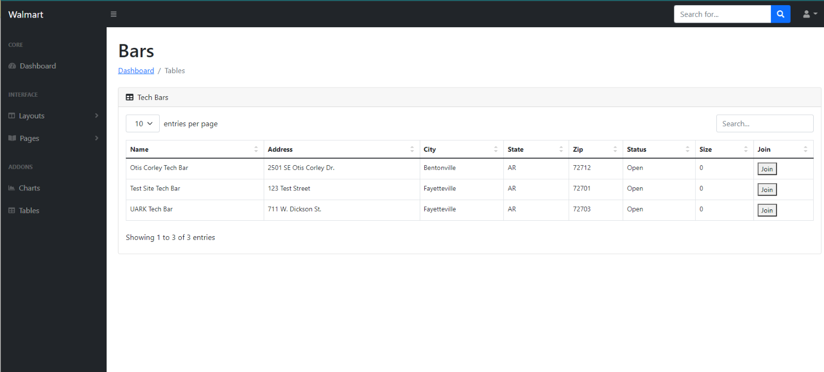
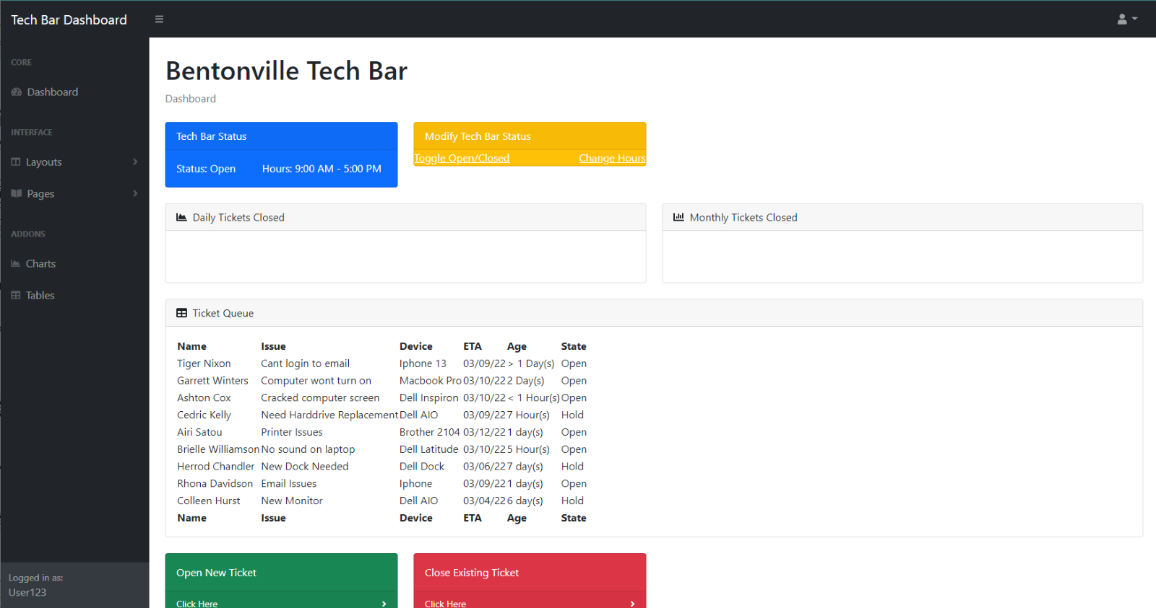
Walmart Tech Bar Scheduler
Ben Hodges, Joe Tam, Austin Dixon, Cole Alvarado
Design
Impact
Results
Overview
Our application was built using Ruby-on-Rails. For our database we used PostgreSQL. Our application is currently being hosted on Heroku.
Database
Our database consists of 4 different tables. These tables are Users, Bars, Lines, and Tickets. Users holds User data. Bars holds information about each Tech Bar. Lines holds information about the users in line at each Bar, and Tickets holds users that have been helped by a Technician.
Controllers
Controllers are used in our structure to pass data from our database into our views and allow the database to change based on interactions in the application. These controllers are written in Ruby.
Interface
Our homepage is the login screen. The login screen allows users to login. If they are an associate they are taken to the list of bars in their area and allowed to queue into them after entering their information. If they are a technician, they are taken to the page for the bar they work at in which they can open and close tickets for associates in line.
The goal of this project is to create an end-to-end Tech Bar scheduler web application for Walmart associates and tech support technicians. This application will greatly benefit both associates and technicians by allowing associates to schedule tech support appointments with IT technicians fully online and from anywhere thus saving the time of associates who will no longer need to wait in a physical line and the time of the technicians who will be prepared for every associate who arrives at their tech bar.
The result of our project was a working web application that fell into the specifications given to us by Walmart. The associate side reliably allows them to see Tech Bars that are close to them and enter in the queues of those bars. The technician side allows a large degree of freedom when manipulating their own bar while also helping associates in their queue. We also were able to implement a large range of error checking that ensures that our database and application will not be compromised by misinput by users. You can see below some of those results.
Introduction
Walmart’s currently designed IT portal named “MyTech” is great for solving technology issues small enough to be done through instructions online. However, there are times when issues arise that are so complicated that an expert in the field must inspect the hardware physically. To solve this problem Walmart has implemented “Tech Bars” in many locations at which associates can bring their hardware with issues and tech support technicians can fix those issues.
With the state of the pandemic changing, Walmart has begun to open these Tech Bars again, but the system used to check-in to them is flawed and in need of improvement. Due to this, our team was tasked with creating a web application to improve the check-in process at these Tech Bars.

