Slide 1
NASA LUNABOTICS
by James Hand

Slide 2
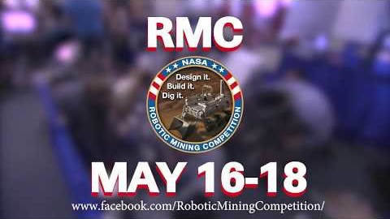
Problem

Slide 3
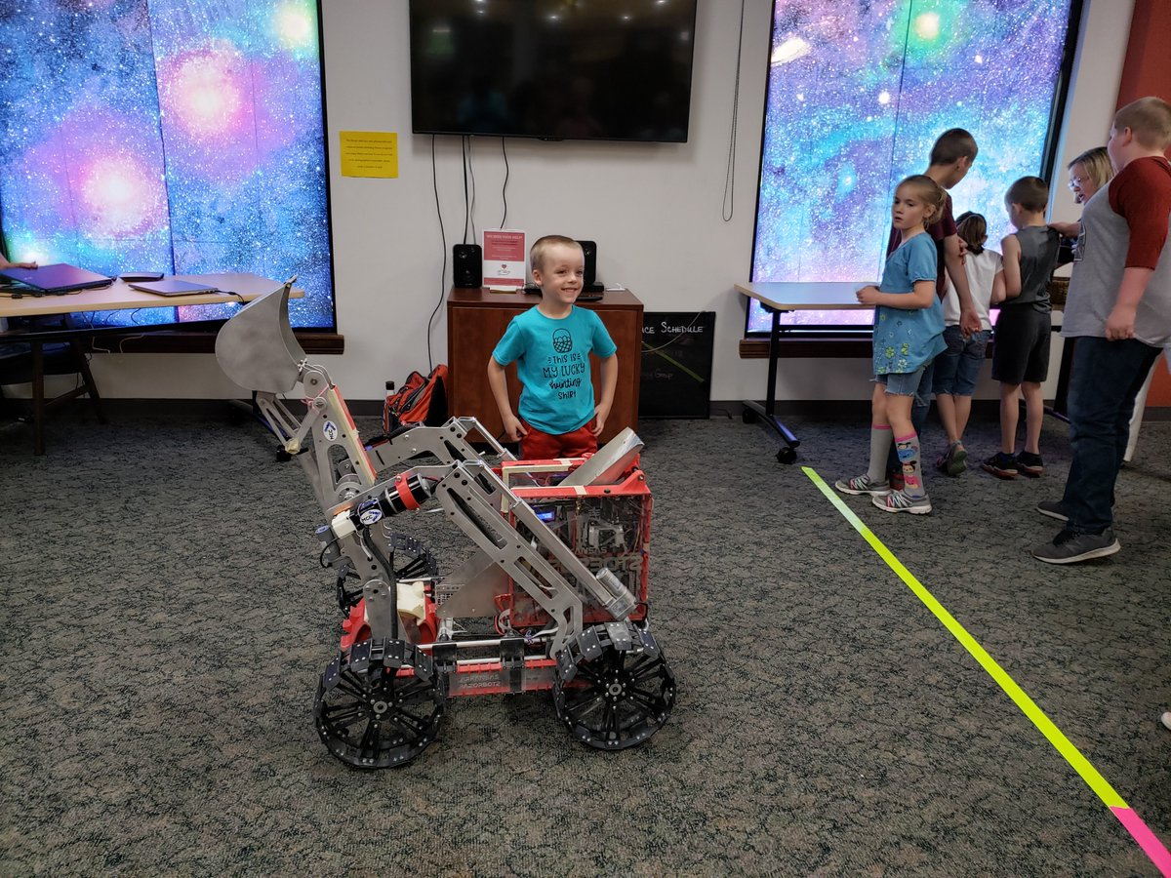
Solution and My Part
SLAM –Simultaneous Localization And Mapping
Computer Vision
Infrared Detection
ROS – Robotic Operating System
Weight Detection
Hardware Design
Excavation
Locomotion
Testing
Design Report
Outreach

Slide 4
Risk Factors
Risk | Risk Reduction
Loss of University property through misuse of on campus resources | We use a number of resources from the university including 3D printers and metal working machines. To minimize the risk of damage and/or personal harm we maintain that all students must be properly certified with the university to use the machines they operate.
Personal harm through robot operation | With so many moving parts the robot does stand as a moving hazard when in operation. To mitigate the risks with its operation we maintain a safety perimeter around the robot at all times. Also the robot has two ways of shut down, one through the controlling software threat is used to operate the robot and an Emergency mechanical stop that cuts off all power to the robot, located at the very top of the robot.
Accidentally using proprietary/copyrighted software in our program without the proper permissions. | Most of the software we are/will be using is either open source (ex. Ubuntu and ROS) or is freely accessible code found through various sources. To mitigate the chance of crossing any legal boundaries we are careful to follow proper documentation and reference to all sources of code.

Slide 5
Schedule for Development
Tasks | Dates
1. Research into Computer Vision APIs and object detection software | 11/1-11/15
2. Testing with integration between ROS and CV applications. | 11/15-12/13
3. Development of algorithm to process CV data into usable map information for robot. | 12/13-1/17
4. Autonomy testing and revision. | 1/17-4/10
5. Thorough revision of documentation for all process taken. | 4/10-5/18
6. Robotic Competition | 5/18-5/22
7. Final group meetings and closing design notes. | 5/22-5/23

Slide 6
Conclusion
Why?
Hopes of leading innovation in robotics
Increasing awareness of the role robotics has in exploration
Cultivating skills in college students

