Slide 1
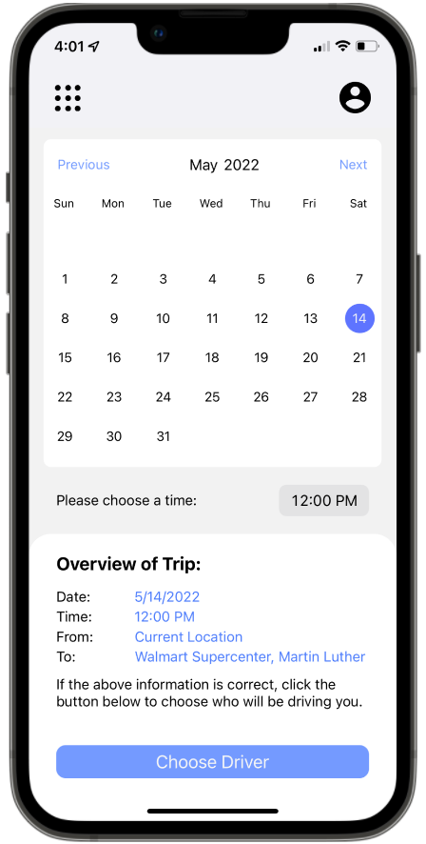
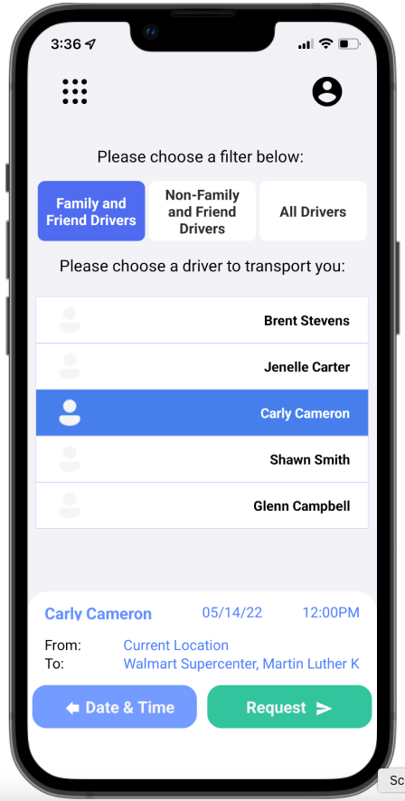
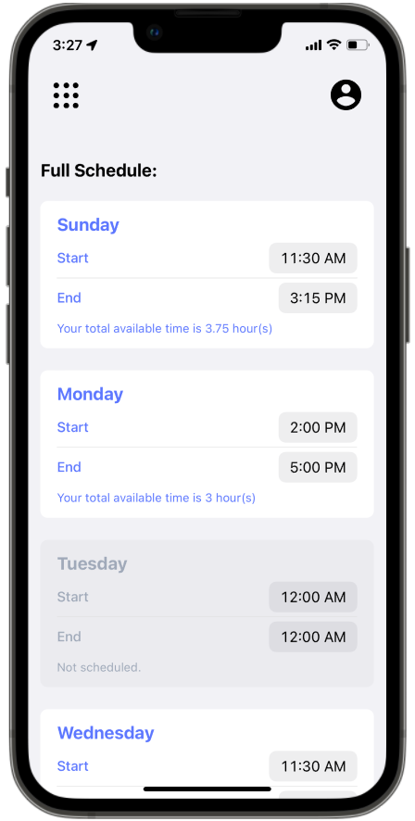
MAGIC A Transportation Toolkit and Mobile Application for Older Adults
Team 6: Emily Lea, Patrick Karangwa, Patrick Page, Alan Torres, Sailesh Sirigineedi
Introduction
Passengers
Results
In the US, the older adult population ages 65 and over is expected to sharply increase within the next decade. Older adults often face issues in securing transportation to locations such as grocery stores or medical appointments. They may be unable to drive themselves due to poor health or mobility issues, and they may be hesitant to use other transportation resources due to safety concerns or not knowing how to use those resources. The goal of MAGIC is to connect older adults with safe, reliable transportation resources in their region by allowing them to coordinate with a family member, friend, or volunteer community member; or by providing them with information about safe, alternative local transportation resources.
Passengers will have a separate side of the application designed for them. The passenger will have the ability to perform three main actions.
The first one will be to Go Home, which will allow them to request a ride from their current location to their saved home address.
The MAGIC, or Mobility and Aging In Collaboration, mobile application developed by our team uses the most recent mobile programming technologies to assist the elderly who have trouble getting transportation to and from different destinations. Despite the many obstacles that our team had to overcome, we have created a product which could easily assist the elderly with getting connected with friend, family, and/or volunteer drivers in their area from whom they could get any transportation they may need.
The second action will be to Schedule a Trip. This will enable the passenger to request a ride, either now or a future time, from their current location or another location of their choosing, to their preferred destination. The third action will give passengers the option to access other local Transportation Resources such as public transit buses, taxi services, trains, etc., by means of a phone call to those services.
Future Work
Background Checks/Driving History for drivers.
Web component to the application.
Alternate login methods for ease of use.
In-app Navigation.
Translation to languages other than English.
Ability to contact emergency services in-app.
Ability to adjust the text size to enable the visually impaired to read text more easily.
Ability to switch application to Dark-Mode which is easier on the eyes for some people.
A rating system for passengers to rate their transportation.
Architecture
MAGIC is a mobile application capable of running on both Android and iOS operating systems. The application consists of three core components: a React Native application, a Python application, and a PostgreSQL database.
The React Native application utilizes the Expo framework and is the frontend portion of MAGIC. The modules used in this portion of the application make up the user interface, and the modules used allow for functionalities such as sending and receiving push notifications and uploading images.
The Python application uses the Django framework and implements the backend portion of the application. This is the portion of the application that a user does not directly interact with, but instead receives information from. Both the Django application and the PostgreSQL database are hosted on Heroku.
Ultimately, the core components of MAGIC allow the user to interact with the sign up or log into the application under one of two roles: a passenger or a driver.
Drivers
Drivers have a separate home page than Passengers. In the driver home page, there are three main actions the user can take. The first one is setting their immediate availability using the Available to Drive button. This makes them available at that instant, so if a passenger is needing a ride at that moment, the driver is seen as available, regardless of their set availability schedule.
Sponsor/Advisor
Dr. Suman Mitra - Dr Suman Mitra, our project sponsor, is an Assistant Professor in the Department of Civil Engineering at the University of Arkansas. His research focuses are the travel behaviors of disadvantaged populations, travel demand modeling, and sustainable transportation, shared mobility services and autonomous vehicles, transportation and health, and land use-transportation interaction.
Dr. Matthew Patitz - Dr Matthew Patitz, our project advisor, is an Associate Professor in the Computer Science and Computer Engineering Department at the University of Arkansas. His research focuses on DNA computing and algorithmic self-assembly. He received a CAREER award in 2016 and has published over 60 peer-reviewed journal and conference papers.
The next main action is the Set Availability button. This opens a page where the driver can view and update their weekly schedule of the days and times they are available to drive. The last main action is the Send Friend Request button, which is used to send friend requests to passengers to be in their inner circle.

