Slide 1
Walmart: Predictive planning, ordering and monitoring
Kyle Orman
George romano
Abigail Tee
Joshua thornburgh
Margaret turner

Slide 2
Problem
Walmart associates manually plan what supplies they need to order for the store weekly, this can raise opportunity for mistakes
objective
The objective of this project is to help associates order supplies more efficiently by forecasting what items need to be ordered and the quantity of them
Based on trends and patterns, historical purchases and logistics along with holidays and seasonal purchasing
Implementing a machine learning model in Python based on generated data
Generate simulated ordering data to represent stores

Slide 3
Requirements/use cases/design goals
Requirements
Minimalist website front-end that accepts user login credentials and runs data generator
Generated data to simulate real store order history
Machine learning model we will develop that uses the reflected generated data
Use Cases
The primary use case of this project is for restocking and reordering Walmart store locations with business supplies that employees regularly use
Design Goals
Generated data will drive a machine learning model that yields a predictive algorithm that will be used for supply ordering and restocking

Slide 4
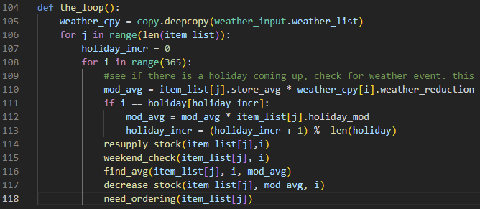
Data Generator
Purpose
To generate data to train the ML model
Challenges
Generating enough data to be meaningful
Capturing how outside variables affect foot traffic
Shallow reflection of real life

Slide 5
Inputs
Holidays
Major North American Holidays
Items list
ID, min, max, description, initial stock value
Six years of weather data
Rain, Snow, Average Temperature

Slide 6
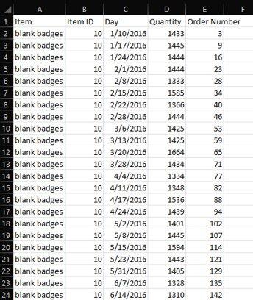
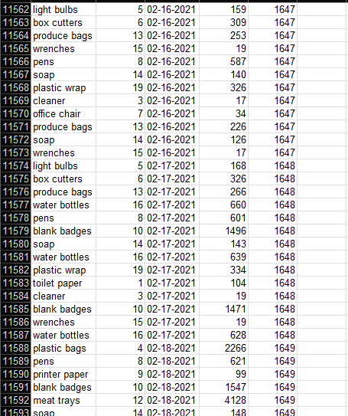
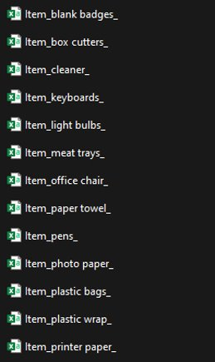
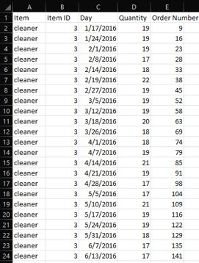
Outputs
Day an item is ordered, quantity ordered, and order number
16000 ordered items
~2000 orders placed
Splits into individual items
Helps simplify the process for the ML model

Slide 7
Ways To improve Data Generation
More historical data
Real customer counts
Real order values
More in-depth analysis as to what brings customers to the stores.

Slide 8
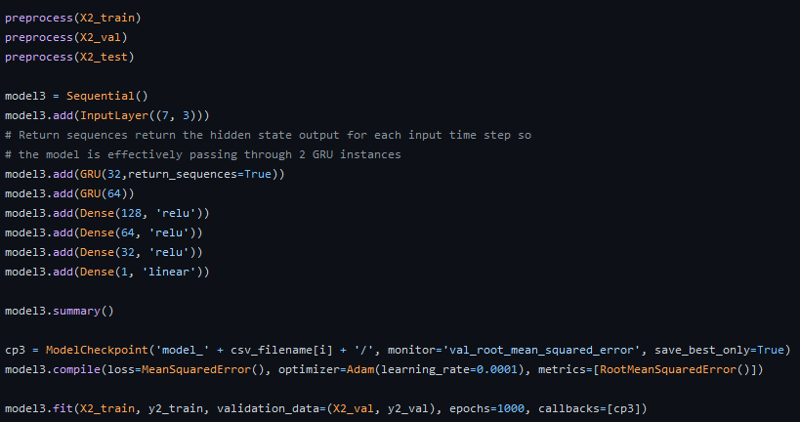
Machine Learning
Purpose
To use generated data to train the ML model
Challenges
Quality and quantity of data
Type of ML model
Amount of trainable parameters
RNN topology
Time invested in training the model

Slide 9
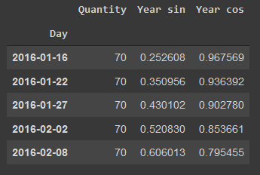
Inputs
The individual item csv files generated by the data generator is loaded into a pandas DataFrame object
Sin and Cos functions are created to reflect yearly trends
The DataFrame object is converted into a numpy array so the model can accept the quantity, Sin, and Cos values as inputs

Slide 10
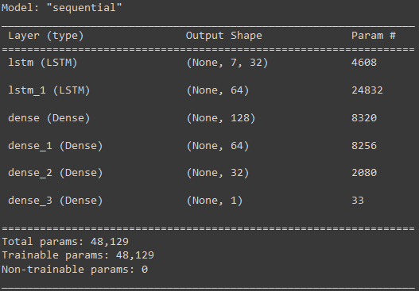
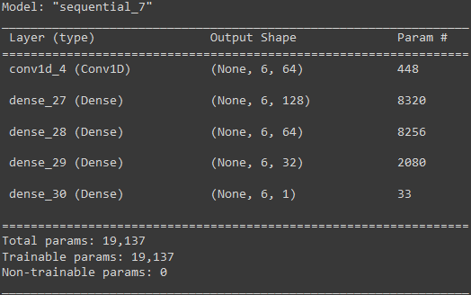
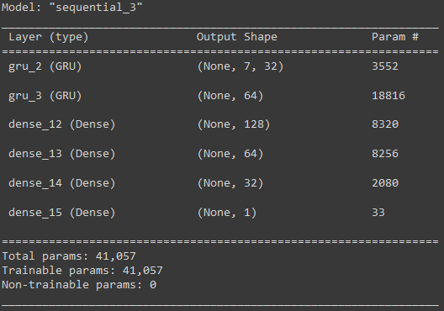
Determining a Model Type
A high number of trainable parameters
Two LSTM layers can be used for increased accuracy
A low number of trainable parameters
Only one Conv1D layer can be used
A good balance of model complexity between the other two models
Two GRU layers can be used for increased accuracy
Functionally very similar to LSTM model

Slide 11
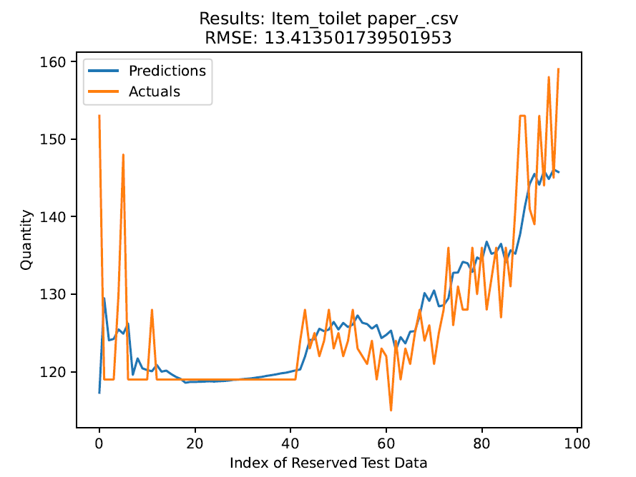
Machine Learning Results

Slide 12
Ways To improve Machine Learning
More data
Increasing the quantity of training data will yield a more accurate model
Normalizing data
Manipulating the data by removing outliers and improving the quality of the data
Increasing model complexity by using more variables as inputs
Refining hyperparameters of the model (number of layers, layer shapes, etc.)

Slide 13
Front-end Components
Home
Log In
Generate Data
Machine Learning Predictions
About Us

Slide 14
Front-end implementation
Django
High-level Python web framework that encourages rapid development and clean, pragmatic design.
Heroku and Downloading
Since the predictive tool run time takes over four hours, it is beneficial for it to be deployed locally.
The application can be found on our Heroku webpage with downloadable instructions to deploy it.

Slide 15
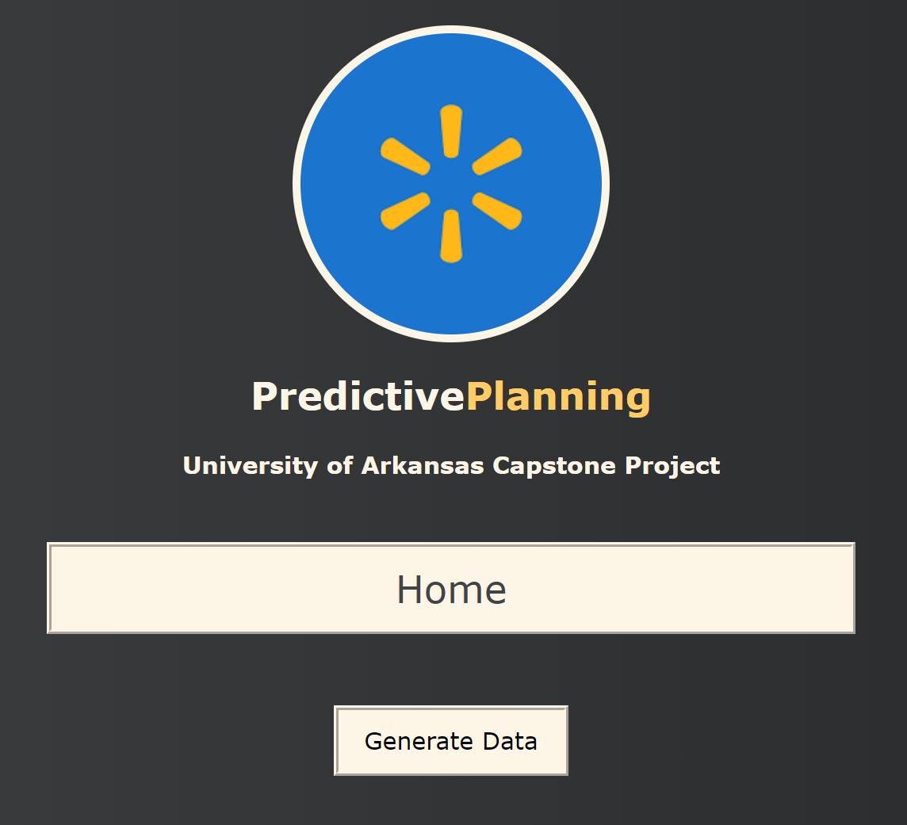
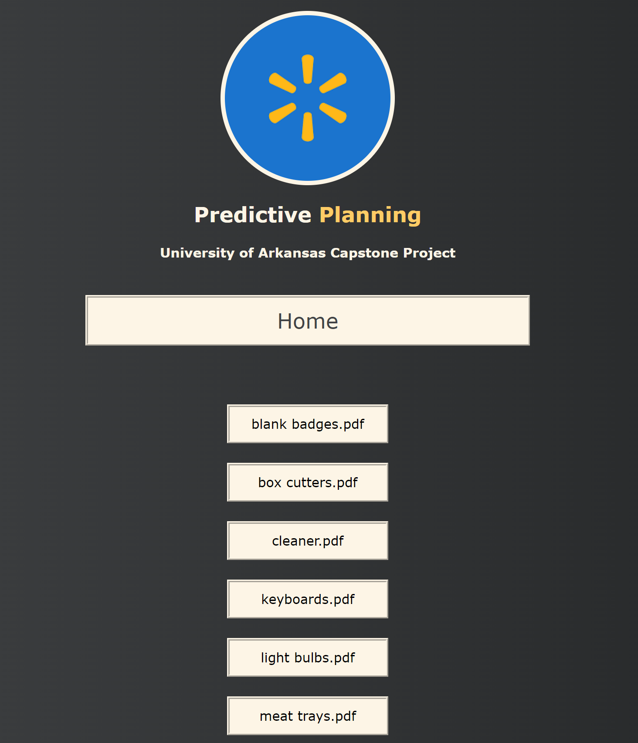
Front-end demo/Screenshots

Slide 16
Demo

