Slide 1
Walmart Tech Bar Scheduler
Ben Hodges, Joe Tam,
Austin Dixon, Cole Alvarado

Slide 2
Problem
Walmart's MyTech Portal is great for solving Tech related issues from a remote location.
However, some issues require a technician to physically repair a device, and in that case the associate will need to go to a Tech Bar.
The current system for checking into these Tech Bars is flawed and can cause associates to lose time and technicians to be unprepared for arriving associates.

Slide 3
Objectives
The goal of this project is to create an end-to-end Tech Bar scheduler web application for Walmart associates and tech support technicians.
Associates can see the bars closest to them and choose to queue in the bar that they prefer. They can also leave the bar they are currently queued in if they have other obligations that occur.
Technicians can manage the bar they assign themselves to. This includes pulling associates out of the queue, closing the bar when the time comes, and closing tickets.
A login system will also allow a degree of security to ensure associates and technicians are only authorized to see the pages in the app that they are supposed to.

Slide 4
Technologies Used
PostgreSQL
Used to support our database. Ruby-on-Rails works well with it because migrations and seeds can be written in Ruby and performed automatically.
Ruby-On-Rails
This is our web development framework. Most members of our group did not have a lot of web development experience, so this was a great choice to develop in.
HTML/CSS
This was used to visually create our pages in the application. It connected with Ruby-On-Rails to get relevant data out of the database.

Slide 5
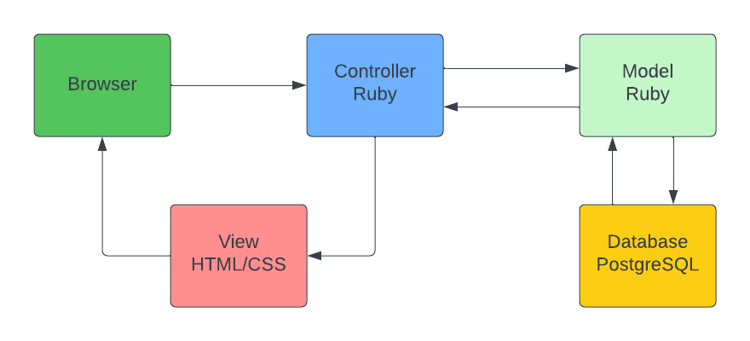
High Level Architecture

Slide 6
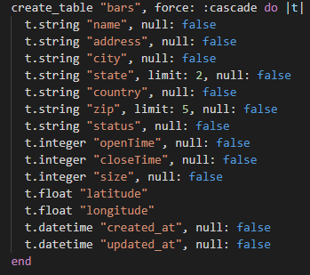
Database
Users
This Table holds the information about every user. This includes a username, a password, and a boolean which tells the system whether they are a technician.
Bars
This Table holds information about each bar. This starts with the name of the bar. Then it holds the locational value of it. After this it holds whether the bar is open or closed. After this it holds when the bar opens and closes, and finally, using a geocoder inside our application, the longitude and latitude are automatically calculated and held in our table.

Slide 7
Database
Lines
This table holds the information about each user in each queue at each bar. This includes their name, the type of device with an issue, and a description of their issue.
Tickets
This table is the result when a technician pulls an associate out of line. It holds the same information as the Lines table with the addition of the status of the ticket, a note from the technician, and the date when the ticket was resolved.

Slide 8
Associate Side Controller Functions
List
This passes every current bar from the database to the associate so they can choose the Bar they want to go to.
Show
When the associate enters the queue of a bar this shows information about their spot in the queue.
CreateSpot
This passes data about the associate into the Line table in the database when they enter the queue for a Bar
Leave
This takes the associate out of the Line table when they leave their Bar's queue.

Slide 9
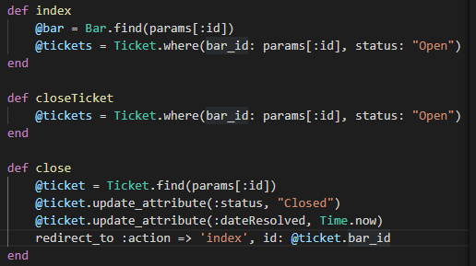
Technician Side Controller Functions
ChooseBar
Allows a technician to choose the bar they are stationed at when they sign in
Index
Gets the data from the database to display currently open tickets and statistics from previously closed tickets.
OpenTicket
Gets users currently in line at a bar so that the technician may open a ticket for them
CloseTicket
Gets currently open tickets so technicians can close them when their issue is resolved.

Slide 10
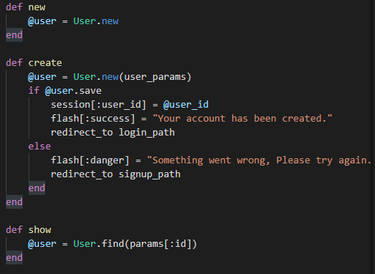
Login Controller Functions
Create
This will take your username and password information and authenticate it with the user's database and based on whether you're an associate or a technician, it will redirect you to the correct page. If your login information is incorrect, it will prompt you to try again.
Destroy
This will log you out of the current session and any access of the website will require you to log back in.

Slide 11
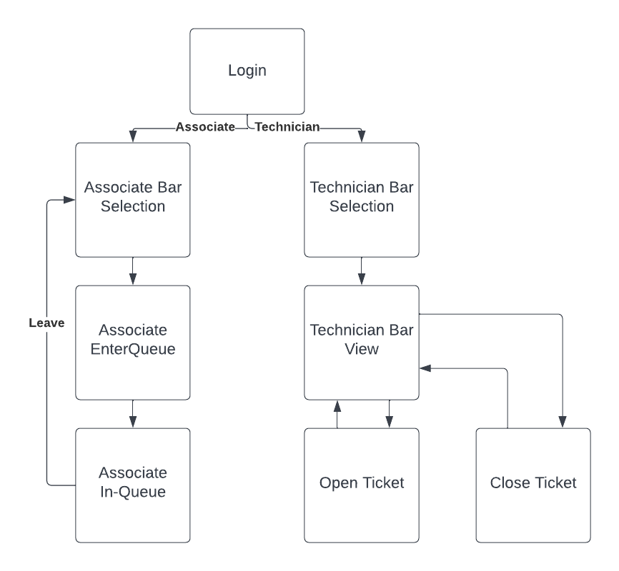
Routes

Slide 12
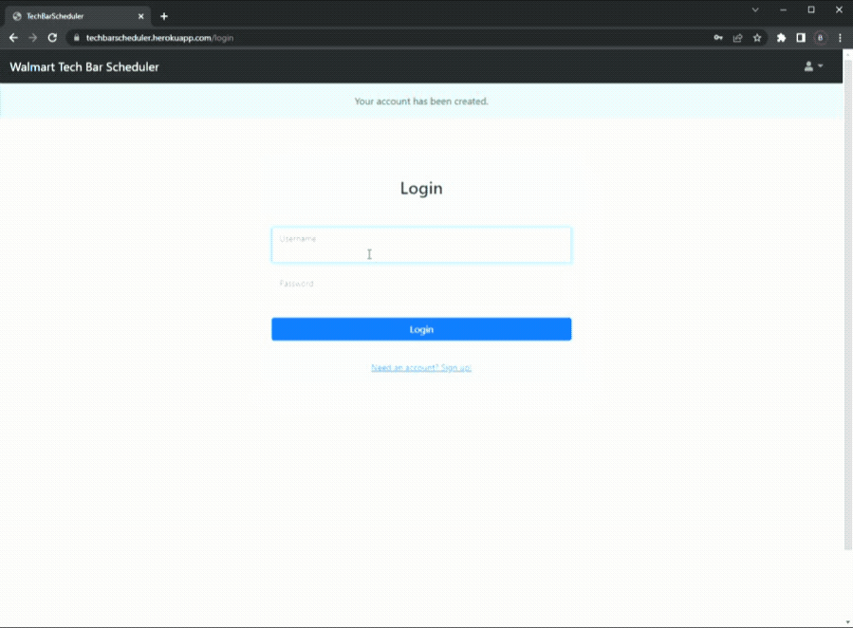
Login Page

Slide 13
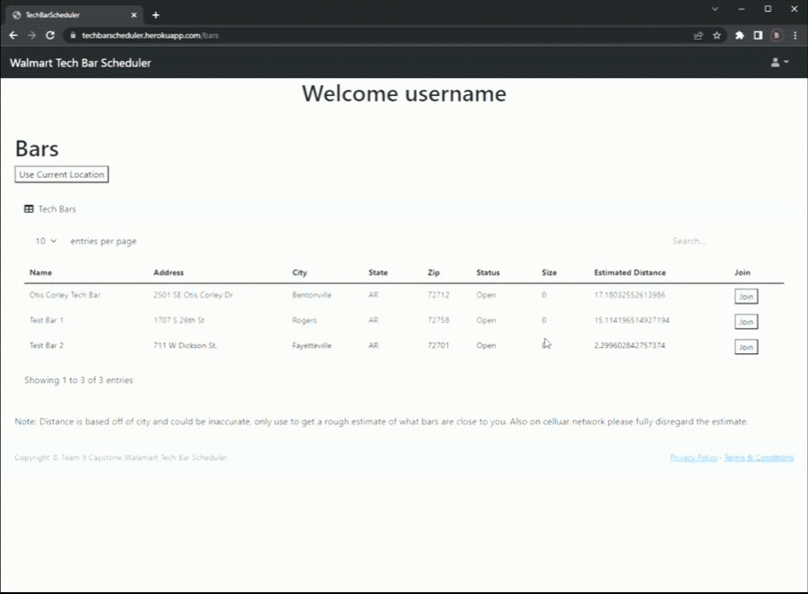
Associate Tech Bar Selection Page

Slide 14
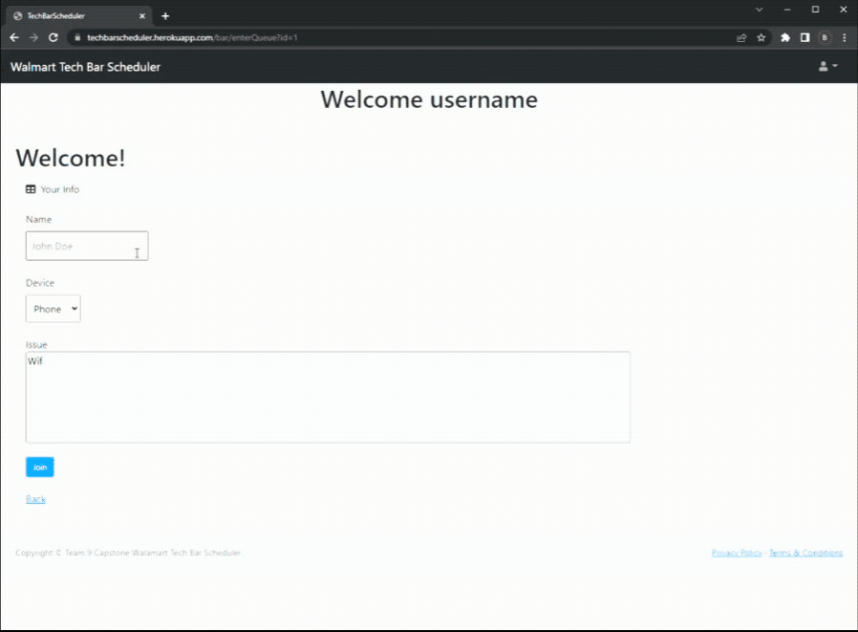
Associate Tech Bar Entrance Page

Slide 15
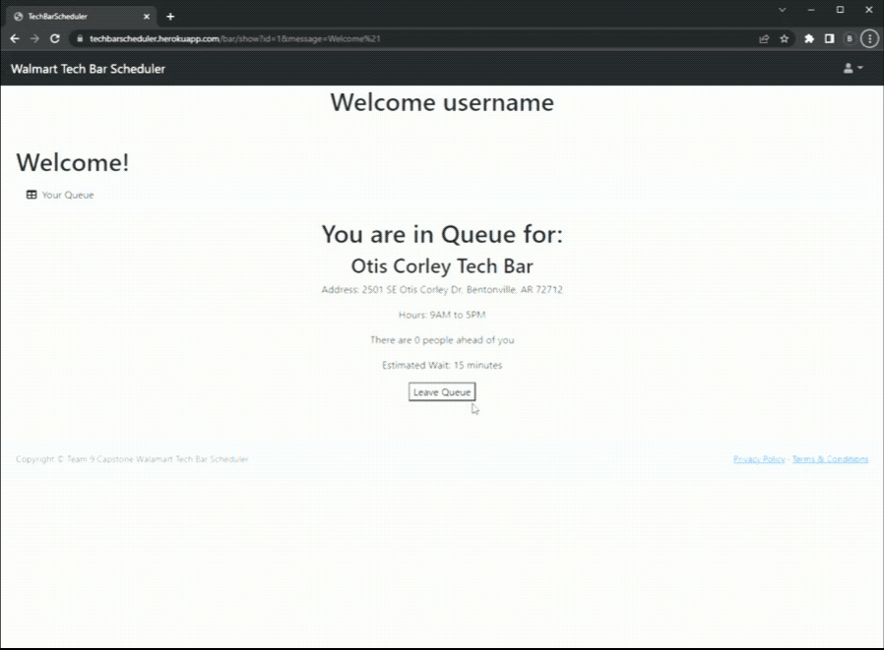
Associate Tech Bar In Queue Page

Slide 16
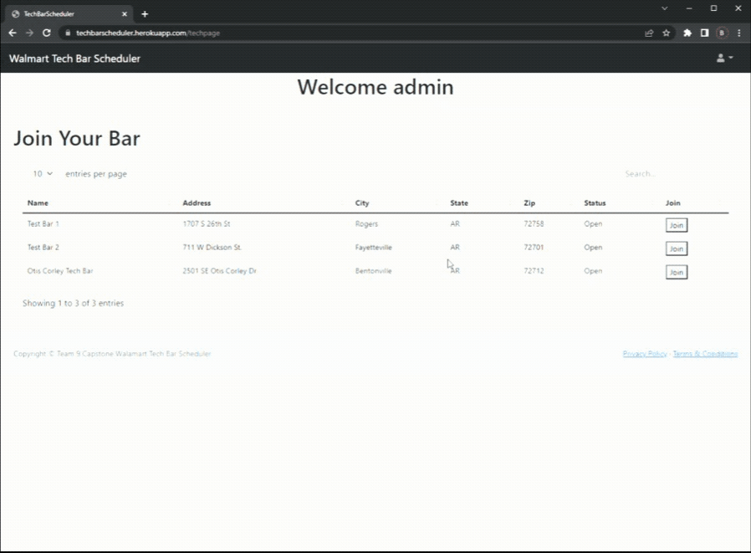
Technician Selection Page

Slide 17
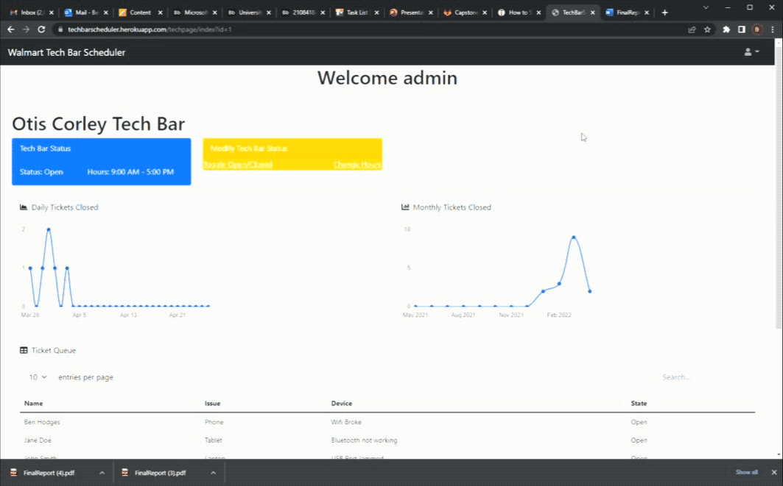
Technician Main Page

Slide 18
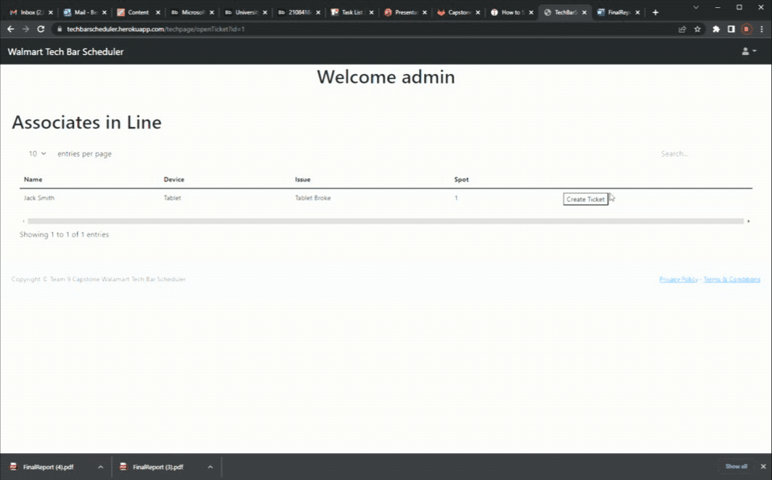
Technician Create Ticket

Slide 19
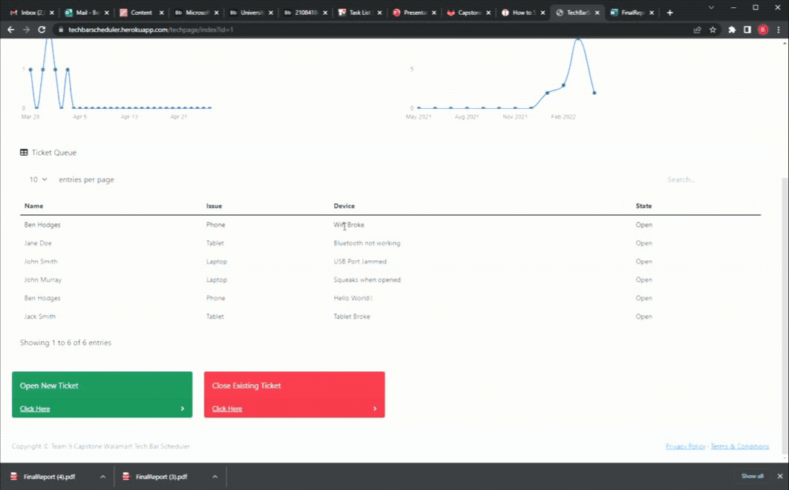
Technician Close Ticket

Slide 20
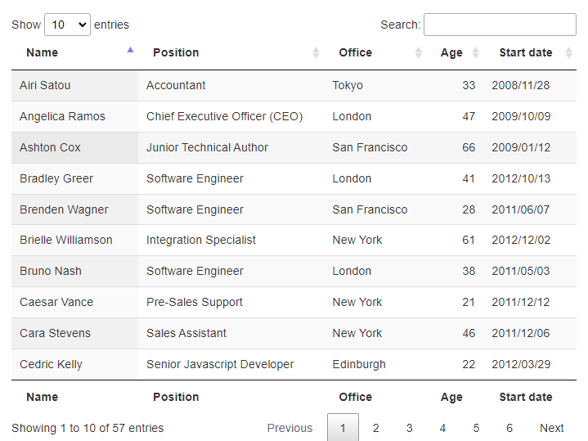
External Technologies
Bootstrap
Our Bootstrap served as a template for our application. This was crucial for our development since none of us had a lot of UI experience.
Datatables JQuery
To make the datatables in our application look nice we used a JQuery that automatically creates visually appealing ones out of data.
Geocoder
A geocoder gem was used to automatically calculate the longitude and latitude of Bars when they are placed in the database.

Slide 21
Future Steps
Location Improvements
Our current implementation of location detection only takes the current city of the user into account. A major improvement would be to calculate the closest Tech Bar by exact location.
Security Improvements
With none of us being experts in Web development some security oversights were most likely made. Someone well versed in the field would most likely be able to improve our security.

