Slide 1
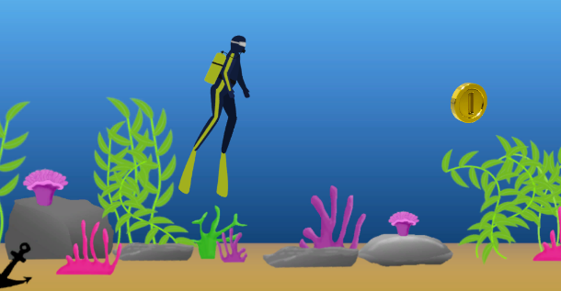
Preoperative Anesthesia Game for Young Patients
William Baker, Gavin Glenn, Jackson Gregory, Jared Harris, John Ostermueller, John Shelnutt
University of Arkansas, College of Engineering: Computer Science
Introduction
Children undergoing anesthesia before surgery are often stressed and anxious about their operation. This stress can make the anesthesia delivery process difficult for both hospital staff and the child-patients alike.
In order to relieve the stress caused by preoperative anesthesia, Arkansas Children’s Northwest Hospital (ACNW) has asked us to develop a game for kids to interact with during the preoperative anesthesia process. Such a game would provide an easier task for nurses delivering anesthesia while also providing a more enjoyable experience overall for the child-patients.
Methods
The game was developed in Unity with a C# code base. We chose Unity because of its ease of deployment. We chose the setting for the game to be an underwater diving scenario, where a diver is encouraged to move laterally across a 2D screen in order to collect coins.
An Amazon Fire Tablet with a child-safe case was used to host the application. Kids are able to hold the tablet themselves when undergoing anesthesia. We also utilized a DinoFire presentation clicker to serve as a remote control device for the nurse: when the child breathes a healthy breath, the nurse triggers the clicker which causes the diver to move forward across the screen.
The assets for the game were designed in GIMP, then imported into unity and further edited with Unity’s built-in sprite editor.
Results
Our game is fully functional, with a clicker-controlled diver moving across the screen laterally. The diver has been rigged with organic swimming animations and the background has been populated with various assets to provide an immersive game environment.
Coins have been set to automatically spawn on the right side of the screen: they are collected whenever the diver passes by. To add another level of interaction, we’ve added a small bubble animation whenever the child taps the screen.
Conclusion
We hope that this game will be able to reduce stress and anxiety for preoperative child-patients. Due to covid restrictions we have been unable to test drive our app in person--we’re excited to continue working with ACNW to test out our app with patients in the coming weeks.
Purpose
Below are the main goals of our project:
Encourage healthy breathing in the child during anesthesia delivery
Reduce the stress of the child during the anesthesia process and provide an overall enjoyable experience
Ease the task of anesthesia delivery for the nurse and other ACNW staff
Acknowledgements
University of Arkansas
College of Engineering
Dr. Staci Allen - ACNW
Ashlynn Young - ACNW
Lora Streeter - UARK
Figure 1: A still of the idle diver

