Slide 1
Fay Jones Lab Request System
Aaron Faubion, Elliot Mason, Matthew Brooke, Tanner Paschal, and Zachary Thiher
Notes:
Intro slide, everyone say name

Slide 2
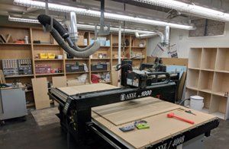
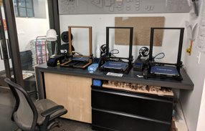
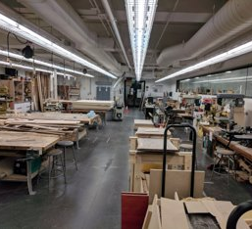
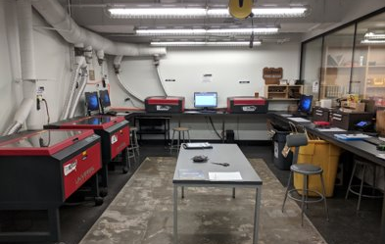
The Lab Space
Notes:
The What – review of the lab space for architecture students and the whatnot
Elliot - QUICK

Slide 3
What is FJLRS?
Online webapp that allows students to submit print jobs to a queue
Allows staff to have a single point to view the queue, interact with the jobs, and update the status
Submit Print Job
Assign a printer and start the job
(optional) Add comments and hold
Print
Notes:
Matthew

Slide 4
Why?
The current system for the print lab is inconvenient.
Students must email to schedule an in-person consultation in order to print.
Jobs are manually added to an Excel file to track them.
Email
Employees may miss the email
Consultation
In-person consultation is time consuming
Excel
Excel is not optimal for managing a queue of jobs
Notes:
Matthew

Slide 5
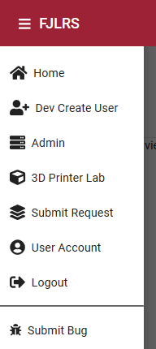
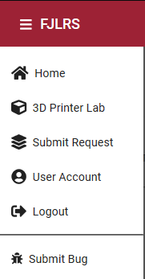
Employee & Student Navigation Views
Admins have exclusive capabilities
Notes:
Zach

Slide 6
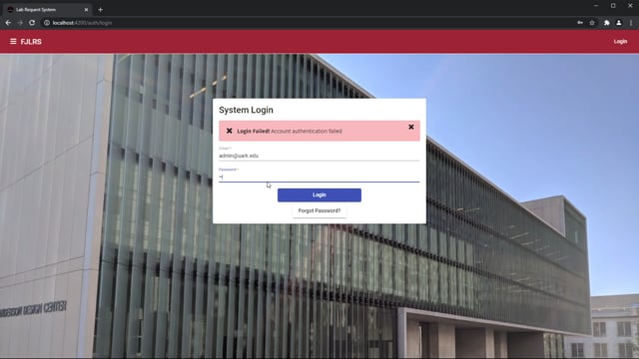
User Enrollment (ADMIN)
*video
Notes:
Zach 0:50

Slide 7
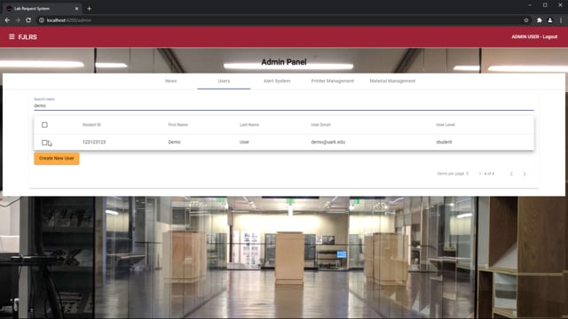
User Management (ADMIN)
*video
Notes:
Elliot 0:40

Slide 8
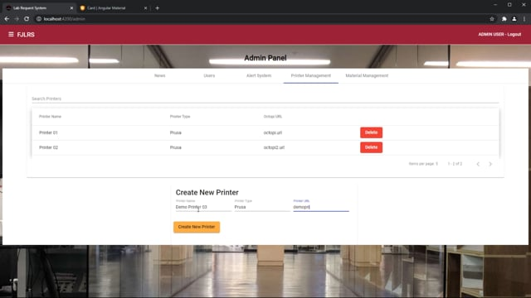
Manage Printers (ADMIN)
*video
Notes:
Aaron

Slide 9
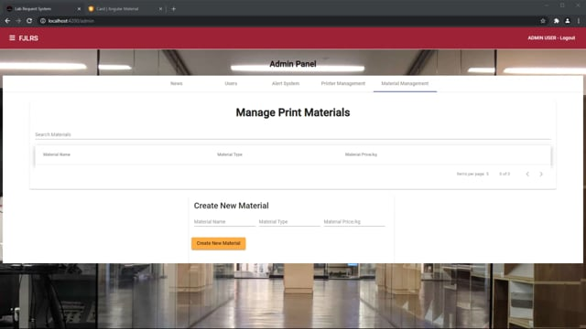
Manage Materials (ADMIN)
*video
Notes:
Aaron

Slide 10
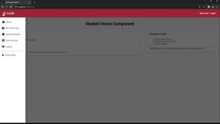
Submitting a File and Queue Job
*video
Notes:
Elliot - :45

Slide 11
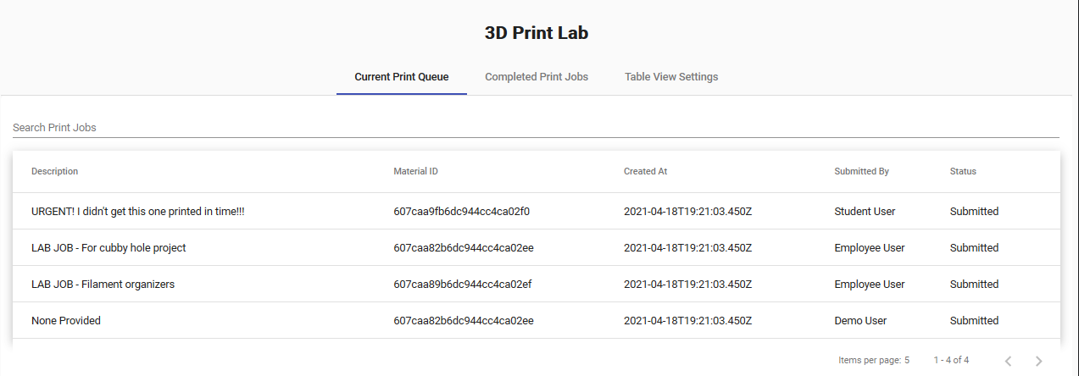
Print Queue Overview
Notes:
Tanner

Slide 12
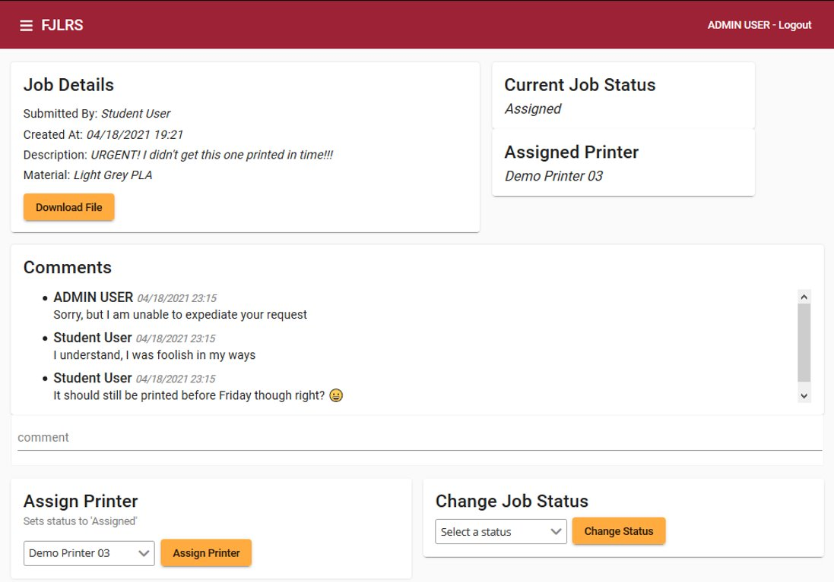
Print Queue Detail

Slide 13
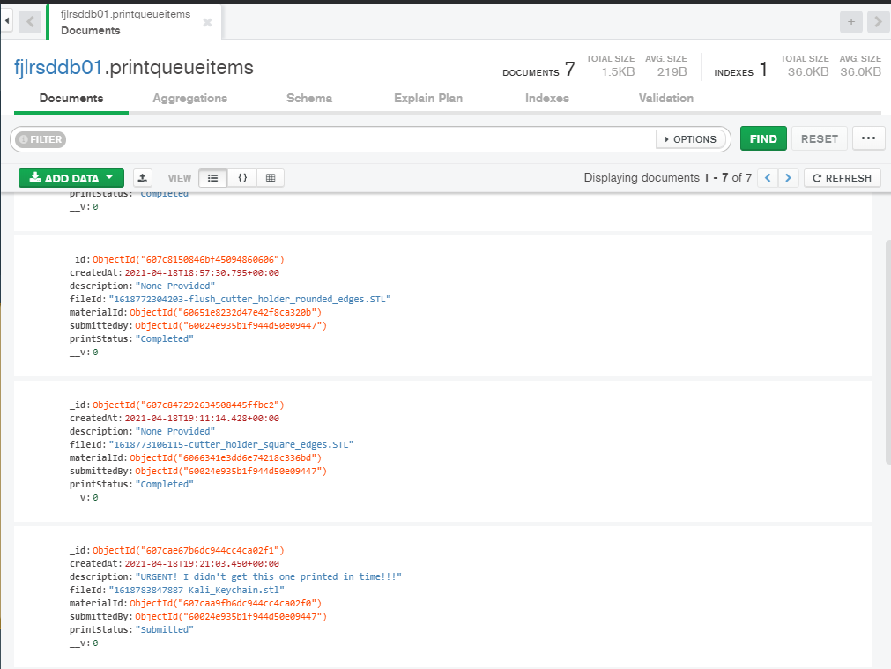
Print Queue in Database
Notes:
Tanner

Slide 14
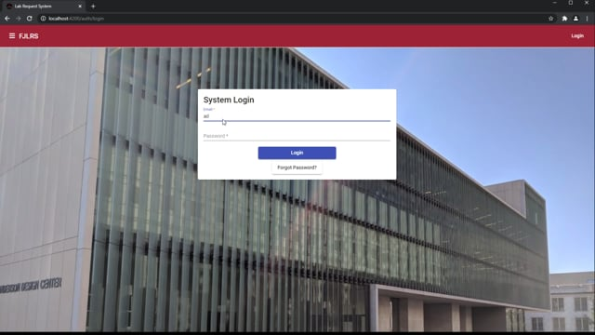
Checking the Print Queue
*video
Notes:
Tanner -- 1:30

Slide 15
In the Future
Update the student when their job is complete
Adding an STL Viewer to allow for users and admins to view the file in real time
Ability to upload multiple files per job item submission
Generate a dynamic invoice that takes the size and material prices into account
Notes:
Elliot

Slide 16
Thank you!

