Slide 1
The Apron App
Team #6
Kayla Boyd, Bertrand Kalisa, Gregory Renteria, Luis Pinzon, Soroush Shirali, Rachel Culbertson

Slide 2
Introduction
Objective
Simplify the sometimes complicated process of meal planning
Create an easy-to-use web application that can assist users in planning out their meals
Allow users with dietary restrictions to sort through meals to find the best match
Recommends new and different meals to users

Slide 3
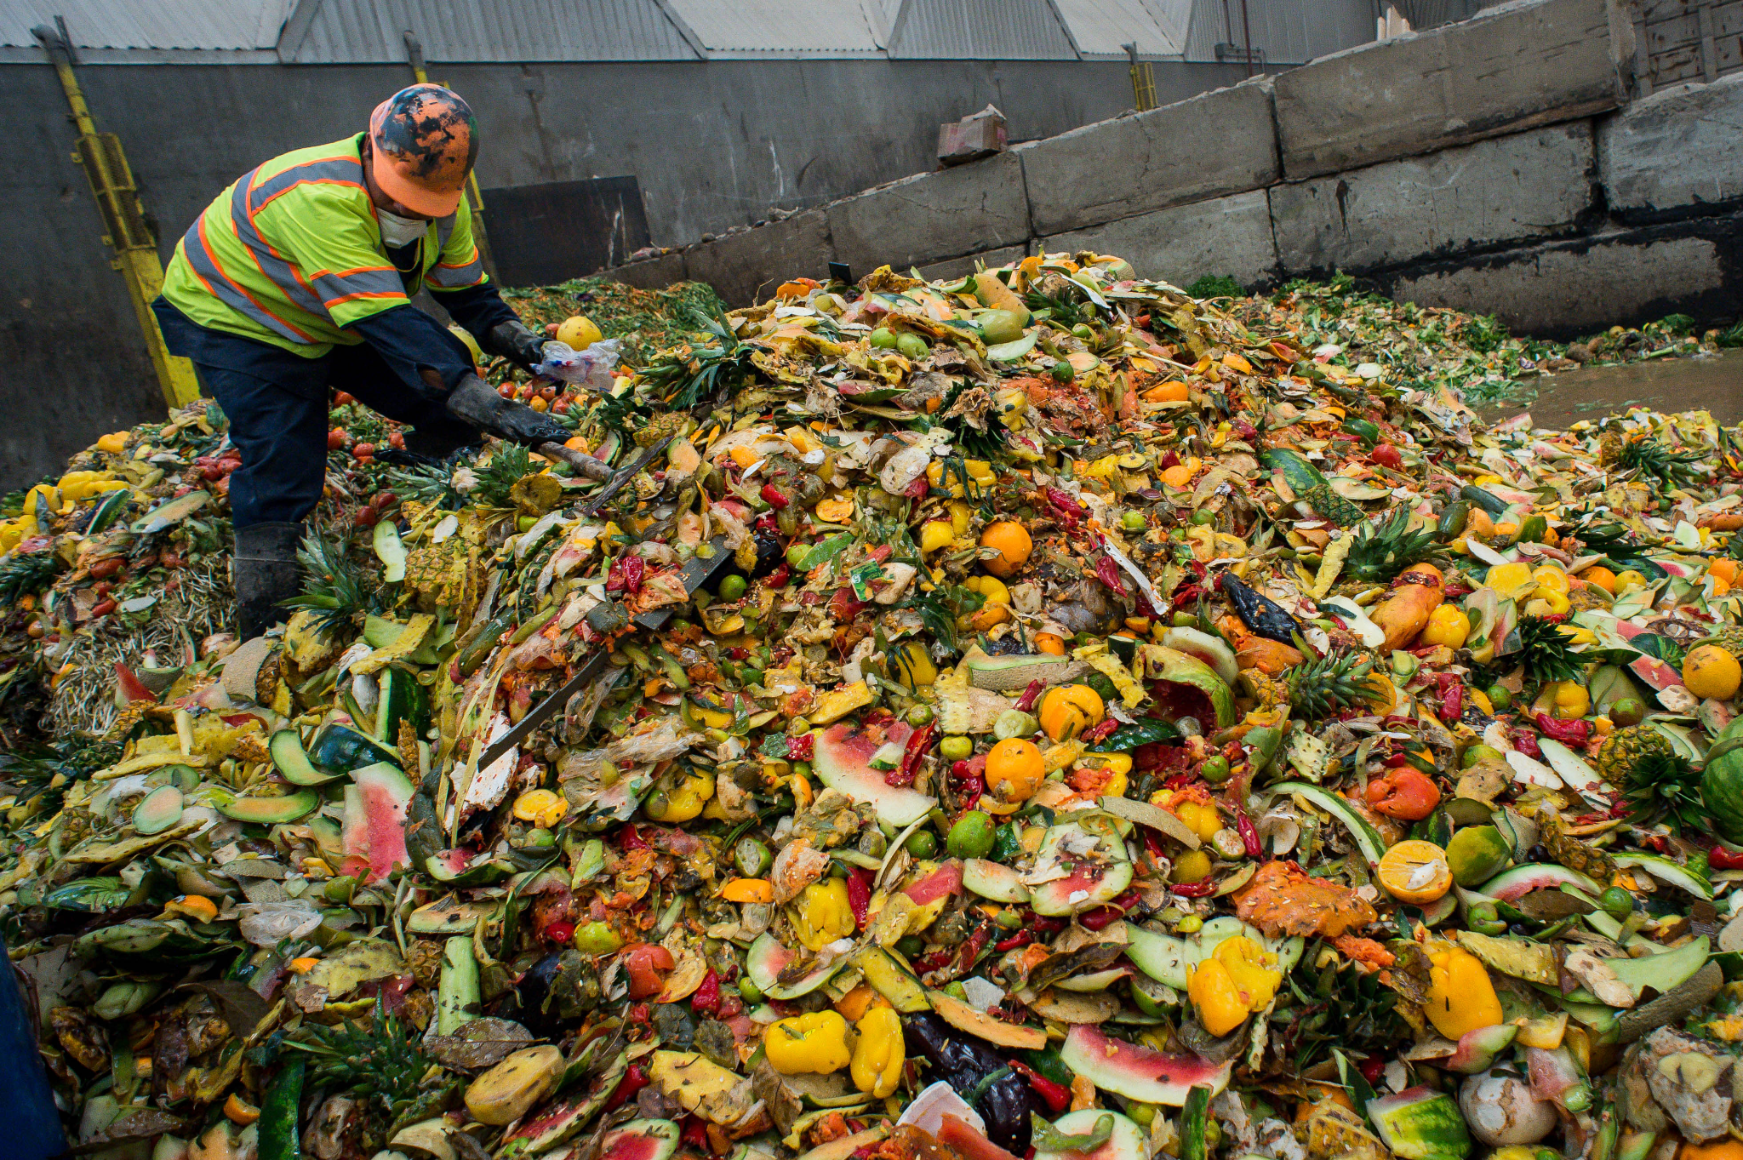
What Problem are we Solving?
Time management
Meal planning can be time consuming
People who do not want to plan meals may opt for easier but unhealthy/expensive options. (i.e. takeout, frozen meals)
Food waste
Poor planning leads to expired and wasted out food
Environmental impact
Dietary restrictions
17.1% of adults followed a specific diet in 2015-2018. [1]

Slide 4
Features
Sign In/Sign Up page
Homepage/Feed
Profile/ Favorite
Grocery Lists
Pantry
Calendar
Navigation Bar

Slide 5
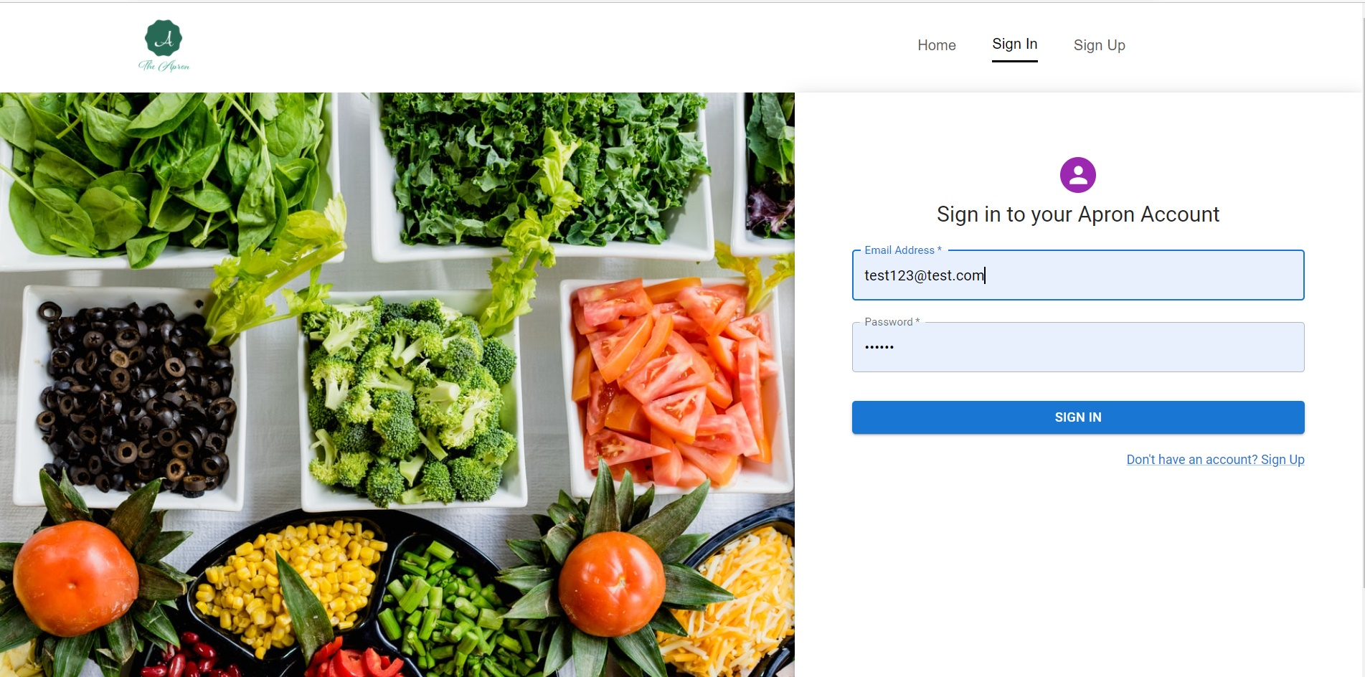
Sign In
Navigation Bar
Link to Sign Up

Slide 6
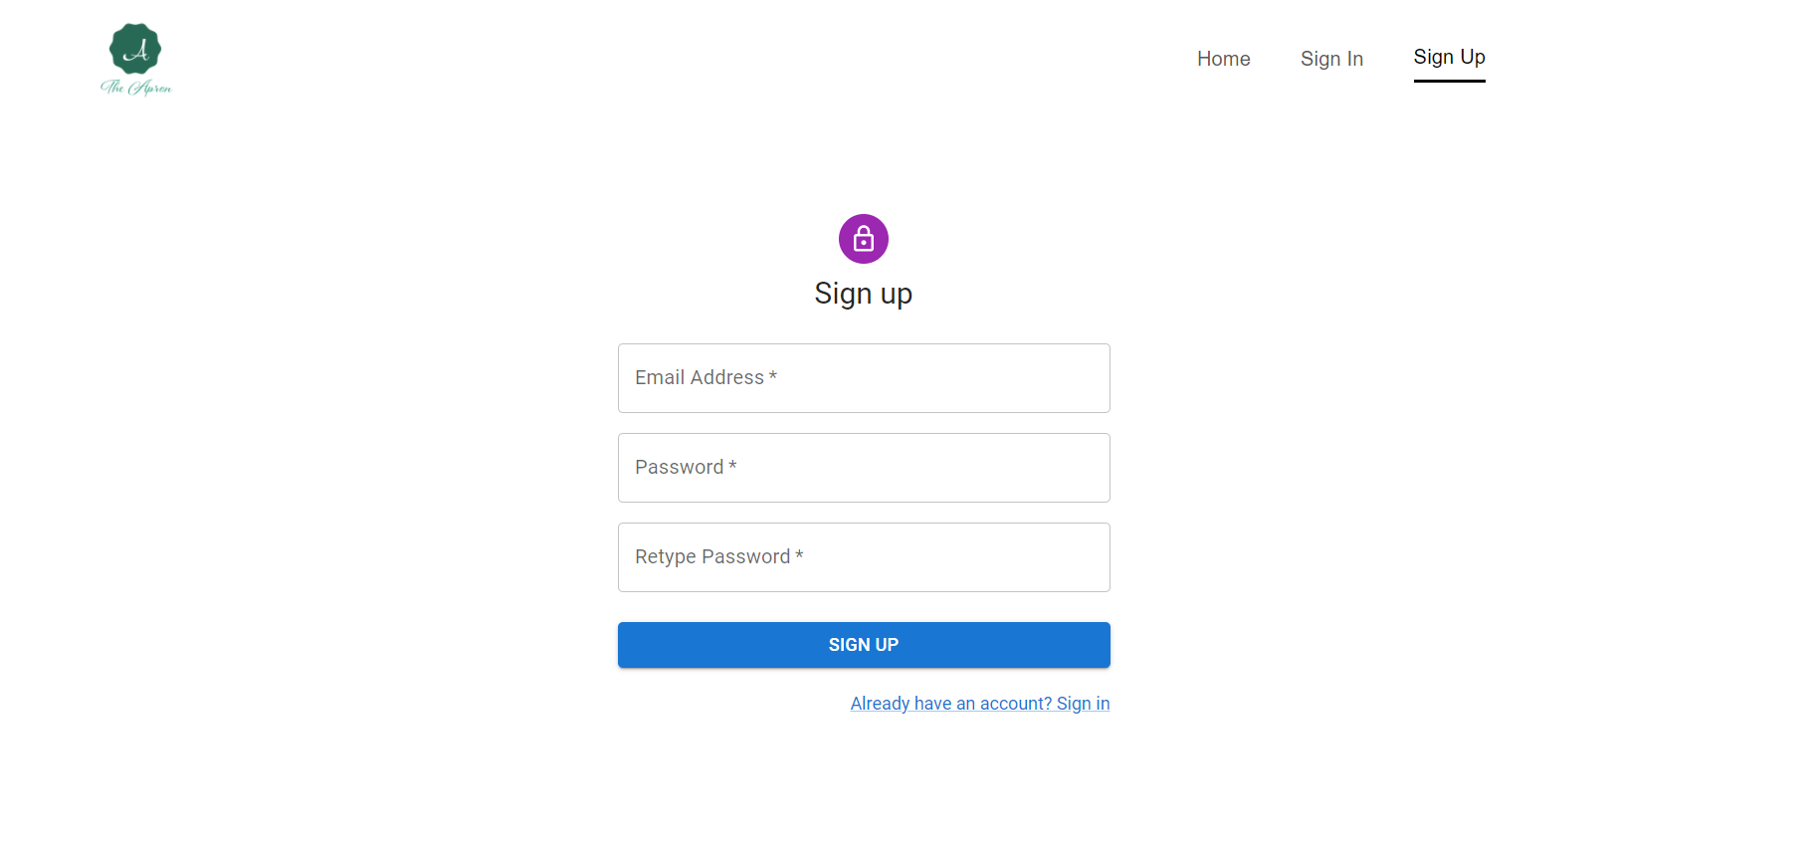
Sign Up
Navigation Bar
Link to Sign In
Notes:
How is it connected to the backend…

Slide 7
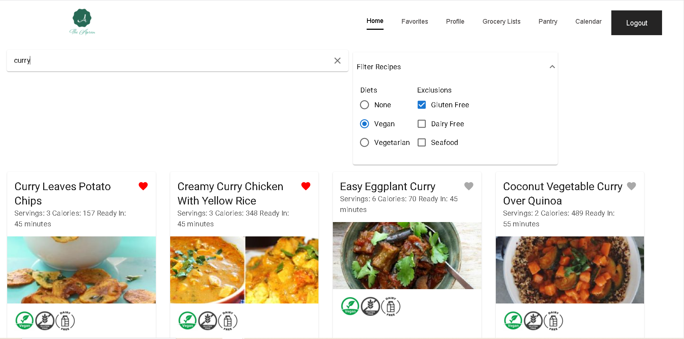
Homepage
Navigation bar
search
filter
Recipe Card Component
Notes:
Once you sign in..
At first, it shows two-hundred recipes that have been randomly selected from the Spoonacular API. Twenty recipes are shown on each page and pages can be changed through a page handler on the bottom of the page. (page change handler)
Recipe Card Component: Each recipe is displayed in a card component that is defined externally
Filter, navigation bar, search

Slide 8
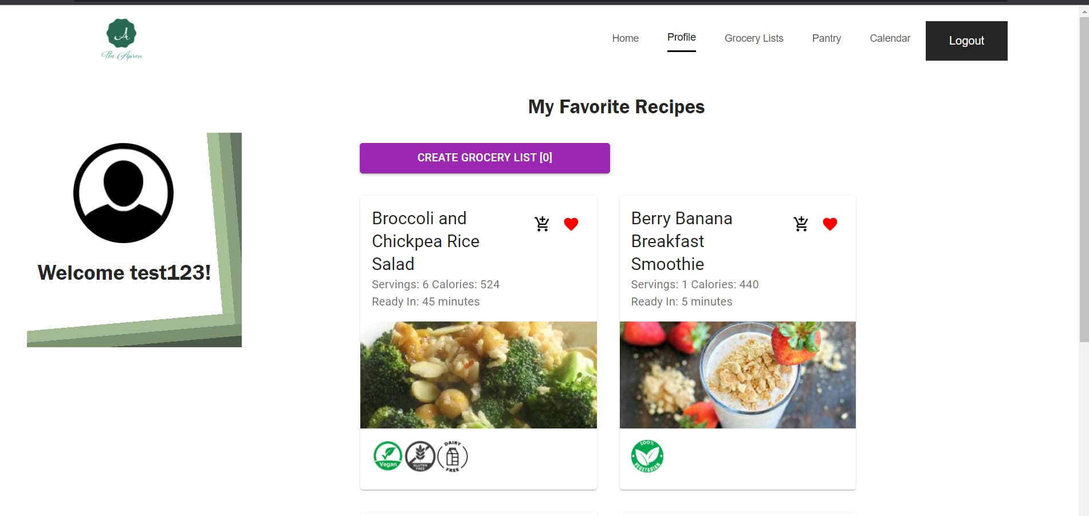
Profile
Navigation bar
User avatar
Grocery List Button
Display of user’s favorite recipes
Welcoming user text

Slide 9
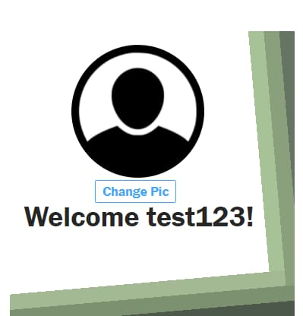
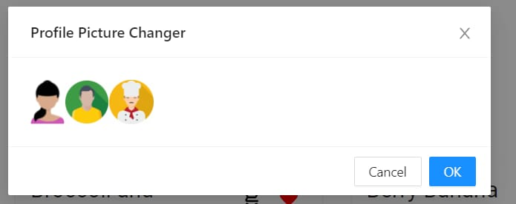
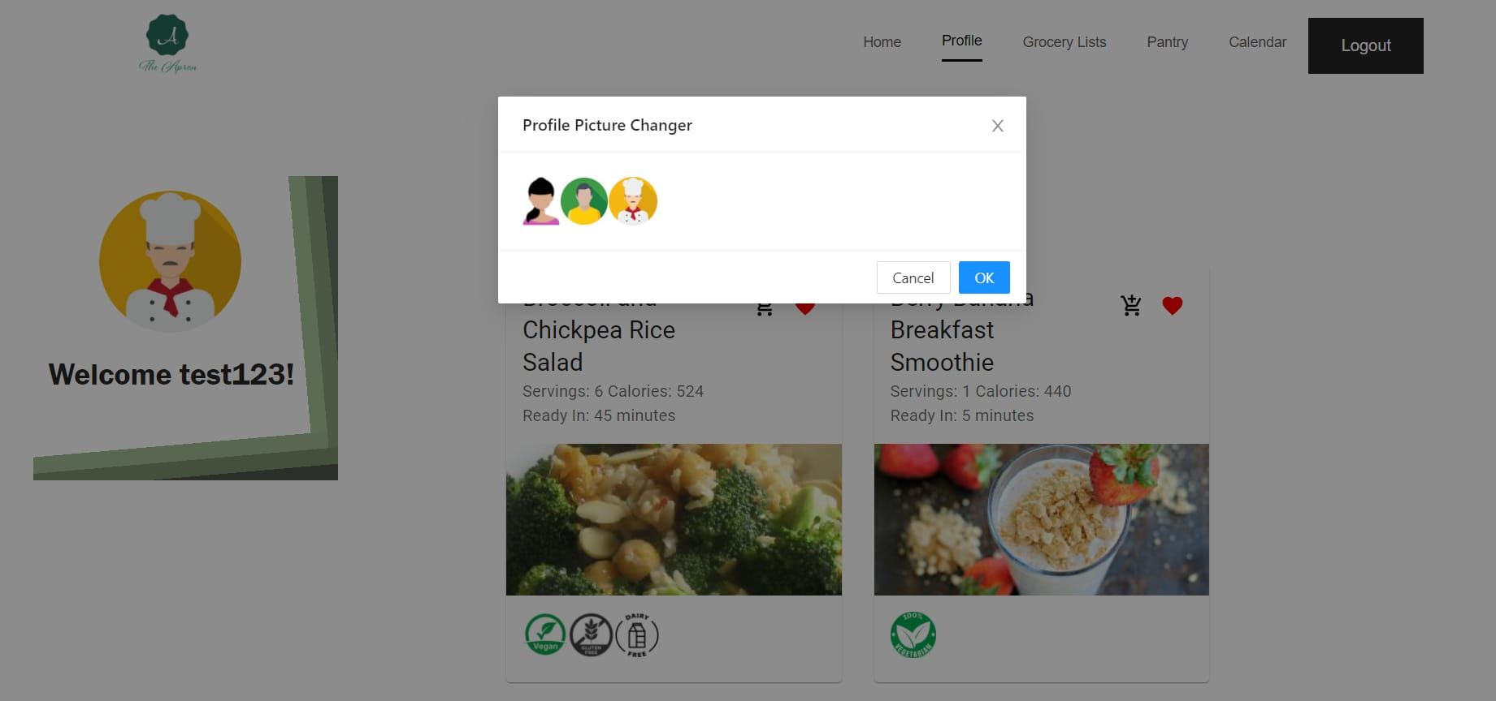
Profile
Profile picture modal
Ghost button picture changer
Image getting changed from modal picker

Slide 10
Profile

Slide 11
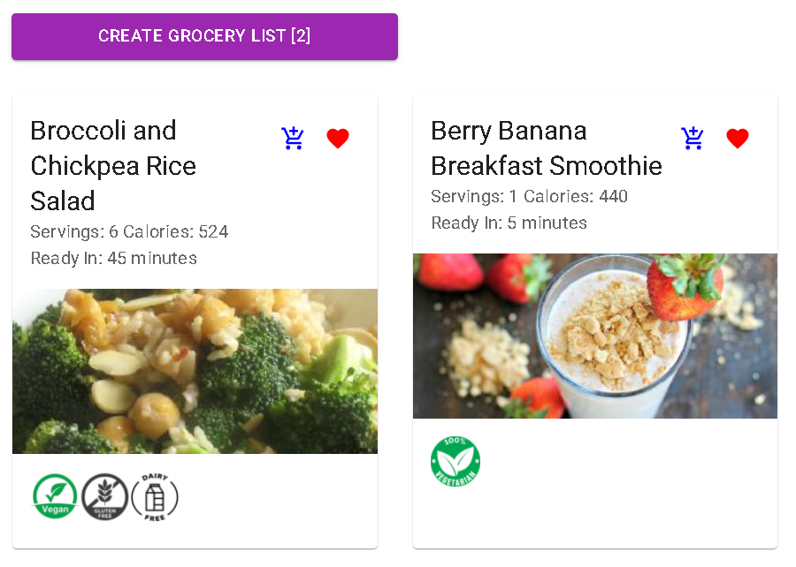
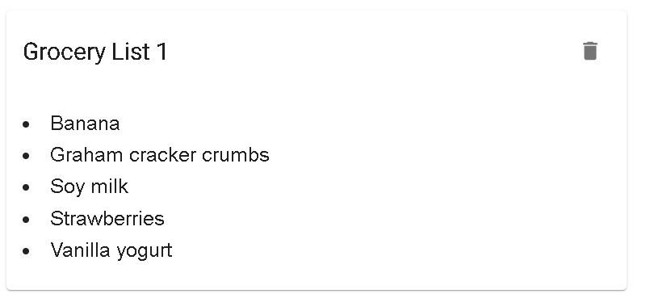
Grocery Lists
Recipes added in profile page
Previously added list
Notes:
The grocery lists page displays lists that the user currently has saved
You can create a new grocery list by clicking on the cart icon on saved recipes in the profile page.
The recipe’s ingredients will be saved to the Redux store.
When the user clicks the create grocery list button, the recipes are sent to the backend and the ingredients are aggregated to create a new grocery list. Ingredients with the same name will only be added once.
Once that is complete, the user will be redirected to the grocery list page.

Slide 12
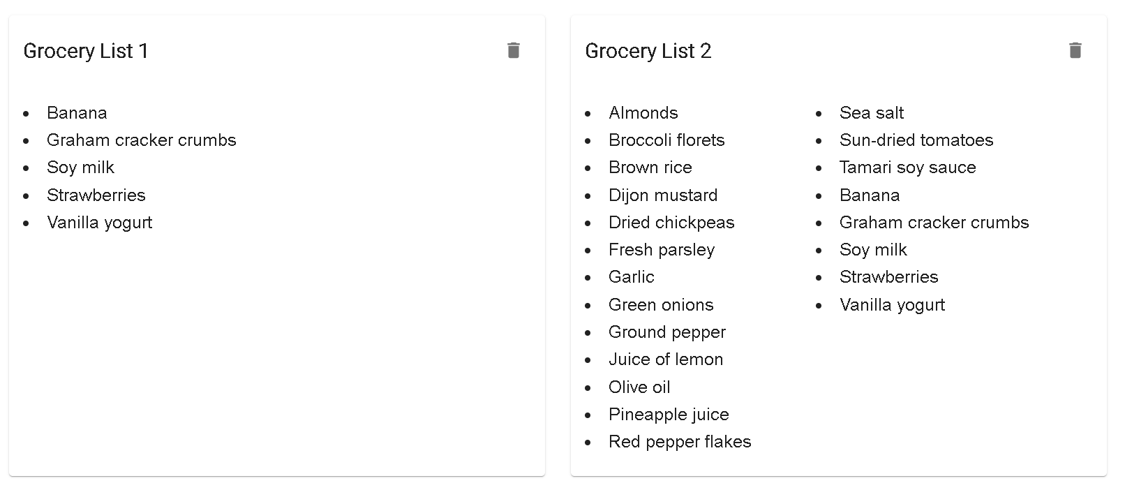
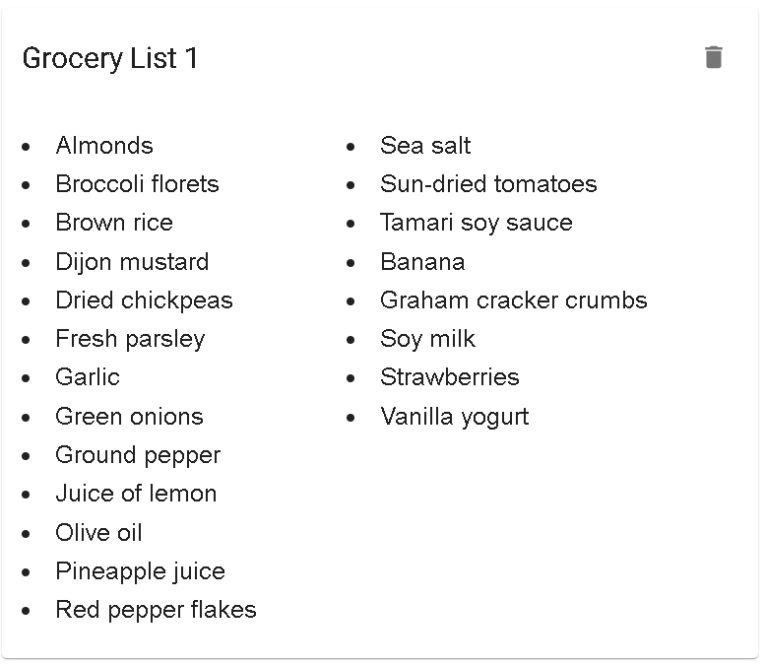
Grocery Lists
Newly added list
After deleting
Notes:
The newly added recipe will be displayed on the page.
You can remove a recipe by clicking on the delete icon.
The UI and list names will be automatically updated

Slide 13
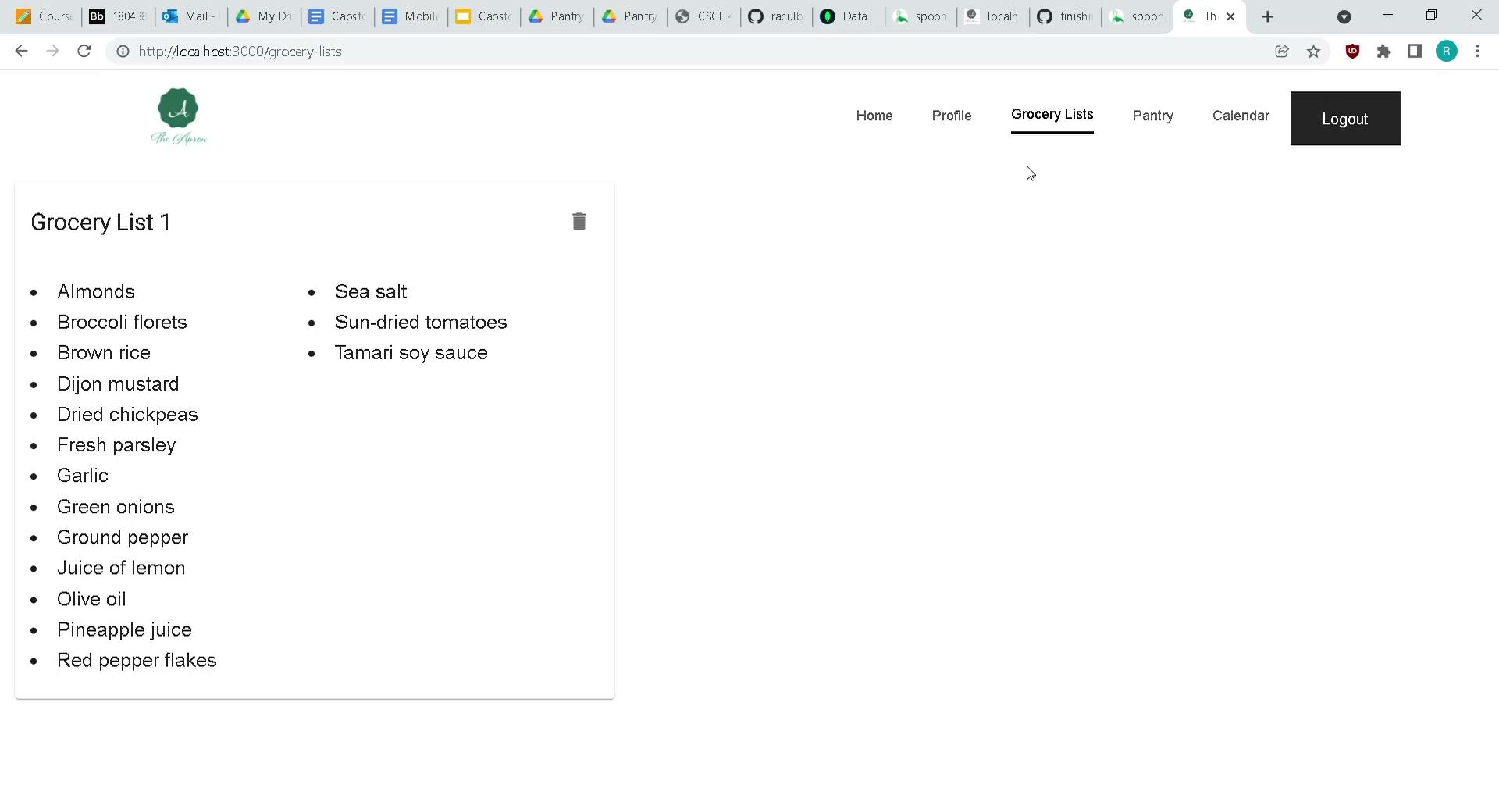
Grocery Lists

Slide 14
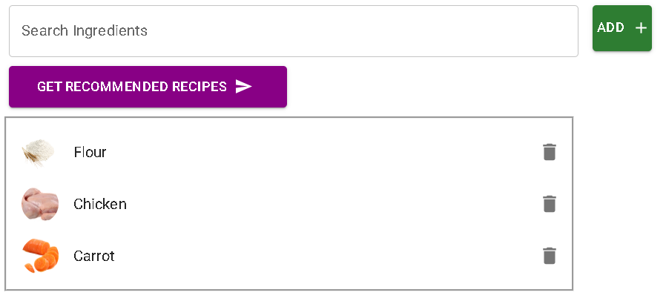
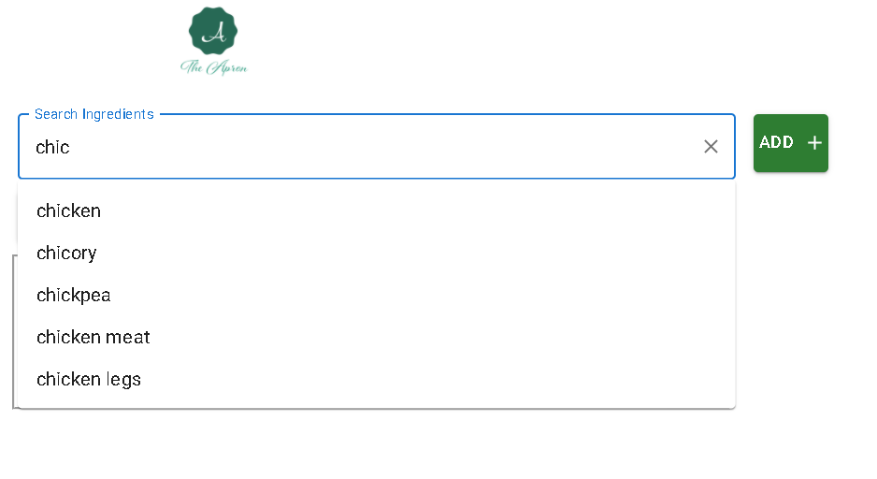
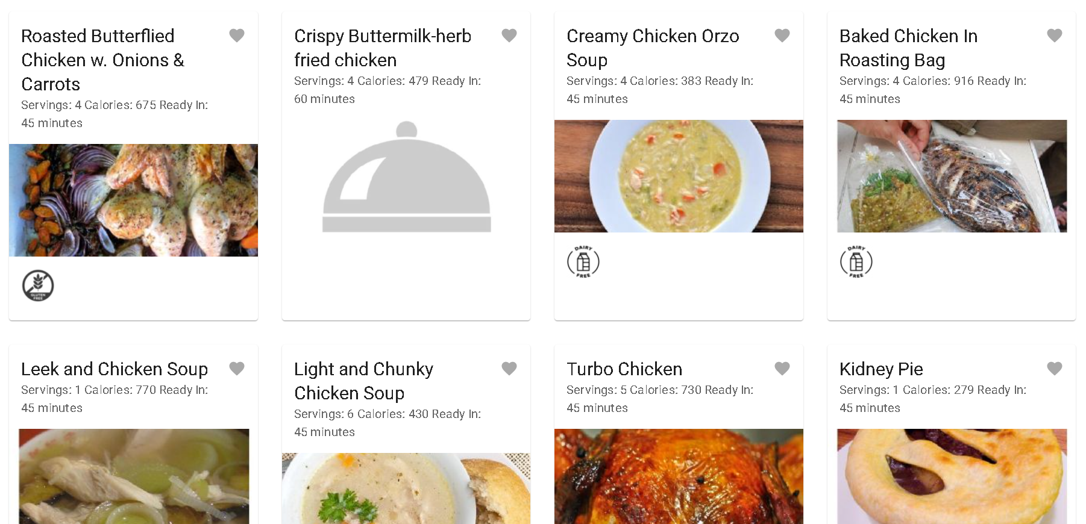
Pantry
Previously added ingredients
Autocomplete search results
Recommended recipes
Delete ingredients
Notes:
The pantry page is used for storing ingredients that the user currently has.
You can search for a new ingredient to add in the search bar. The search bar comes with autocomplete functionality that will show up to five valid ingredients that can be added based on the current search query.
Clicking “Get Recommended Recipes” will load recommended recipes based on the added ingredients
You can also delete individual ingredients and the UI will be automatically updated.

Slide 15
Pantry

Slide 16
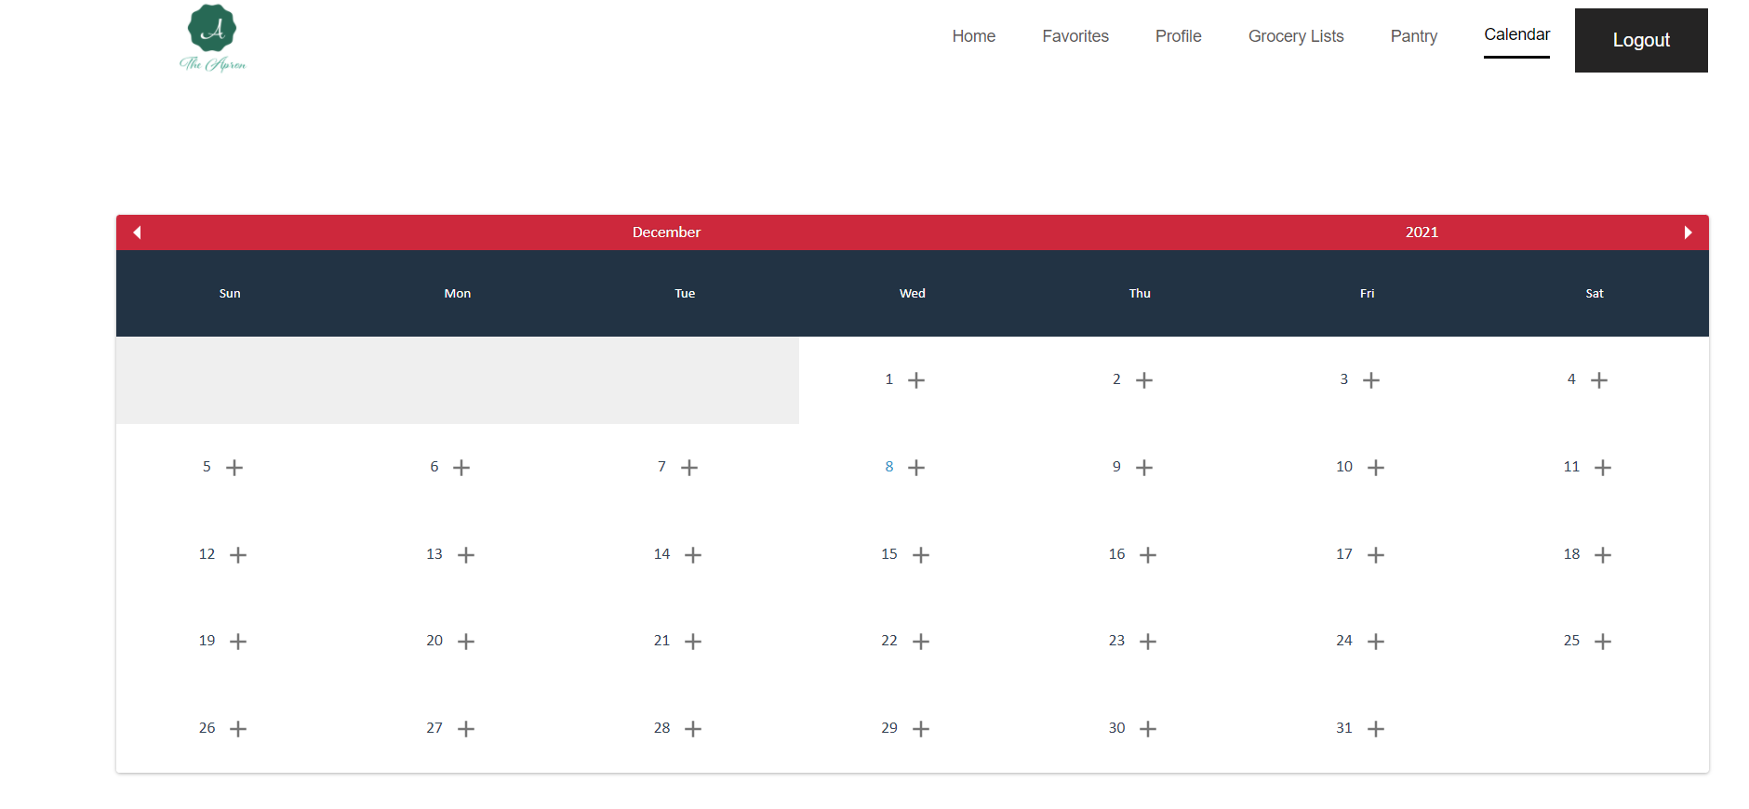
Calendar

Slide 17
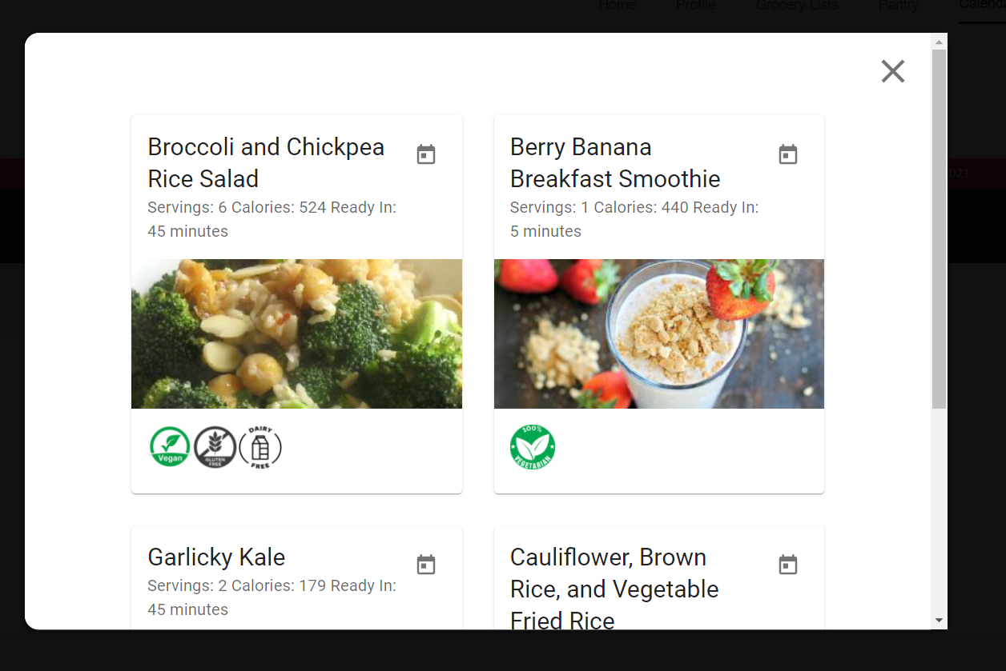
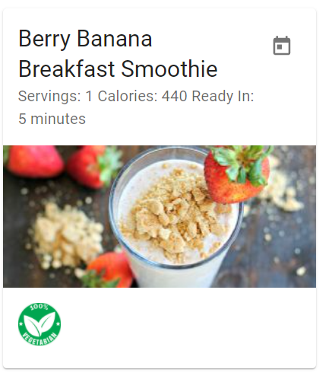
How Calendar works - Adding a recipe
Add to calendar

Slide 18
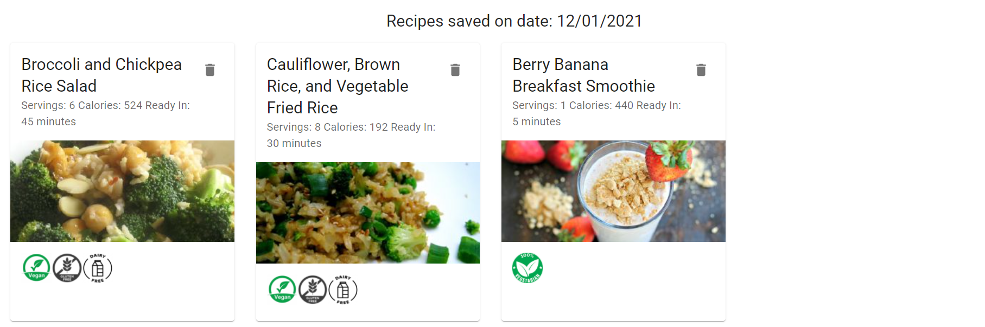
How Calendar works - Saved recipes and Delete a recipe

Slide 19
Calendar

Slide 20
Technology
Frontend Development
React
Backend Language
NodeJS
Database
MongoDB
Framework
Express
API’s
Google Calendar, Spoonacular, Nutritionix,etc
Source Control
Github
Project Board
Trello
Deployment Amazon Web Service
Container Nginx/Docker

Slide 21
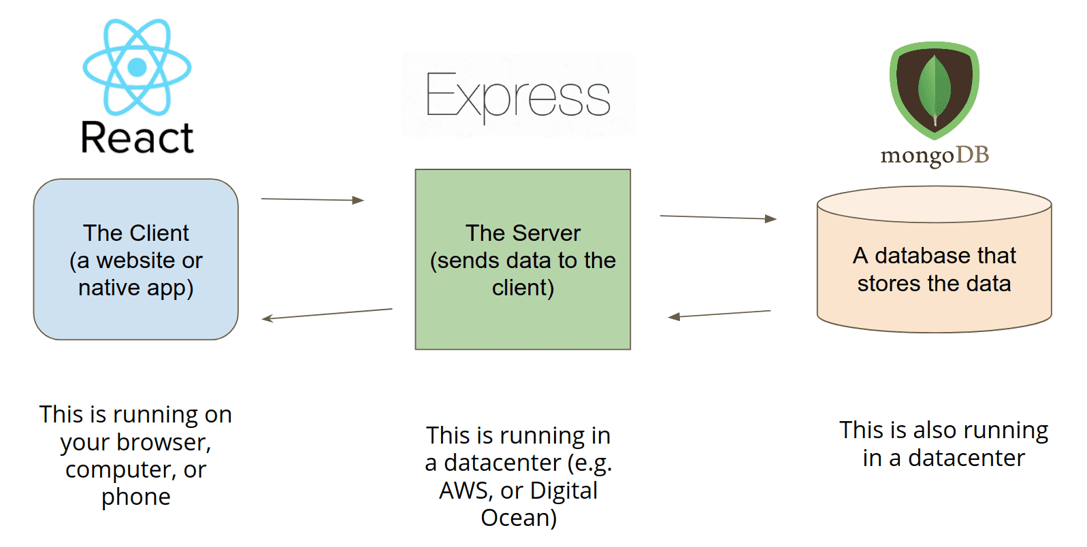

Slide 22
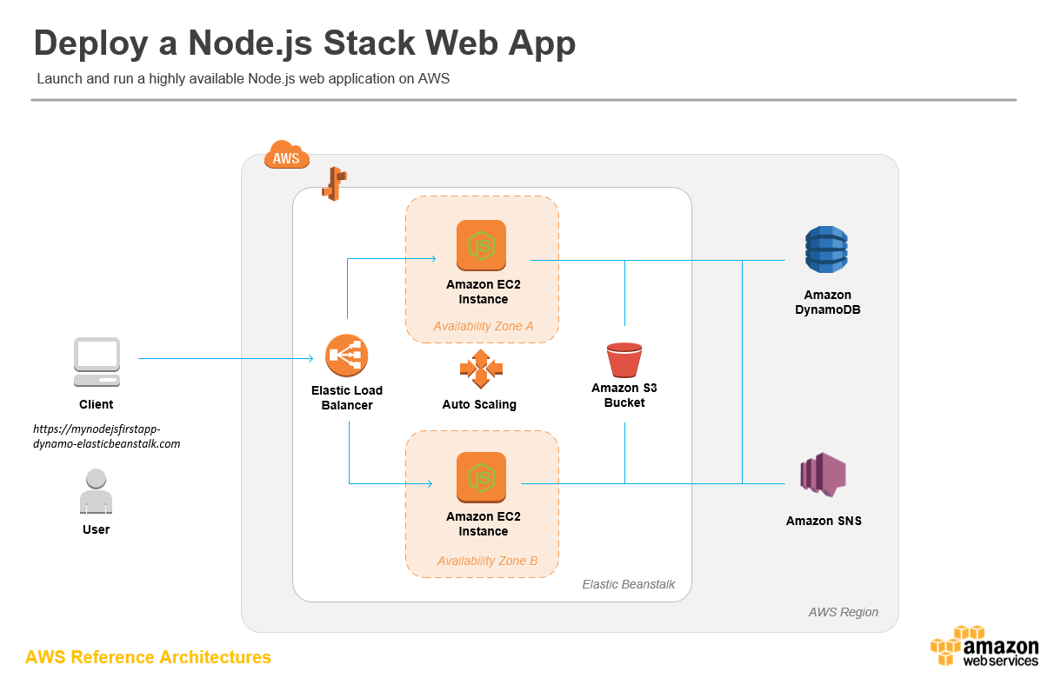

Slide 23
Questions?

