Slide 1
The Apron App
Team #6
Kayla Boyd, Bertrand Kalisa, Gregory Renteria, Luis Pinzon, Soroush Shirali, Rachel Culbertson

Slide 2
Introduction
Objective
Simplify the sometimes complicated process of meal planning
Create an easy-to-use web application that can assist users in planning out their meals.
Possible features
Option to save recipes
Create grocery list based on selected recipes
Calendar
Recommend recipes based on ingredients user already has

Slide 3
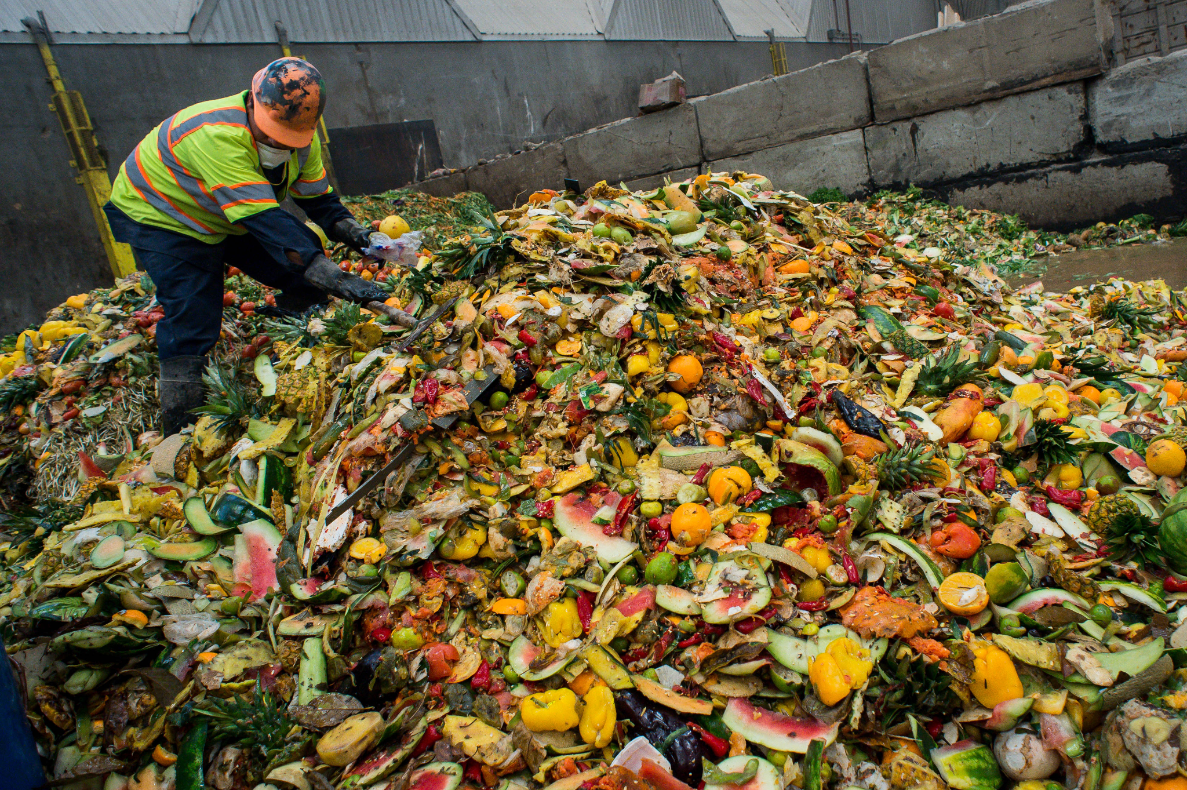
Problem
Time management
Meal planning can be time consuming
People who do not want to plan meals may opt for easier but unhealthy/expensive options. (i.e. takeout, frozen meals)
Food waste
Poor planning leads to expired and wasted out food
Environmental impact
Dietary restrictions
17.1% of adults followed a specific diet in 2015-2018. [1]
NRDC, https://www.nrdc.org/sites/default/files/wasted-2017-report.pdf

Slide 4
Technologies
Frontend Development | React
Backend Language | NodeJS
Database | MongoDB
Framework | Express
API’s | Google Calendar, Spoonacular, Nutritionix,etc
Source Control | Github
Project Board | Trello

Slide 5
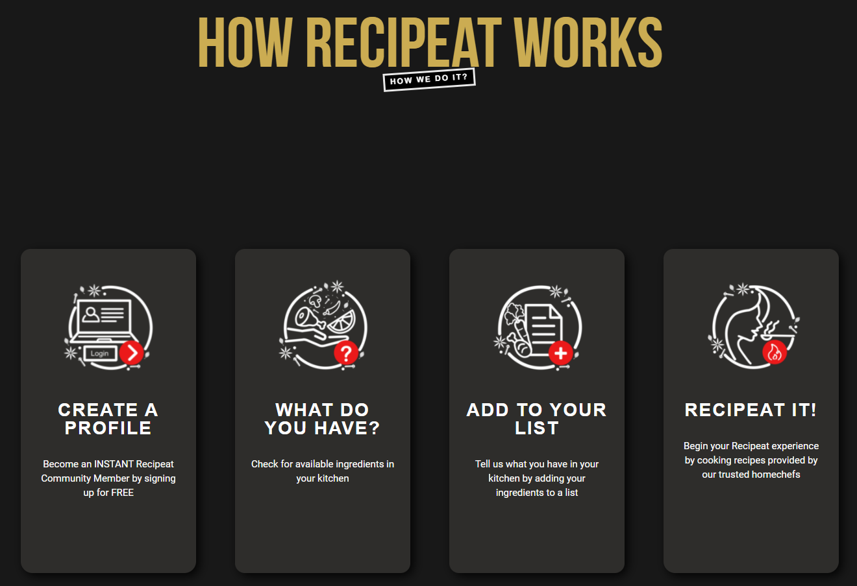
Related Work - Recipeat

Slide 6
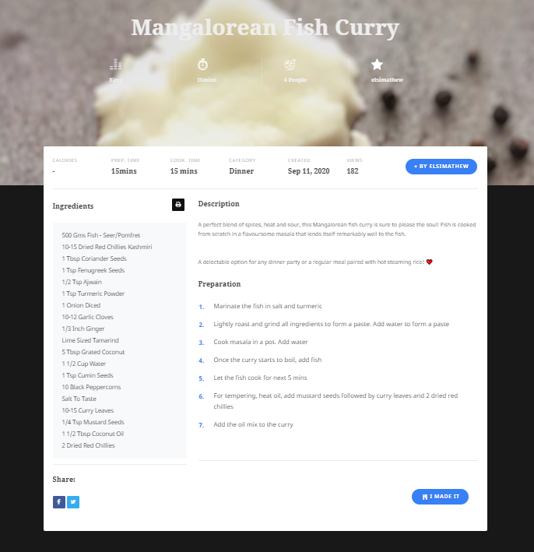
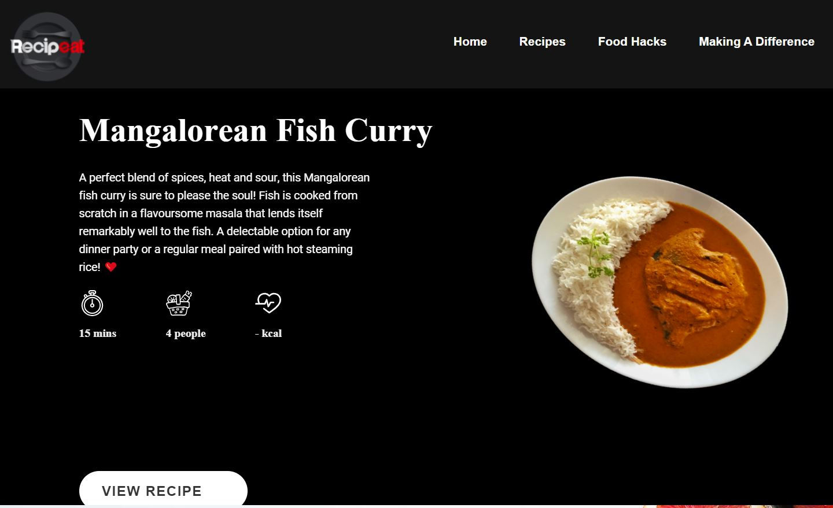

Slide 7
Design Goals
Hamburger menu
Different diets
Calendar feature
Save & pantry feature
Home screen
This will have a list of recipes from online sources
Search bar
This will be where a user can search for new ingredients and add them to their pantry.
User settings
This is where a user can easily update their basic information, username, password etc…

Slide 8
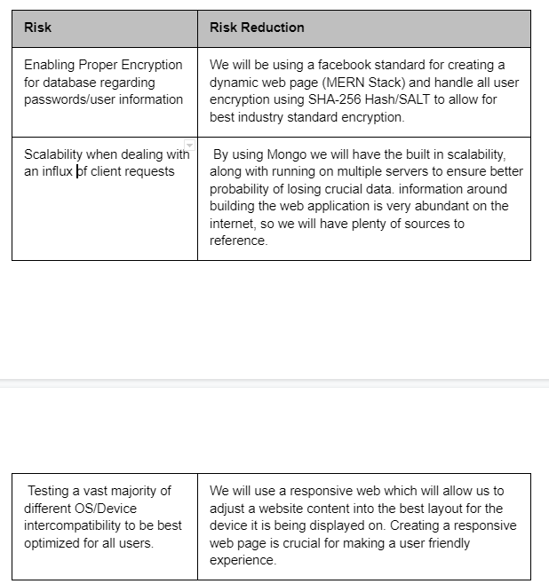
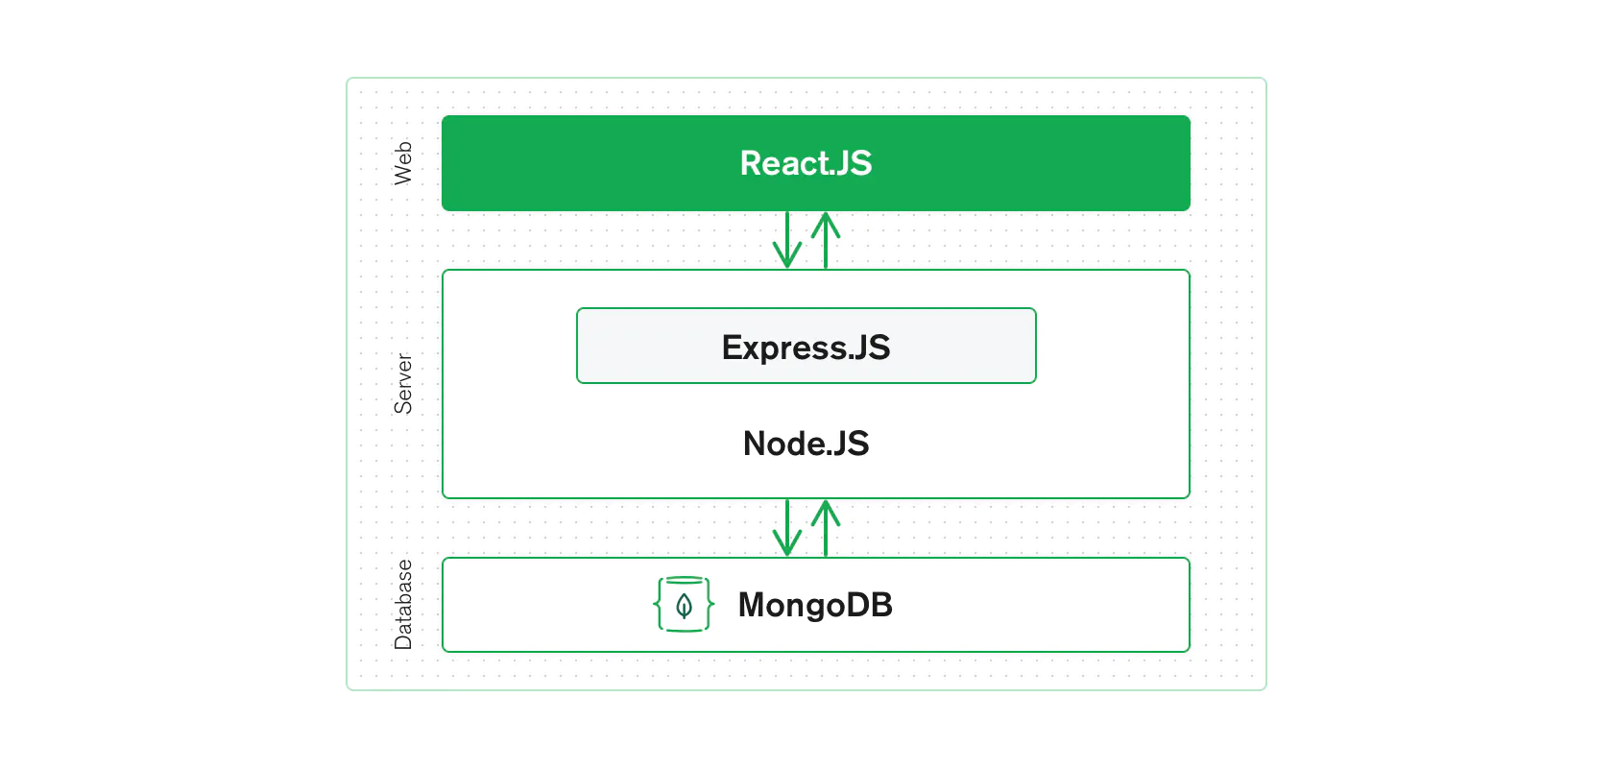
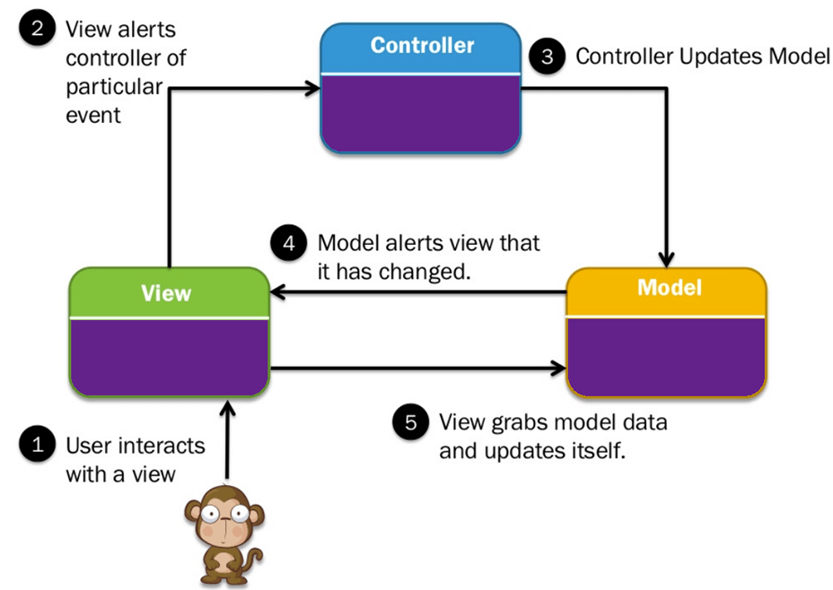

Slide 9
Tasks and Schedule
Tasks | Dates
1. Work on preliminary proposal and presentation | 8/23-9/13
Identify the concepts and objective of the project | 8/23-8/27
Understand the goals and obstacle of future users | 8/30-9/3
Write initial proposal | 9/7-910
Delivery proposal presentation | 9/10-9/15

Slide 10
2. Initial app planning | 9/17-9/24
Work on the wireframe for each of the screens of the app: -Discuss UI design pattern and color palette - Create a user-flow diagram and discuss navigation for each screen. | 9/17-9/20
Make final decisions on what features the app will have | 9/20-9/22
Make final decision on technologies which is best suited for the project | 9/20-9/22
Gather recipes (Research APIs for finding online recipes) | 9/22-9/24

Slide 11
4. Development | 10/1-11/15
Create login/sign-up functionality | 10/1-10/6
Create and design MongoDB schema for storing user data. | 10/1-/6
Design and create UI for login and sign up pages with ReactJS | 10/8-10/15
Implement API for user authentication | 10/8-10/15

Slide 12
5.Finish fine tuning the website and testing use cases | 11/2-11/15
Perform functional testing Perform performance testing Deploy app | 11/2-11/15
6. Final report and presentation | 11/15

Slide 13
Deliverables
Design Document: Documentation of all software used
Database schema and initial data: The DB schema is for MongoDB and we will also be using a recipe and calendar API
Website: Will allow the user to find recipes based off of the items they have in their pantry along with other features
Final Report
Notes:
This includes React, NodeJS, Express and MongoDB

Slide 14
Questions?

