Slide 1
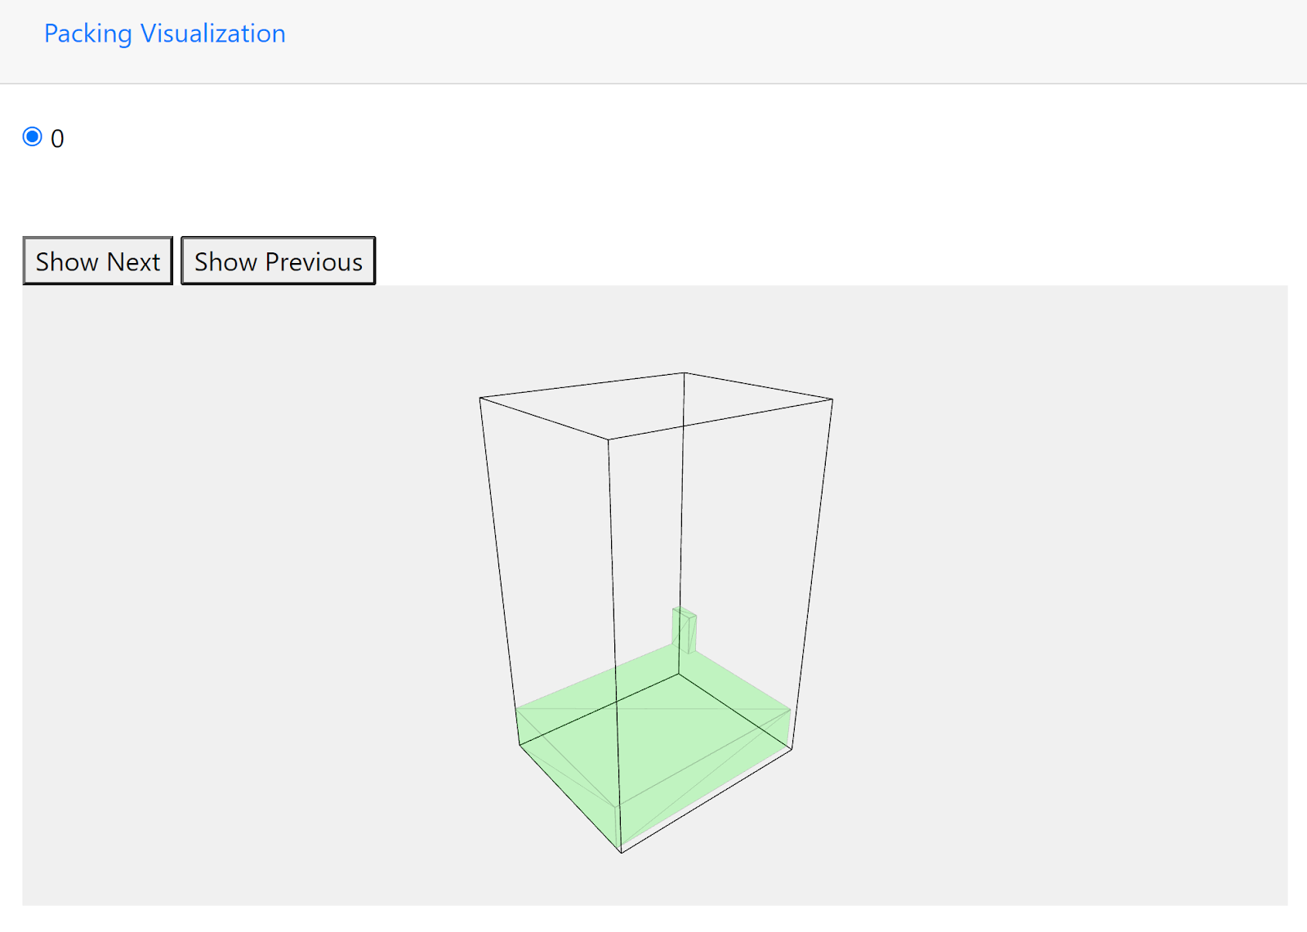
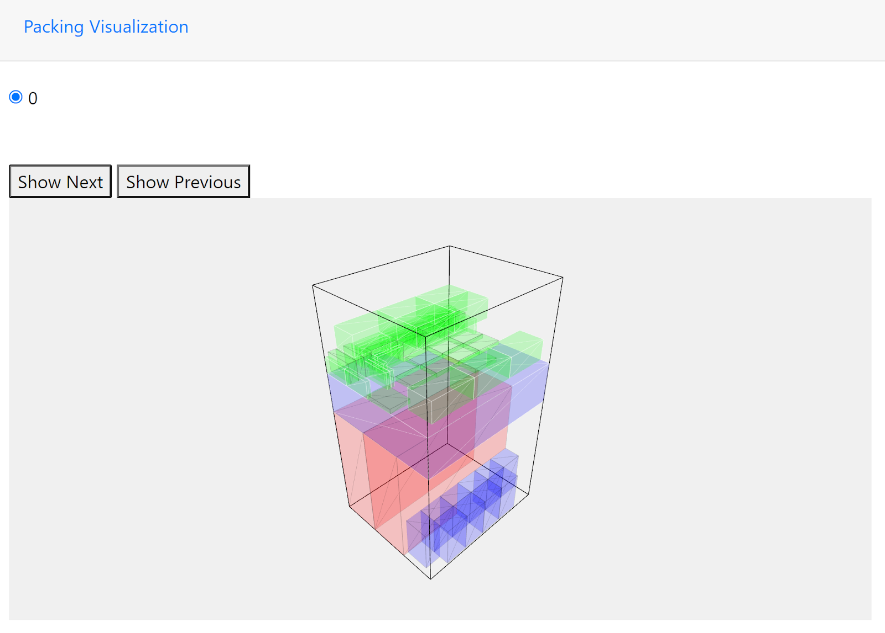
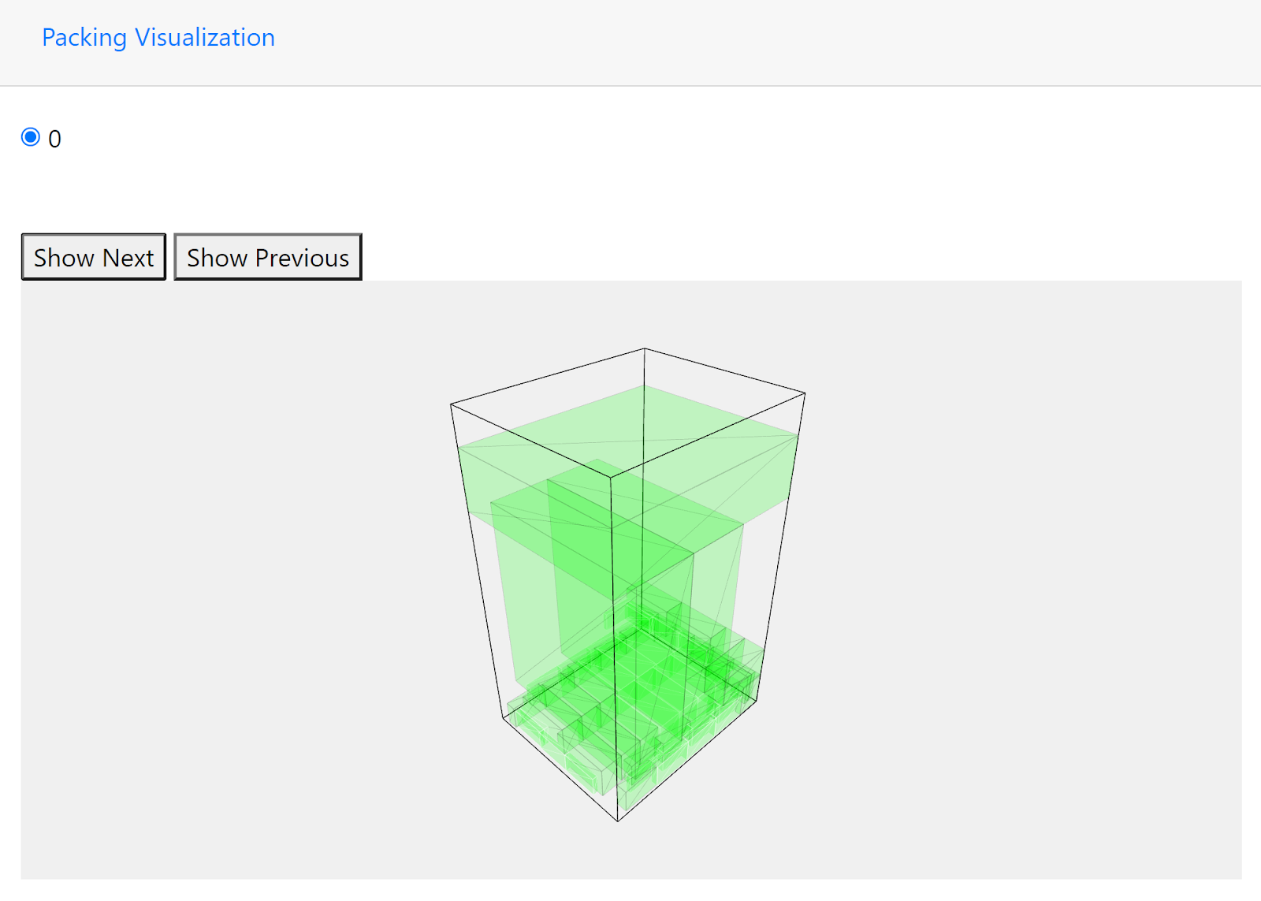
In-House Packing Engine for MARSHALLTOWN
Carey Lawrence, Akhila Parvathaneni, and Evelyn Smith
Abstract
Architecture and Design
A B C Item Weighting
The ABC item weighting turned out to be a more in-depth change than those mentioned. With this method of item weighting, we had to start by assigning a weight of A, B, or C to every item within the database by altering the schema to include a column named “CharWeight”. Following this, we had to update the item model to have a partner attribute for that value to be mapped to, which we called “WeightDef”. From there, the method we pursued for implementation revolved around editing the contents of the EB-AFIT algorithm. To do this, on entering the initialize function within the algorithm, we split the _itemsToPack List that contains the full list of every individual item to pack into three arrays: _itemsToPackA, _itemsToPackB, and _itemsToPackC and went through the algorithm to pack the items contained in these array in the A B C order.
Results
This packing engine will optimize packaging smaller items in the most appropriate larger box as well as the stacking of all items on a palette. This packing engine will take into account individual box dimensions, weight, space limitations from the client and shipping company and the vast array of potential solutions. In order to achieve this, we are starting with a space optimization program and test databases provided by MARSHALLTOWN.
We started with the front-end development to get the user interface working correctly. The next step was to take each of the additional limitations of packing. Moving this software in-house provides many benefits. The first benefit of our project is creating a palette optimization that will take into account weight instead of just box dimensions. Additionally, MARSHALLTOWN will now have the ability to adapt the program as needed and add new features as new limitations present themselves. Lastly, it helps pack the same amount of area more efficiently and therefore reduce overall shipping costs.
For the front-end design of our webapp, we plan to use the Blazor framework. Blazor is an extension of the .NET developer platform that allows for the creation of Razor components. These components then allow for the integration of HTML and C# code to create web pages. Unlike MVC apps, Blazor does not follow a request/response model, but instead centers around client-side UI logic where the logic can then make further calls to the .NET Standard backend [1]. This UI is meant to be intuitive to enter data into and offer clear explanations of how the results of a call to the packing algorithm should be interpreted. This front-end utilizes a JavaScript library called THREE.js to perform the modeling and display the items in the order they’re packed for an easier visualization of the packing process. As suggested, THREE.js allows for us to produce 3-d objects and map them to a defined view as it interfaces with WebGL to provide an easier development process than simply utilizing WebGL.
This project utilizes a SQL database of sample data used at MARSHALLTOWN. To access, manipulate, and create the stored procedures for the database, we will be using SQL Server Express as our software of choice.
Our connector to the SQL database utilizes the .NET Library linq2db to send and retrieve the data to and from our SQL database. The data acquired through this method will be used to validate items and box sizes, as well as to retrieve information regarding specific customers’ needs for pallet packing.
The final large component of our project is the packing algorithm. While we have been given a starting C# solution for this project, we found most of the changes in this project being made in this part of our work. The packing algorithm is what this project largely revolves around, with the end goal of this specific component being to accurately compute the most cost-efficient way to pack boxes and pallets. This component will communicate with our Blazor project to take in the data regarding what is to be packed, and then to return a model of how those items should be packed.
With the starter project we were given, some of the design decisions regarding the packing algorithm had already been set for us. We were given a basic web interface that utilizes the EB-AFIT algorithm developed by Erhan Baltacioglu of the US Airforce in 2001. This algorithm essentially takes in a list of items with dimension attributes, as well as a container, then outputs an ordered pack list of the most efficient method of packing said container. That list is then taken in by the THREE.js component of the front-end to provide an incrementable, 3-d representation of the packing result that can be used on the production floor. The final major part of the C# Solution we implemented was the SQL connector that populates the information from the database, including the possible container sizes and the order to be processed.
The database scripting language we used for this project was SQL, as per standard within MARSHALLTOWN. To start our database, we were given a restore file which we used on a local database instance to ensure everything was working with what they gave us. We then used a rather large dataset given to us from MARSHALLTOWN that contained the entirety of one large order to populate our ItemsToPalletize table. While we were given seven total tables to work with, only three are required for our project to work, with only two being used in the current iteration of the project. These tables were ItemsToPalletize, which contained all the information regarding the items on an order and BoxData, which contained all the information regarding the sizes of containers we had available and could be used for packing items in.
Grouping Items
To group our items into complete layers as best as possible, we didn’t end up having to change the EB-AFIT algorithm itself, but rather how the algorithm was entered. To do so, we utilized a method named LayerItems that takes in one item type at a time. It then parses this item type into a list of that item that is the length of the total quantity of that item in the current order. At this point, that list is sent into our EB-AFIT algorithm to return our packing results for that specific item. We can then perform a little math on the packing result to find out if a full layer was packed and if there were any leftover items that didn’t constitute a full layer. If we were able to create a perfect layer of those items, we group them as a layer of that item type and then return any leftover items.
Objectives
There are two different jobs that this application will serve. The first is selecting appropriately sized boxes to pack mixed cases and how said boxes will be packed. The second will be to determine the most efficient way to pack a pallet given its dimensions and what’s to be packed on said pallet. The front-end requirement for this project will be to create an interface that works intuitively as possible to provide the user with an easy way to enter any items, boxes, or dimensions that will restrict the order.
Because of the products that MARSHALLTOWN produces, many additional requirements will factor into the algorithm we will be designing. At MARSHALLTOWN, many products ship in case quantities or are mixed cases with many different items inside. A requirement of this algorithm is to prioritize heaviest cases at the bottom. With MARSHALLTOWN, the method of weight stacking used is noted as the ABC method where and A cannot be stacked on a B or C class item, a B item can be stacked on an A but not a C, and finally, C class items can be stacked atop any of the classes. Additionally, many products must be shipped following a certain orientation, therefore the algorithm may not be allowed to alter the orientation of certain items, even at the cost of efficiency. MARSHALLTOWN products such as industrial rakes have abnormal, triangle-shaped boxes and are packed with an exposed handle with a length of around 60”. A final requirement given to us by MARSHALLTOWN was to try to pack items with items of their kind as much as possible to reduce confusion with production workers and minimize the time spent searching for different items. These requirements cause great difficulty when packing and are what makes this project with MARSHALLTOWN so unique.
Fixed Item Orientation
To tackle the issue of fixed item orientation, we had to start by altering the initial schema of the database to include a column of the type ‘bit’ specifying if the item can be packed flagpole. We then had to alter the attributes of the item class within the C# project to add a Boolean that will be mapped to the corresponding bit of the database’s table. At this point, it was a matter of breaking down the algorithm to find out where it is that we should determine if an item can be packed following a certain orientation or not.
Red boxes: Class A, Blue box: Class B, Green boxes: Class C
References
[1] Architecture comparison of ASP.NET Web Forms and Blazor, [2] linq2db - Introduction [3] Baltacioglu, Erhan, "The Distributer's Three-Dimensional Pallet-Packing Problem: A Human Intelligence-Based Heuristic Approach" (2001). Theses and Dissertations. 4563. [4]William Knechtel, 3D Container Packing in C#

